Slide 1
Curriculum Learning.
Object Localization and Detection. Image Generation.
Radu Ionescu, Prof. PhD.
raducu.ionescu@gmail.com
Faculty of Mathematics and Computer Science
University of Bucharest

Slide 2
Contents
Brief recap on conv nets
Curriculum learning
Image difficulty
Applications
4.1. Semi-supervised learning
4.2. Weakly supervised object localization
4.2. Cross-domain object detection
4.3. Image generation
Notes:
Notes:
One
Two

Slide 3
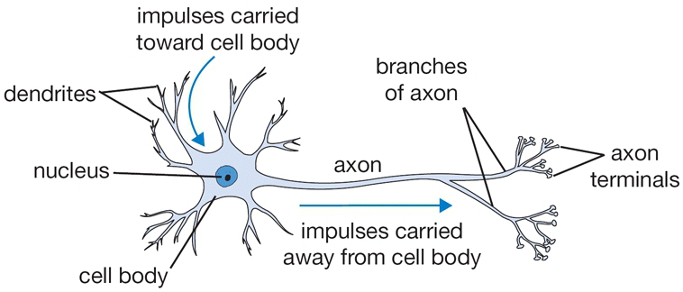
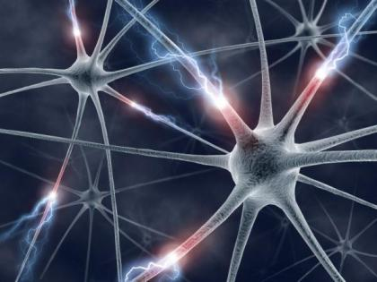
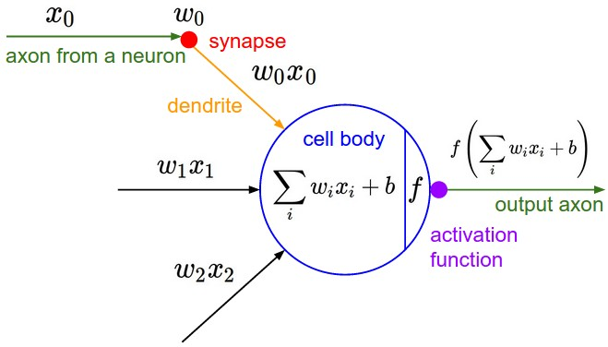
Inspired by the human brain

Slide 4
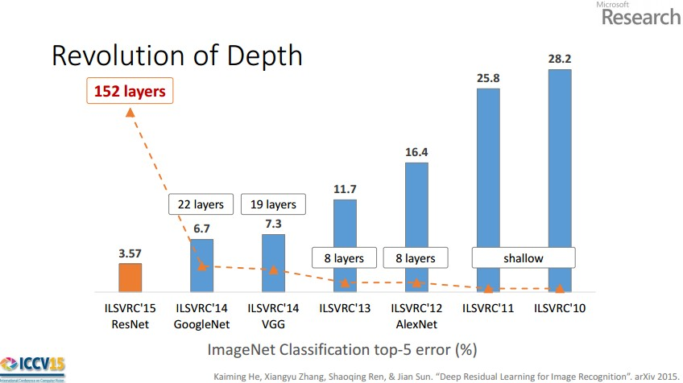
We have deeper and better architectures
Slide credit: Kaiming He

Slide 5
Training is based on SGD with random shuffle
Slide credit: Kaiming He

Slide 6


Training is based on SGD with random shuffle
Examples are selected in a random order during training
But this is not how humans learn!
Notes:
Notes:
One
Two

Slide 7
Curriculum Learning
Humans usually learn concepts on a progressive basis, starting with the easy concepts first
Curriculum learning: train models using a similar paradigm in which examples are presented gradually, from the easy ones to most difficult ones
[Bengio et al., ICML09]
Notes:
Notes:
One
Two

Slide 8
Curriculum Learning
Related to the complexity of the loss function: Curriculum learning is equivalent with training starting from a smoothed-out loss function, that is gradually deblurred until it reaches the complexity of the original (complex) loss.
Notes:
Notes:
One
Two

Slide 9
Curriculum Learning
Progressively deblurring the loss function can be achieved in different ways:
Presenting the examples in increasing order of difficulty, as in [Soviany et al., WACV 2020]. Requires knowledge of the difficulty of data samples.
Gradually increasing the size of the architecture, as in [Karras et al., ICLR 2018]
Gradually deblurring convolutional filters, as in [Sinha et al., NeurIPS 2020]
Notes:
Notes:
One
Two

Slide 10
How Hard Can It Be?
Estimating the Difficulty of
Visual Search in an Image
RT Ionescu, B Alexe, M Leordeanu,
M Popescu, D Papadopoulos, V Ferrari
CVPR 2016
Notes:
Show only first half of title (fun)

Slide 11
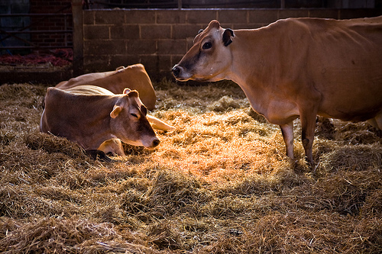
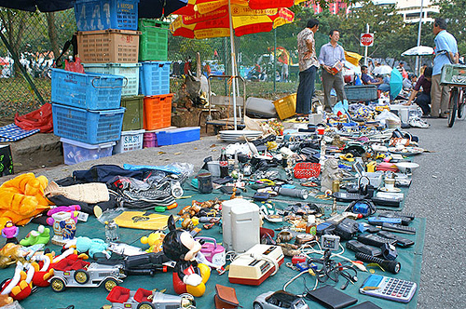

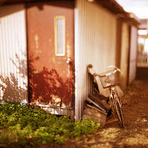
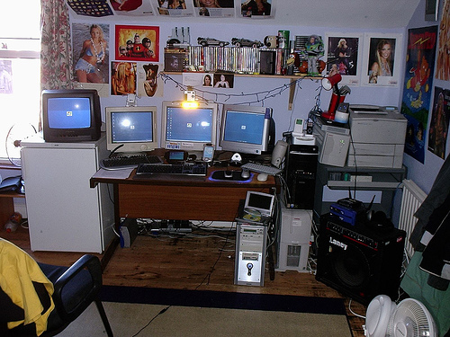
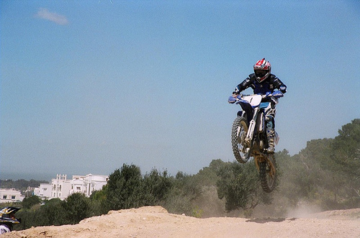
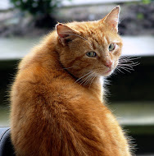
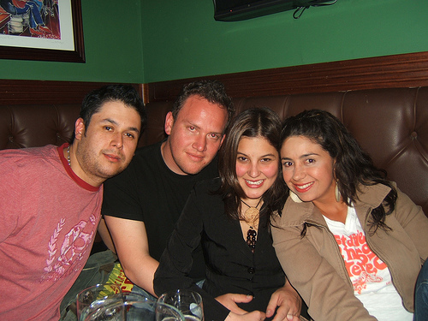
How difficult are these images?
can we measure it?
can we estimate it automatically?
can we use it?
Notes:
Play with audience on which image is difficult
If we knew, could do cur learn (say it already here)

Slide 12
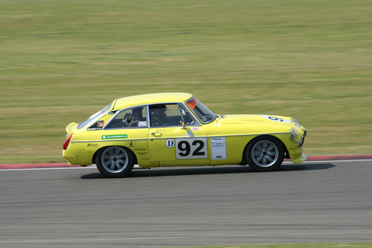
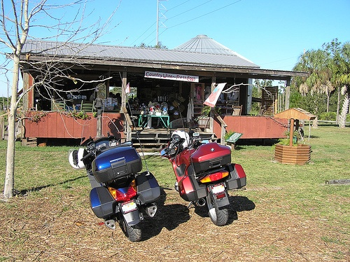

Measuring difficulty for a human
Visual search difficulty = human response time to answer if class present
IS THERE A CAR IN THIS IMAGE?
YES
NO
Annotated PASCAL VOC12 trainval (11540 images) on CrowdFlower
50% YES and 50% NO correct answers
3 annotators X 2 questions per image → 69k annotations
[Arun, Vision Research 2012; Trick, Cognitive Development 1998; Wolfe, Vision Research 2010]
Notes:
Citations: cognitive science (phenomenon has been shown there already: response time prop to visual search difficulty, especially clutter)
Data was collected from CrowdFlower
We associated two questions per image: one question for YES (the object class specified in the question is present in the image) and one question for NO (the object class specified in the question is not present in the image)
Each question was answered by 3 human annotators;
11,540 images x 2 questions x 3 humans = 69, 240 annotations.

Slide 13
Human agreement
Kendall’s τ correlation: agreement in ranking image pairs
One-vs-all: compare time of an annotator to mean of all annotators
τ = 0.56 → 78% image pairs ranked the same
Visual search difficulty can be consistently measured
[Kendall, 1948; Upton and Cook, 2004]
Notes:
Skip saying this 56/58 setting/argument, just tell correlation and number of pairs consequence
We report the inter-human correlations on a subset of 56 images that we used to spot untrusted human annotators;
We consider only the 58 trusted annotators who annotated all these 56 images;
Interesting to say: This high level of agreement among humans demonstrates that visual search difficulty can be consistently measured.

Slide 14
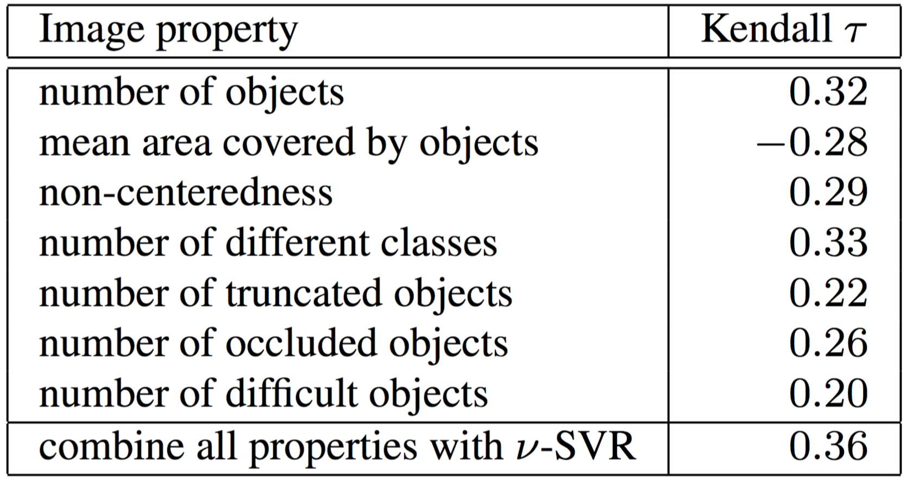
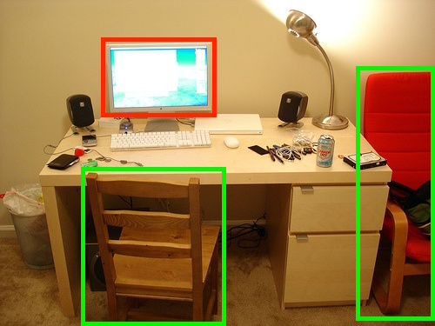
What makes an image difficult?
Correlation between interpretable properties and difficulty scores
Recipe: many instances of different classes scattered all over image
These properties are not available at test time!

Slide 15
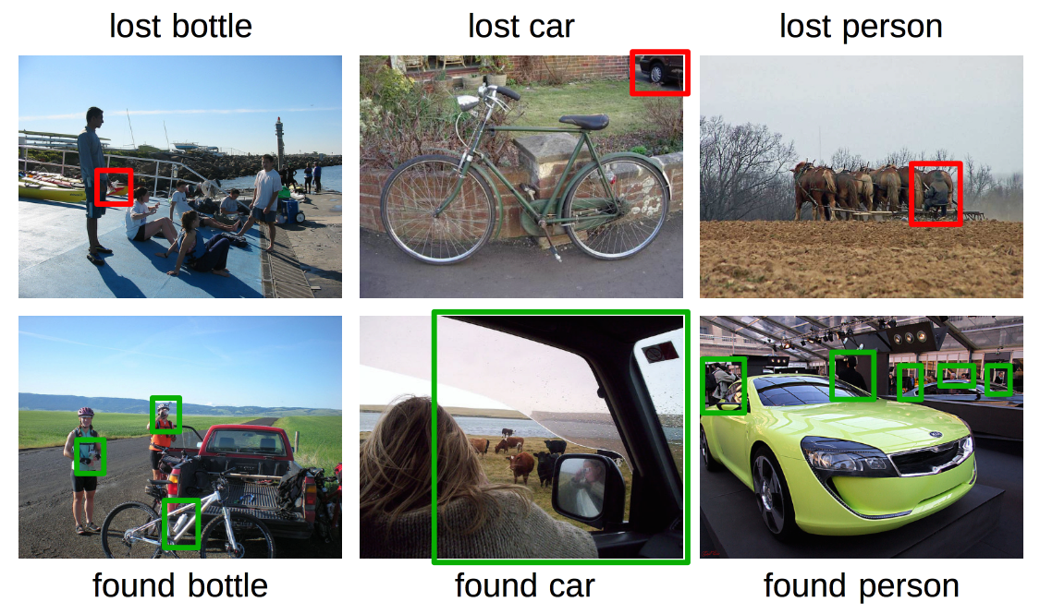
Lost and found
ANNOTATORS’ ANSWER | GROUND TRUTH | EXAMPLES
NO | YES
YES | NO
LOST
OBJECTS
FOUND
NEW
OBJECTS
LOST (40) + FOUND (90) :
- 6 classes for which the number of lost and found instances is > 10: person (21), potted-plant (19), chair (19), bottle(17), dinning table (15), car (13)
Notes:
Analyzing collected annotations we have observed an intriguing phenomenon: for some questions, all three annotators gave the opposite answer from the ground-truth answer (i.e. PASCAL VOC annotations);
We gathered all the images and the associated questions in this situation and reviewed every case individually.
In almost all these images, we found two distinct cases:
When all the annotators answered ``No'', but the ground-truth answer was ``Yes'', we concluded that our annotators were not able to find the object because it was very hard to localize it.
On the other hand, when our annotators answered ``Yes'', but the ground-truth answer was ``No'', we concluded that our annotators actually found ``new'' objects that were not annotated in Pascal VOC 2012.
Overall, our annotators found 90 new objects and lost 40 objects.
There are six object classes for which the number of lost and found objects put together is greater than 10: person (21), potted-plant (19), chair (19), bottle(17), dinning table (15), car (13);
Probably skip this phrase: most of these classes (besides person and car} also seem to be very difficult on average, according to the statistics presented in Table 3 (see paper).

Slide 16
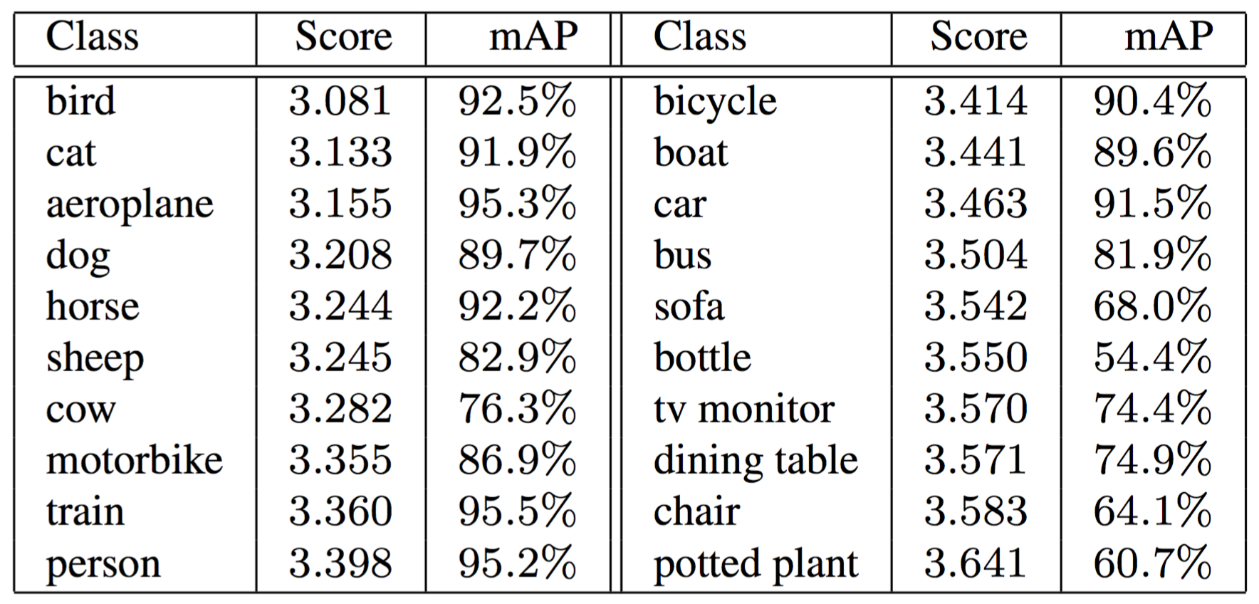
Human versus machine at the class level
Comparing mAP of VGG [Chatfield, BMVC 2014] versus human time
top 6 most difficult are the same
3 in top 5 most easy are the same

Slide 17
Human difficulty order
easy medium
medium hard
Geometric mean of annotators times (without untrusted ones and outliers)
Notes:
Data cleanup / post-processing
- We normalized each annotator’s response times by subtracting the annotator’s mean time and by dividing the resulted times by the standard deviation;
We removed all the annotators with less than 3 annotations since their mean time is not representative.
We also excluded all the annotators with less than 10 annotations with an aver- age response time higher than 10 seconds.
After removing all the outliers, the difficulty score per image is computed as the geometric mean of the remaining times.
Trusted annotators = 90% classification accuracy (as we know presence/absence labels)

Slide 18
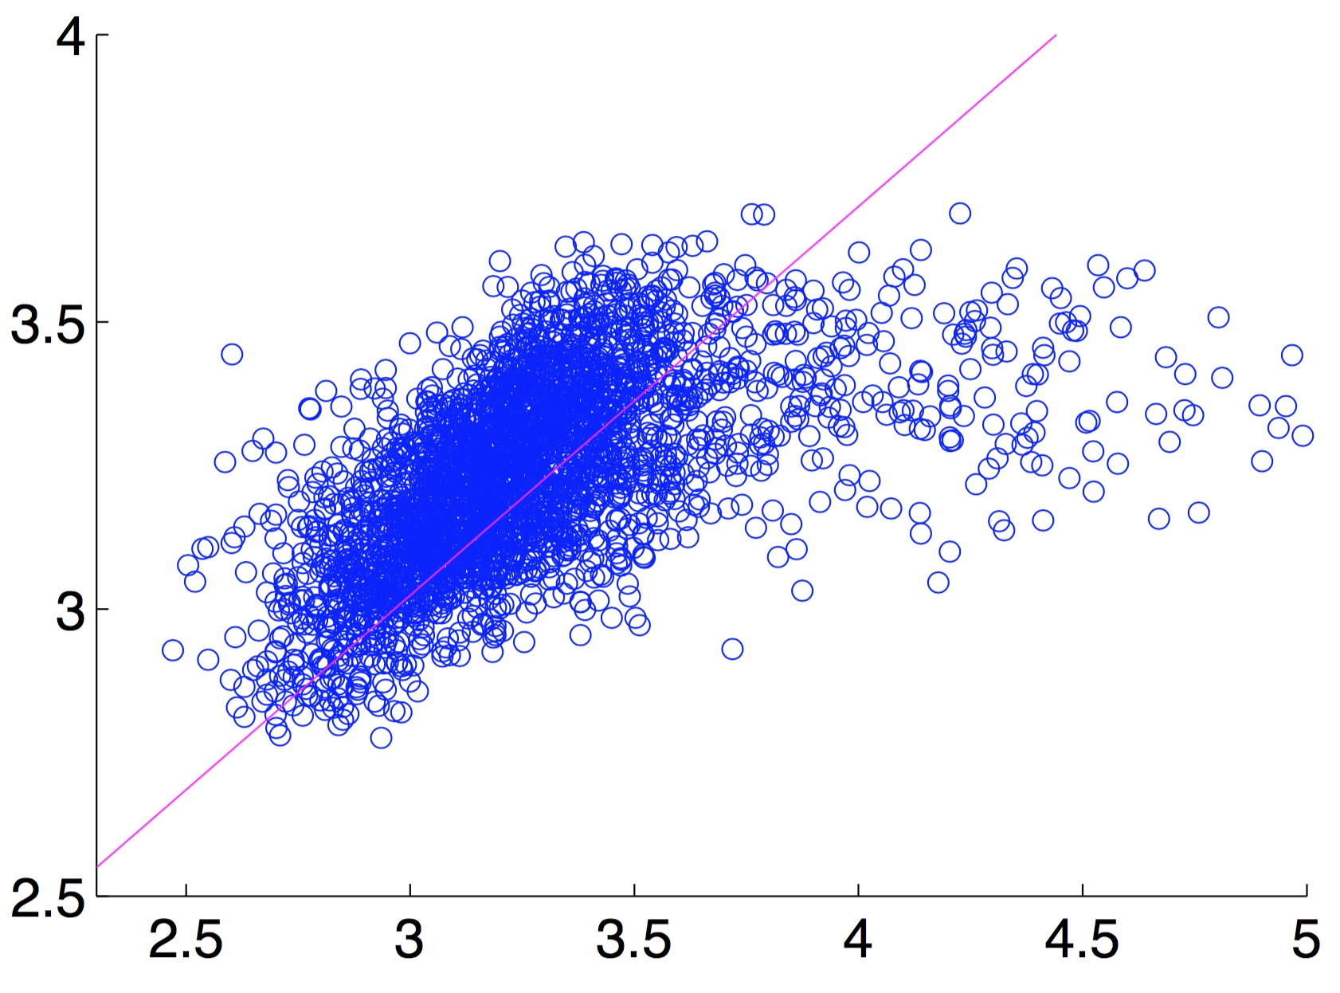
Automatically estimating difficulty
CNN features (VGG-f + VGG16, pyramid, flip) + SVR
Pre-trained CNN on ILSVRC12 classification
Train SVR on 50% of VOC12 train-val, set regularization on 25%, test on 25%
Predicted scores
Ground-truth scores
[Chatfield, BMVC 2014; Simonyan, ICLR 2015; Shawe-Taylor and Cristianini, 2004]
Notes:
VOC12 trainval, always, we did not annoate test set
Nice diagonal, red line is least-square fit → strong correlation
SVR: we use v-SVR, but keep it simple on this slide, and avoid Q on what it is ;)
CHECK v-SVR, WHAT IS IT?

Slide 19
Estimated difficulty order
easy medium
medium hard
Kendall correlation 0.472 → correctly ranks 74% image pairs
Close to human agreement upper bound (78%)
Notes:
sorted by ground truth difficulty score, so the predicted scores written in RED are ranked in the wrong order by our system
A little unfair comparison to human agreement, as 0.472 got on all data, not on 56/58 subset, but ok for this talk
Lots of baselines and variations of our model in the paper

Slide 20
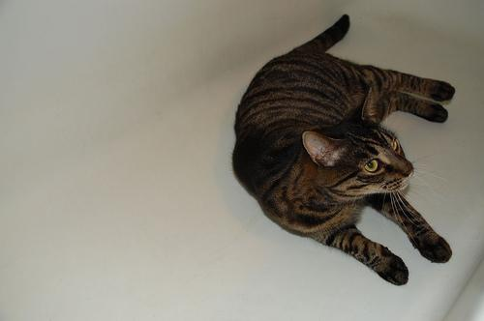
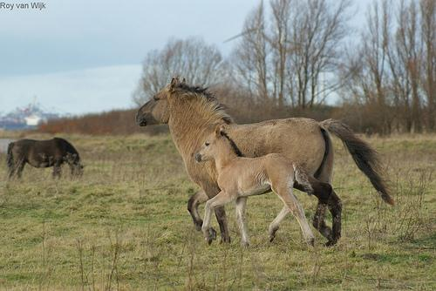
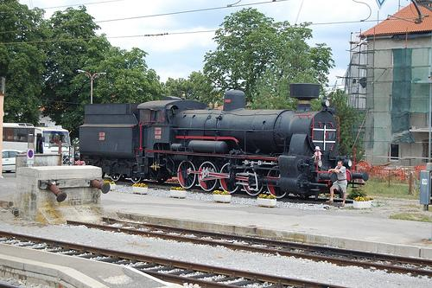
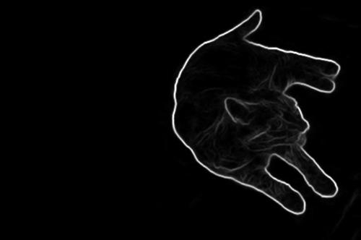
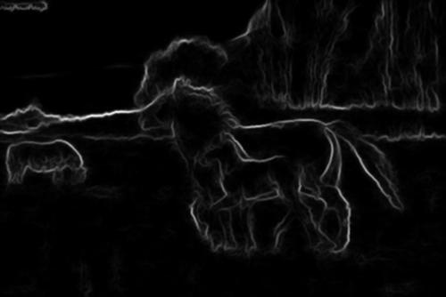
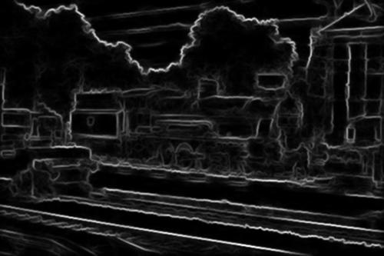
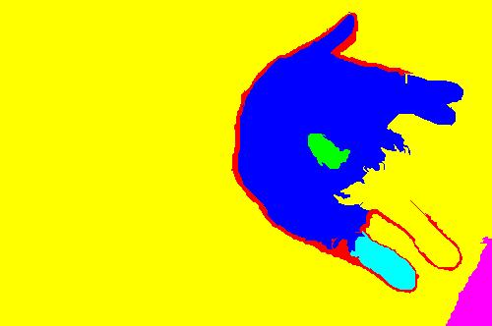
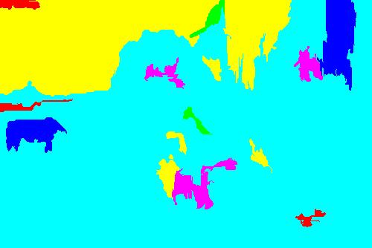
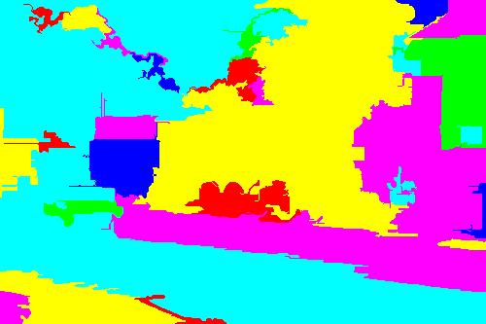
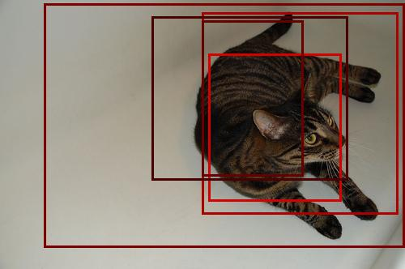
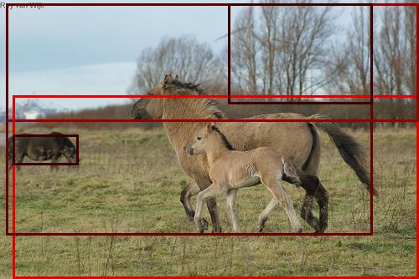
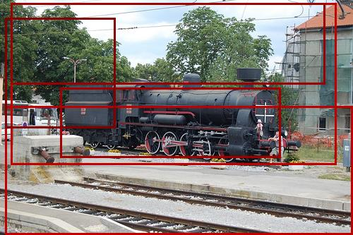
Our model vs. baselines
our model
2.60
3.28
6.50
image difficulty score
easy
hard
edge strenghts [Dollar, PAMI 2015]
edges
4103
6008
14652
# segments
[Felzenszwalb, IJCV 2004]
segments
7
23
45
sum of objectness scores
[Alexe, PAMI 2012]
objectness
16.45
31.85
72.62

Slide 21
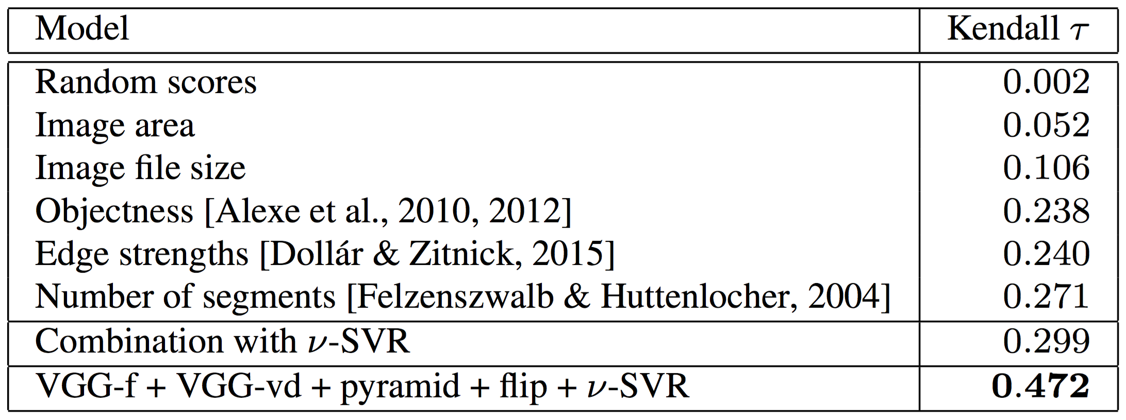
Our model vs. baselines

Slide 22
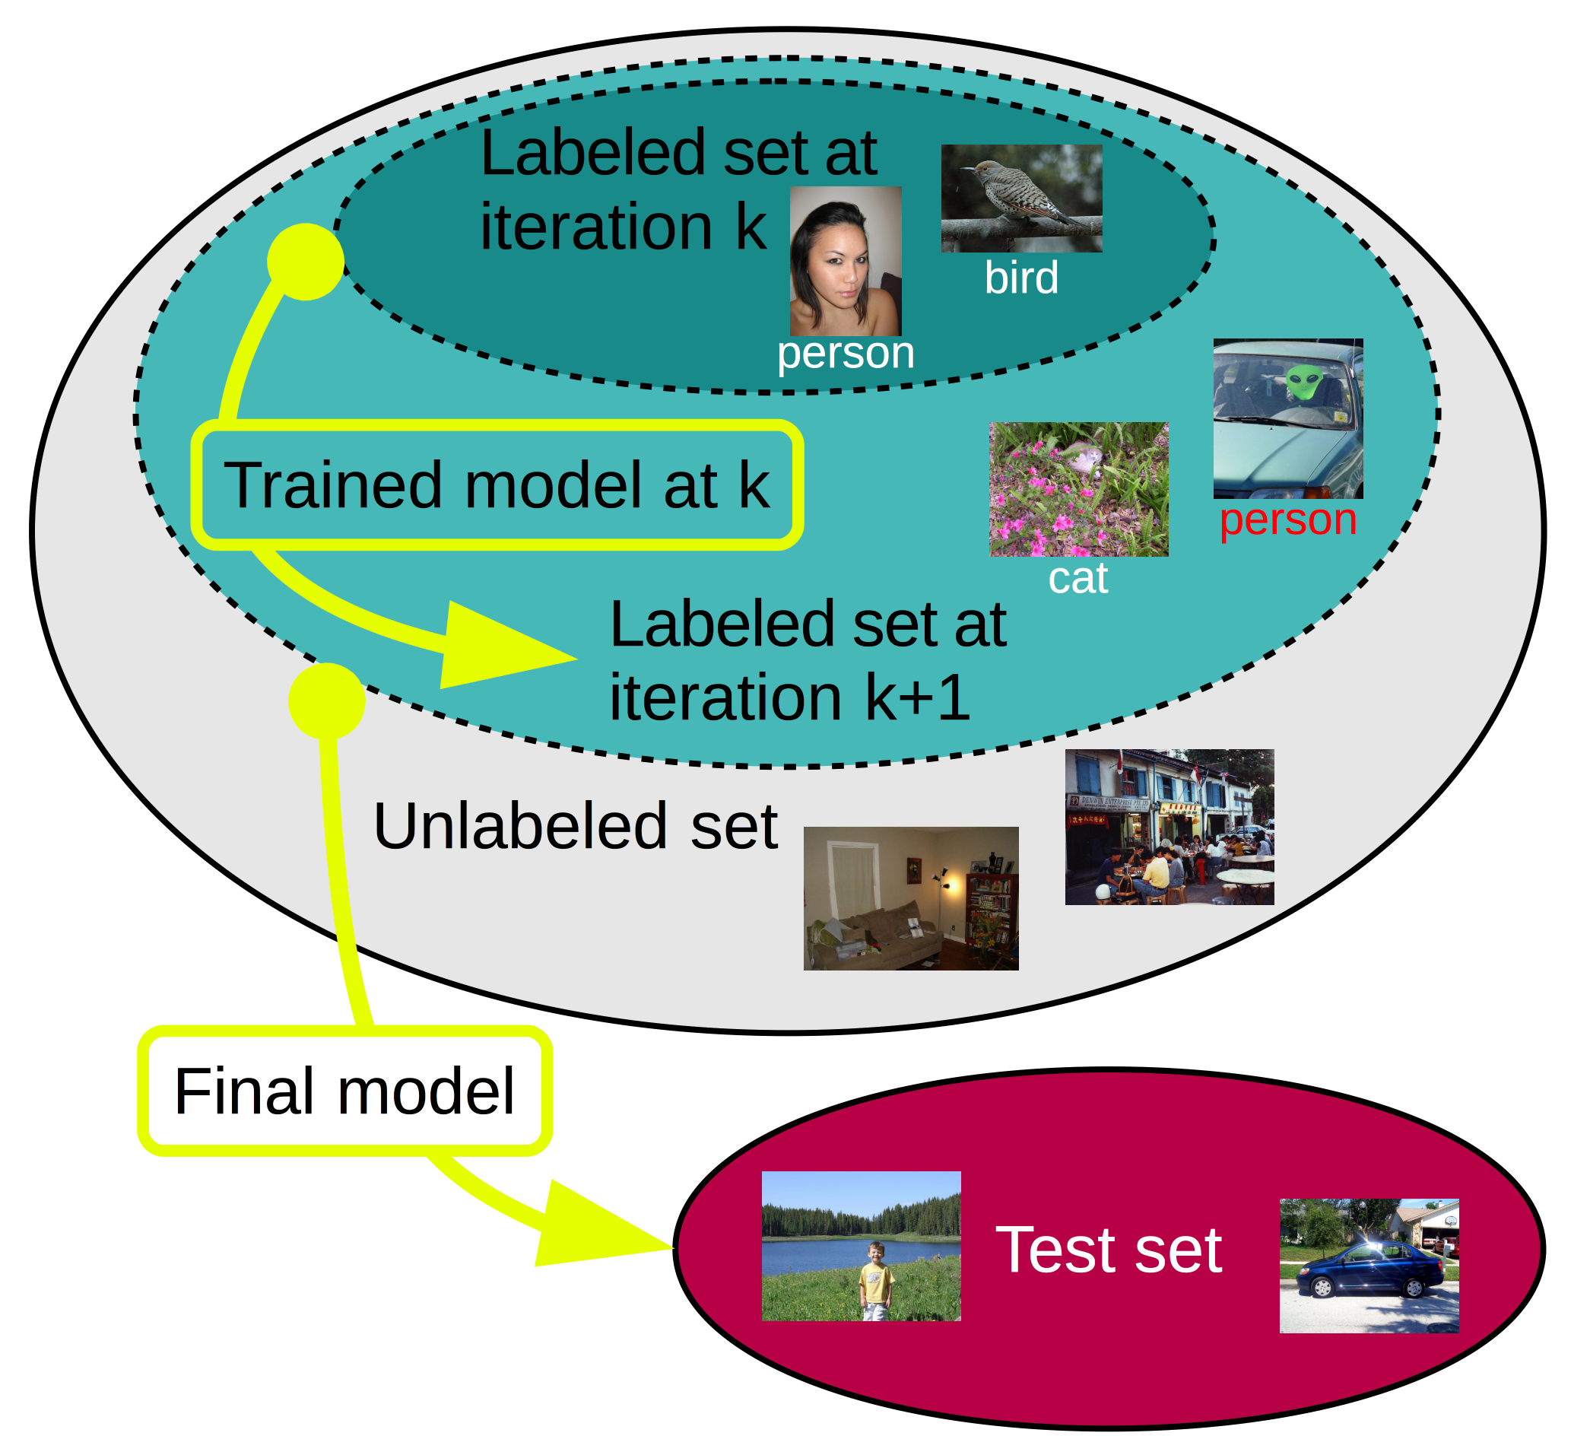
Application 1: semi-supervised object classification

Slide 23
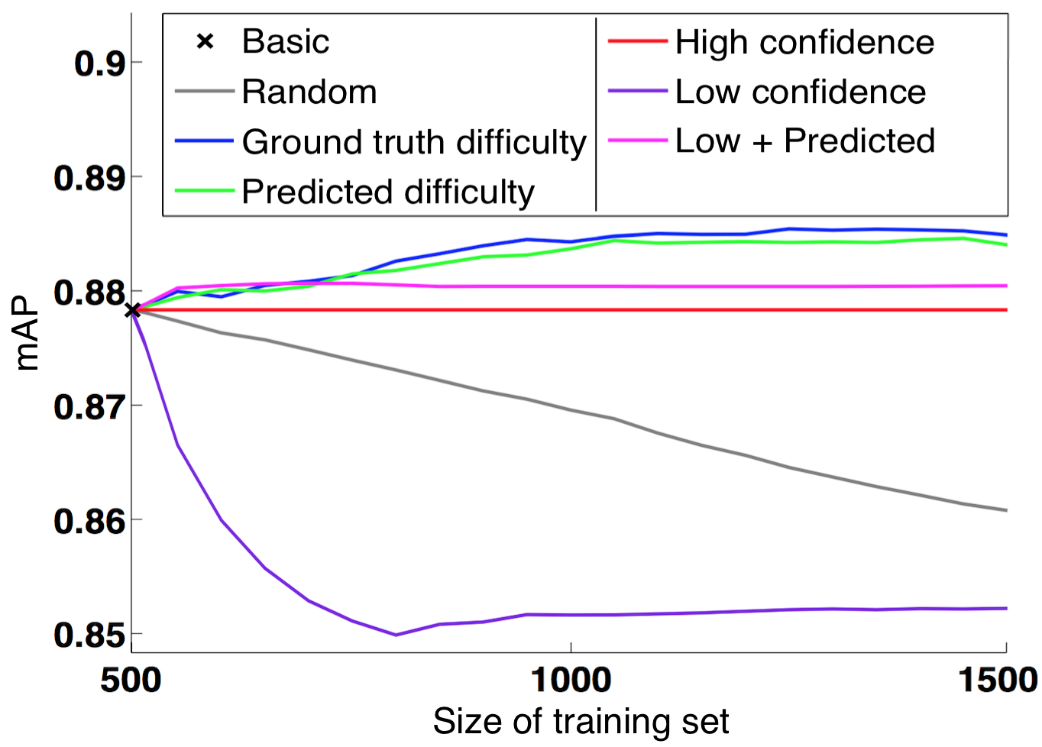
Application 1: semi-supervised object classification

Slide 24
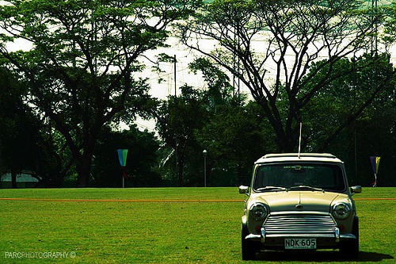
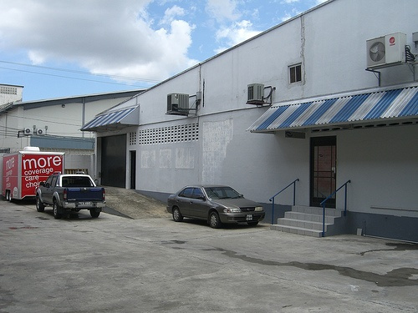
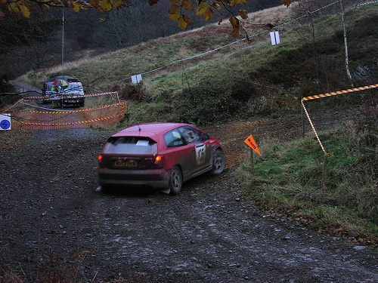
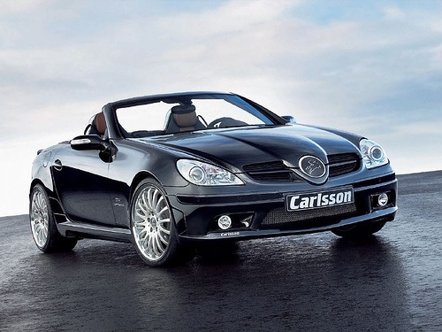
Application 2: Weakly supervised object localization
Images with cars
(no locations given)
Images with localized cars
(and negatives without cars)
Model
Weakly Supervised Learning
[Bilen BMVC14, Cinbis CVPR14, Deselaers ECCV10, Nguyen ICCV09, Siva ICCV11, Wang TIP15]
Notes:
Recap from first part of talk (also got many negative images with no cars, not shown on slide)

Slide 25
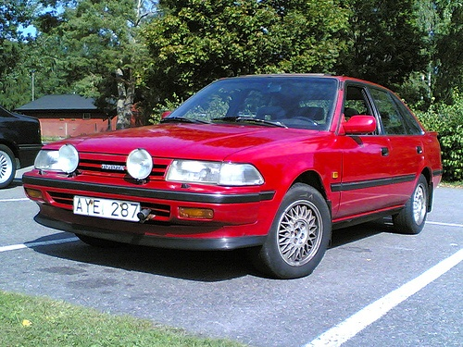
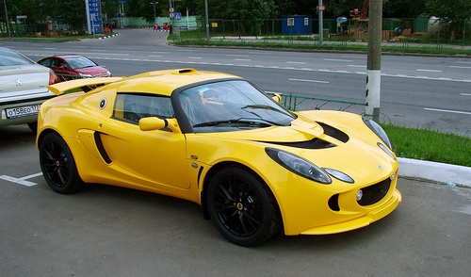
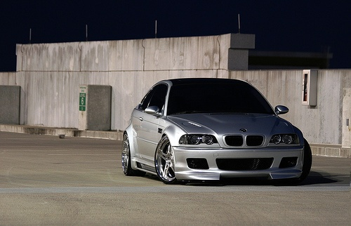
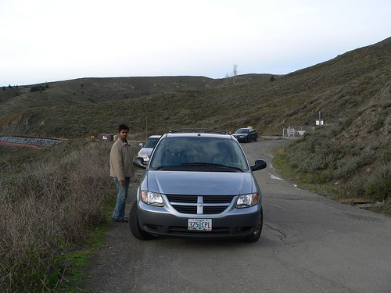
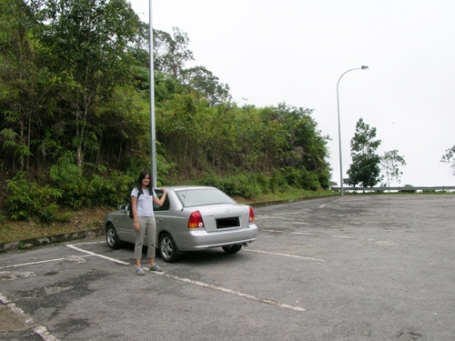
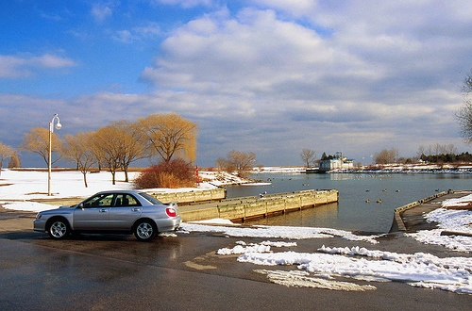
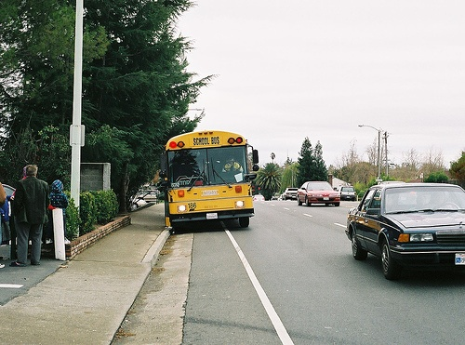
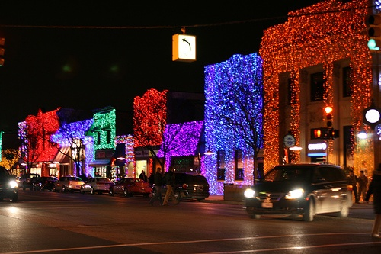
Easy-to-hard MIL
Make three batches in order of increasing estimated difficulty
Model
[Bengio ICML09, Kumar NIPS10, Lee CVPR11, Pentina CVPR15, Sharmanska CVPR13, Lapin NN14]
Notes:
class: car
PASCAL07 images
Processing easier images in initial stages gives better class models that in turn improve later stages;
By the time the process reaches hard images, it already has a good class model
Say this is a curriculum learning scheme
Citations: general curriculum learning, none did what we did here

Slide 26
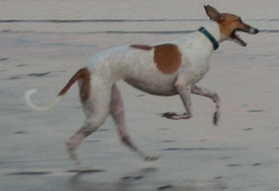
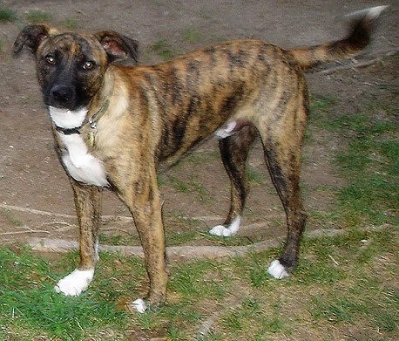
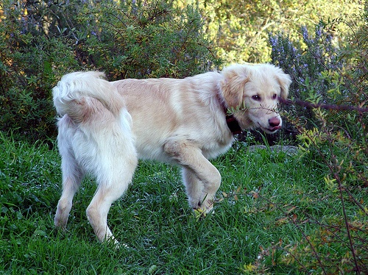
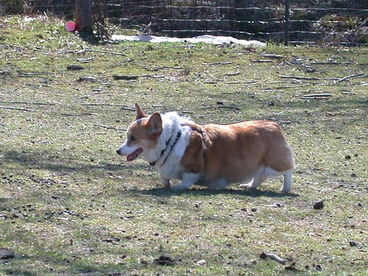
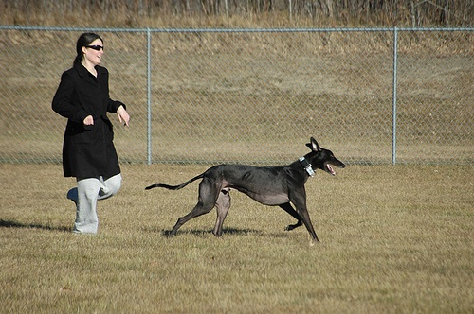







Easy-to-hard MIL
Make three batches in order of increasing estimated difficulty
Model
[Bengio ICML09, Kumar NIPS10, Lee CVPR11, Pentina CVPR15, Sharmanska CVPR13, Lapin NN14]
Notes:
class: dog

Slide 27




Results
CorLoc (IoU > 0.5) on PASCAL VOC 07 trainval
34.4%: plain MIL, 10 iterations (no objectness, no multi-folding)
42.8%: easy-to-hard MIL, 3 batches X 3 iterations
= plain MIL
= easy-to-hard MIL
Notes:
PASCAL VOC07 disjoint from VOC12, on which we trained the measure; shows our measure generalizes across datasets
In paper: generaliz across classes too
Biased selection of examples, only cases where easy-to-hard MIL improves over plain MIL
Improves especially on hard images with small objects

Slide 28
Conclusion of our paper
Collected 11k human difficulty measurements on VOC12
http://image-difficulty.herokuapp.com
Difficulty correlates with number of objects, classes, non-centeredness and size
Automatically estimate difficulty
Used difficulty estimates for easy-to-hard
weakly supervised object localization (WSOL)
In paper: generalization across classes + other details
Notes:
Released collected human scores and our code to predict difficulty

Slide 29
Weakly Supervised Object Localization Using Size Estimates
M Shi, V Ferrari
ECCV 2016
Notes:
Show only first half of title (fun)

Slide 30




Using size estimates in WSOL
Notes:
Bad image quality! Replace images with originals!

Slide 31
Using size estimates in WSOL
Assuming we have an object size predictor !!
Notes:
Bad image quality! Replace images with originals!

Slide 32
Using size estimates in WSOL
Assuming we have an object size predictor !!
motorbike: 0.74
motorbike: 0.27
Notes:
Bad image quality! Replace images with originals!

Slide 33





Size Order
Notes:
Bad image quality! Replace images with originals!

Slide 34
Size Order
Notes:
Bad image quality! Replace images with originals!

Slide 35
Size Order
Curriculum learning: learning from easy (images with bigger objects) to hard (with smaller objects)
Notes:
Bad image quality! Replace images with originals!

Slide 36
Size Weighting
Notes:
Bad image quality, but let’s not replace as it would be too much work; even if you pick bicycles to illustrate size order, then you can still keep this motorcycle here

Slide 37


Size Weighting
w
How close object proposal size matches the estimated object size
Notes:
Bad image quality, but let’s not replace as it would be too much work

Slide 38















Size order example
MIL baseline + Size order Ground truth

Slide 39
Size order example
MIL baseline + Size order Ground truth

Slide 40
Size estimator
Input: 4096D CNN image features
Output: size
Method: kernel ridge regression
Class-specific regressors
Train: PASCAL VOC 12 train-val
Test: PASCAL VOC 07 train-val
motorbike size: 0.27
Notes:
Bad math
Add little icon about this process, on the right hand side: an image with an arrow coming out of an object and then the size estimate at the tip of the arrow (copy it from the first slides, one of the two cases)

Slide 41













Class – Chair: Ground Truth
MIL Baseline
+Size Order
+Size Weighting
Notes:
+size estimates should be +size weighting

Slide 42
Class – Chair: Ground Truth
MIL Baseline
+Size Order
+Size Weighting

Slide 43
Results on PASCAL VOC 07 (20 classes)
*Fast R-CNN [Girshick CVPR15] with VGG16 [Simonyan ICLR15]
Notes:
Start bar plots from 0, not from 39!!! Add actual numbers, to one digit after the comma, on top of the bars (easily done in powerpoint, there is an option for this)
Insert space between our methods and cinbis/wang

Slide 44
Results on PASCAL VOC 07 (20 classes)
*Fast R-CNN [Girshick CVPR15] with VGG16 [Simonyan ICLR15]
Notes:
Start bar plots from 0, not from 19!!! Add actual numbers, to one digit after the comma, on top of the bars (easily done in powerpoint, there is an option for this)
Insert space between our methods and cinbis/wang

Slide 45
class-specific: train size estimator per class on PASCAL VOC 12 trainval
class-generic: train a single size estimator over 20 classes on VOC 12
across-class: separate 20 classes in two groups and train two size estimators and cross use them on PASCAL VOC 07 trainval
Notes:
Add actual numbers, to one digit after the comma, on top of the bars (easily done in powerpoint, there is an option for this)

Slide 46
Conclusion
Curriculum learning strategy to feed training images into WSOL (bigger to smaller objects) gives state-of-the-art results
Future work: continuous ordering, i.e. the batch size goes towards 1
Notes:
Released collected human scores and our code to predict difficulty

Slide 47
Frustratingly Easy Trade-off Optimization between
Single-Stage and Two-Stage
Deep Object Detectors
P Soviany, RT Ionescu
ECCV Workshops 2018
Notes:
Show only first half of title (fun)

Slide 48
Object detection
Finding instances of objects of certain classes
Notes:
- Has many application: pedestrian detectors, face detectors, video surveillance

Slide 49
Object detectors
Evaluation?
  Accuracy
  Speed
  Memory usage
One stage (SSD) is faster
Two stage (Faster R-CNN) is more accurate
Which one is better to use?
Notes:
- Has many application: pedestrian detectors, face detectors, video surveillance

Slide 50

SSD: Single Shot MultiBox Detector
  Real time object detection
  Predefined boxes of different aspect ratios and scales
  Single stage
[Liu et al., ECCV 2016]
Notes:
- the network generates scores for the presence of each object category in each default box and produces adjustments to the box to better match the object shape

Slide 51

Faster R-CNN
  Stage 1: Region Proposal Network – fully convolutional network
  Stage 2: Detection
[Ren et al., NIPS 2015]

Slide 52
Finding the trade-off
Idea: Split the test data set by difficulty
Easy -> One stage detector
Hard -> Two stage detector
Notes:
- the network generates scores for the presence of each object category in each default box and produces adjustments to the box to better match the object shape

Slide 53

Finding the trade-off
Notes:
Effect of proposing increasing number of regions on mAP accuracy (solid lines) and GPU inference time (dotted). Surprisingly, for Faster R-CNN with Inception Resnet, we obtain 96% of the accuracy of using 300 proposals by using only 50 proposals, which reduces running time by a factor of 3.

Slide 54
Other difficulty measures
Using the fast object detector:
  Number of detected objects
  Average size of the detected objects
  Number of detected objects divided by their average size
Notes:
A fast single-stage object detector that returns the number of objects detected in the input image (less objects is easier)
• A fast single-stage object detector that returns the average size of the objects detected in the input image (bigger objects is easier)
• A fast single-stage object detector that returns the number of detected objects divided by their average size (less and bigger objects is easier)

Slide 55

Results on PASCAL VOC 2007
Notes:
The test data is partitioned based on a random split (baseline) or four easy-versus-hard splits.The reported times are measured on CPU.

Slide 56

Results on PASCAL VOC 2007
Notes:
The test data is partitioned based on a random split (baseline) or four easy-versus-hard splits.The reported times are measured on CPU.

Slide 57

Notes:
A fast single-stage object detector that returns the number of objects detected in the input image (less objects is easier)
• A fast single-stage object detector that returns the average size of the objects detected in the input image (bigger objects is easier)
• A fast single-stage object detector that returns the number of detected objects divided by their average size (less and bigger objects is easier)

Slide 58

Notes:
A fast single-stage object detector that returns the number of objects detected in the input image (less objects is easier)
• A fast single-stage object detector that returns the average size of the objects detected in the input image (bigger objects is easier)
• A fast single-stage object detector that returns the number of detected objects divided by their average size (less and bigger objects is easier)

Slide 59
Curriculum Self-Paced Learning for Cross-Domain Object Detection
P Soviany, RT Ionescu, P Rota, N Sebe
CVIU 2021
Notes:
Show only first half of title (fun)

Slide 60
Task: Autonomous Driving
Real data is hard to collect
How about generating artificial data from realistic video games?
Notes:
- Has many application: pedestrian detectors, face detectors, video surveillance

Slide 61




Problem: Domain Gap
Training data and test data are from different domains
Our object detector is likely to perform very poorly
vs.
Notes:
- Has many application: pedestrian detectors, face detectors, video surveillance

Slide 62

Solution: Domain Adaption
Notes:
- Has many application: pedestrian detectors, face detectors, video surveillance

Slide 63

Domain Adaption Algorithm

Slide 64


Image difficulty score
  Number of detected objects divided by their average size:
  $$S\left(I,B\right)=\frac{n}{\frac{1}{n}\sum_{i=1}^{n}{w_{i}∙h_{i}}}=\frac{n^{2}}{\sum_{i=1}^{n}{w_{i}∙h_{i}}}$$
  where $n$ is the number of bounding boxes in $B=\{b_{1},b_{2}, …,b_{n}\}$that were detected in the input image $I$, and each box $b_{i}$is a tuple $(x_{i},y_{i},w_{i},h_{i})$ containing the top left corner, its width and height.
Notes:
- Has many application: pedestrian detectors, face detectors, video surveillance

Slide 65

Results
Notes:
- Has many application: pedestrian detectors, face detectors, video surveillance

Slide 66

Ablation results
Notes:
- Has many application: pedestrian detectors, face detectors, video surveillance

Slide 67

Results
Notes:
- Has many application: pedestrian detectors, face detectors, video surveillance

Slide 68
Curriculum Learning of Generative Adversarial Networks
P Soviany, C Ardei, RT Ionescu,
M Leordeanu
WACV 2020
Notes:
Show only first half of title (fun)

Slide 69


GAN
Notes:
Our first contribution is a two stage outlier elimination approach based on k-means and multiple one-class SVMs
Our second contribution is to augment the spatio-temporal cubes with location, motion direction and deep appearance features

Slide 70

Notes:
Our first contribution is a two stage outlier elimination approach based on k-means and multiple one-class SVMs
Our second contribution is to augment the spatio-temporal cubes with location, motion direction and deep appearance features

Slide 71

Curriculum GAN
Strategy 1: Split real images into batches
Notes:
Our first contribution is a two stage outlier elimination approach based on k-means and multiple one-class SVMs
Our second contribution is to augment the spatio-temporal cubes with location, motion direction and deep appearance features

Slide 72


Curriculum GAN
Define a scoring function:
Notes:
Our first contribution is a two stage outlier elimination approach based on k-means and multiple one-class SVMs
Our second contribution is to augment the spatio-temporal cubes with location, motion direction and deep appearance features

Slide 73

Curriculum GAN
Strategy 2: Include scoring function into the objective function
Notes:
Our first contribution is a two stage outlier elimination approach based on k-means and multiple one-class SVMs
Our second contribution is to augment the spatio-temporal cubes with location, motion direction and deep appearance features

Slide 74


Curriculum GAN
Strategy 3:
Notes:
Our first contribution is a two stage outlier elimination approach based on k-means and multiple one-class SVMs
Our second contribution is to augment the spatio-temporal cubes with location, motion direction and deep appearance features

Slide 75

Image Generation
Notes:
Our first contribution is a two stage outlier elimination approach based on k-means and multiple one-class SVMs
Our second contribution is to augment the spatio-temporal cubes with location, motion direction and deep appearance features

Slide 76

Image Generation
Notes:
Our first contribution is a two stage outlier elimination approach based on k-means and multiple one-class SVMs
Our second contribution is to augment the spatio-temporal cubes with location, motion direction and deep appearance features

Slide 77

Is this image real or fake?

Slide 78

Is this image real or fake?

Slide 79


Image Generation
Notes:
Our first contribution is a two stage outlier elimination approach based on k-means and multiple one-class SVMs
Our second contribution is to augment the spatio-temporal cubes with location, motion direction and deep appearance features

Slide 80

Image Translation
Notes:
Our first contribution is a two stage outlier elimination approach based on k-means and multiple one-class SVMs
Our second contribution is to augment the spatio-temporal cubes with location, motion direction and deep appearance features

Slide 81

Image Translation
Strategy 3:
Notes:
Our first contribution is a two stage outlier elimination approach based on k-means and multiple one-class SVMs
Our second contribution is to augment the spatio-temporal cubes with location, motion direction and deep appearance features

Slide 82
Conclusion
Curriculum learning strategies can help to improve generative results
Future work:
Increase architecture depth as difficult batches are added into the training set
Explore other strategies for estimating sample difficulty
Notes:
Released collected human scores and our code to predict difficulty

Slide 83
Progressive Growing of GANs for Improved Quality, Stability, and Variation
T Karras, T Aila, S Laine, J Lehtinen
ICLR 2018
Notes:
Show only first half of title (fun)

Slide 84

Progressive growing of GANs
Notes:
Released collected human scores and our code to predict difficulty

Slide 85

Faster training
Notes:
Released collected human scores and our code to predict difficulty

Slide 86

High-resolution results
Notes:
Released collected human scores and our code to predict difficulty

Slide 87

Better quality, more realistic
Notes:
Released collected human scores and our code to predict difficulty

Slide 88
Curriculum by Smoothing
S Sinha, A Garg, H Larochelle
NeurIPS 2020
Notes:
Show only first half of title (fun)

Slide 89

Smoothing using Gaussian kernel
Notes:
Released collected human scores and our code to predict difficulty

Slide 90


Gaussian kernel example
0 | 0 | 0 | 0 | 0 | 0 | 0 | 0 | 0 | 0
0 | 0 | 0 | 0 | 0 | 0 | 0 | 0 | 0 | 0
0 | 0 | 0 | 90 | 90 | 90 | 90 | 90 | 0 | 0
0 | 0 | 0 | 90 | 90 | 90 | 90 | 90 | 0 | 0
0 | 0 | 0 | 90 | 90 | 90 | 90 | 90 | 0 | 0
0 | 0 | 0 | 90 | 0 | 90 | 90 | 90 | 0 | 0
0 | 0 | 0 | 90 | 90 | 90 | 90 | 90 | 0 | 0
0 | 0 | 0 | 0 | 0 | 0 | 0 | 0 | 0 | 0
0 | 0 | 90 | 0 | 0 | 0 | 0 | 0 | 0 | 0
0 | 0 | 0 | 0 | 0 | 0 | 0 | 0 | 0 | 0
The kernel approximates the normal distribution in 2D:
1 | 2 | 1
2 | 4 | 2
1 | 2 | 1
Slide after Steve Seitz

Slide 91
Gaussian kernel example
0 | 0 | 0 | 0 | 0 | 0 | 0 | 0 | 0 | 0
0 | 0 | 6 | 17 | 23 | 23 | 23 | 17 | 6 | 0
0 | 0 | 17 | 51 | 68 | 68 | 68 | 51 | 17 | 0
0 | 0 | 23 | 68 | 90 | 90 | 90 | 68 | 23 | 0
0 | 0 | 23 | 62 | 79 | 84 | 90 | 68 | 23 | 0
0 | 0 | 23 | 56 | 68 | 79 | 90 | 68 | 23 | 0
0 | 0 | 17 | 45 | 56 | 62 | 68 | 51 | 17 | 0
0 | 6 | 17 | 23 | 23 | 23 | 23 | 17 | 6 | 0
0 | 11 | 23 | 11 | 0 | 0 | 0 | 0 | 0 | 0
0 | 6 | 11 | 6 | 0 | 0 | 0 | 0 | 0 | 0
The kernel approximates the normal distribution in 2D:
1 | 2 | 1
2 | 4 | 2
1 | 2 | 1
Slide after Steve Seitz

Slide 92

Image classification
Notes:
Released collected human scores and our code to predict difficulty

Slide 93

Image classification
Notes:
Released collected human scores and our code to predict difficulty

Slide 94

Transfer learning for detection and segmentation
Notes:
Released collected human scores and our code to predict difficulty

Slide 95

Ablation study
Notes:
Released collected human scores and our code to predict difficulty

Slide 96
Generic Conclusion
Curriculum learning strategies can bring faster convergence and improved results
Notes:
Released collected human scores and our code to predict difficulty

