Slide 1
Diffusion Models
Radu Ionescu, Prof. PhD.
raducu.ionescu@gmail.com
Faculty of Mathematics and Computer Science
University of Bucharest

Slide 2
Agenda
Motivation
High-level overview
Denoising diffusion probabilistic models
Noise Conditioned Score Network
Stochastic Differential Equations
Conditional Generation
Research directions
Notes:
(Animatie 1)
The agenda of our presentation starts with a short motivation and an overview of diffusion models.
(Animatie 2)
After that we will go through 3 formulations of this type of generative models:
Denoising diffusion probabilistic models
Noise Conditioned Score Networks
And the generalization of the previous two via Stochastic Differential Equations
(Animatie 3)
Further, we will address the guidance techniques used for conditional sampling.
(Animatie 4)
And lastly, we will cover the main directions of research found in the literature.

Slide 3
Outline
Motivation
High-level overview
Denoising diffusion probabilistic models
Noise Conditioned Score Network
Stochastic Differential Equations
Conditional Generation
Research directions
Notes:
Let’s start with the motivation part.

Slide 4
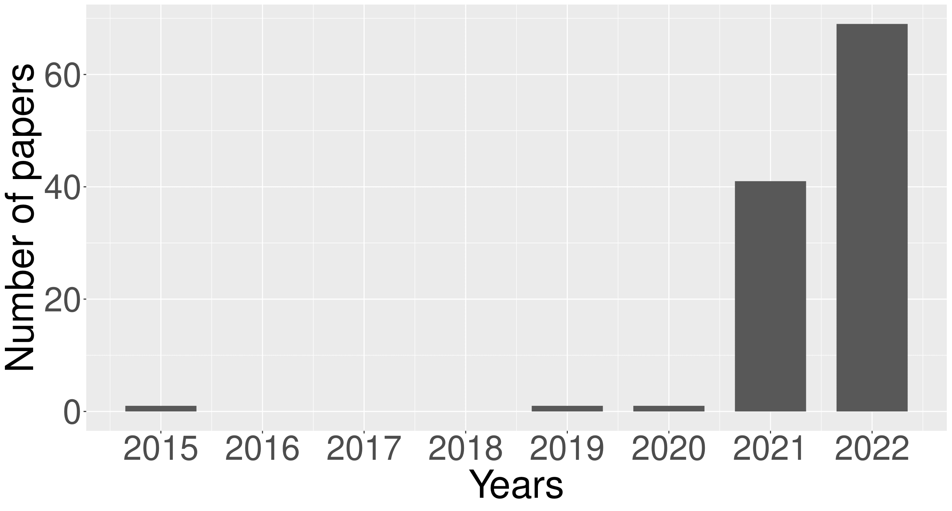
Motivation
Notes:
The motivation, behind making this presentation and our survey, is the recent progress of diffusion models on the image generation task.
(Animatie 1)
Here is an image with the number of papers published on this topic in the last years. We can see that this number is growing at a very fast pace.

Slide 5
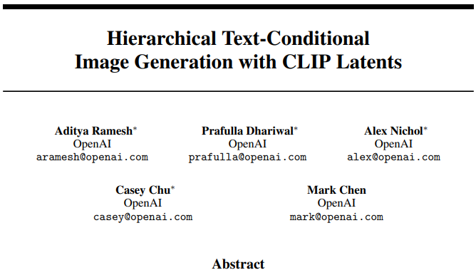
Motivation
2015
2021
2022
Notes:
Let’s mention a few popular works with state-of-the-art results on the image generation task.
(Animatie 1)
Diffusion models were introduced back in 2015, with good results on the CIFAR-10 dataset.
(Animatie 2)
The first major breakthrough happened when diffusion models obtained, for the first time, better sample quality than the state-of-the-art Generative Adversarial Networks.
(Animatie 3)
Other important contributions were the works for text-based image generation, such as Glide.
(Animatie 4)
And the progress went even further with models like DALLE-2 or Latent diffusion. The latter managed to preserve the image quality of the previous works while improving the efficiency.

Slide 6
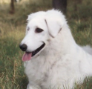
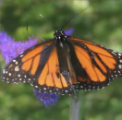
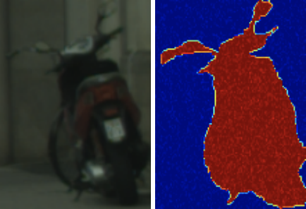
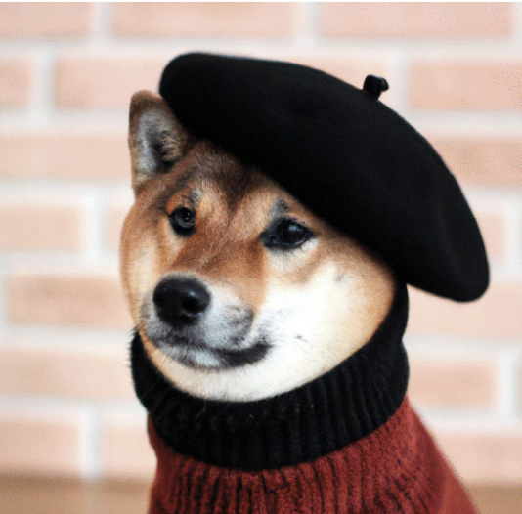
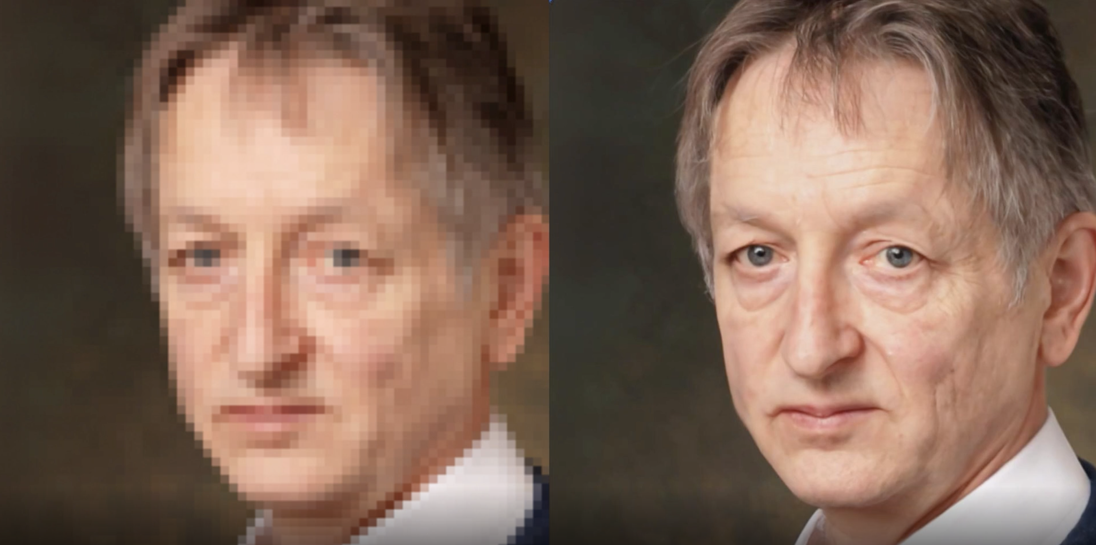
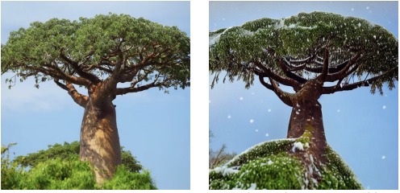
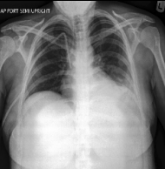
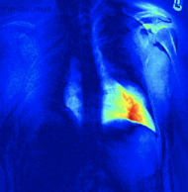
Motivation
Unconditional image generation
Class-conditional image generation
Image segmentation
Text-to-image generation: a Shiba-Inu wearing a beret and black turtleneck
Image super-resolution
Original image -> A tree covered by snow
Anomaly detection in medical images
Notes:
Moreover, diffusion models have been applied successfully on multiple image processing tasks.
We mention a few:
(Animatie 1)
Unconditional and conditional image generation
(Animatie 2)
Image segmentation
(Animatie 3)
Text-to-image generation
(Animatie 4)
Image super-resolution
(Animatie 5)
Text based domain adaptation
(Animatie 6)
Anomaly detection in medical images.

Slide 7
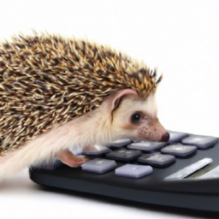
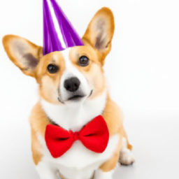
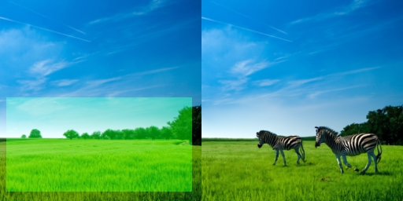
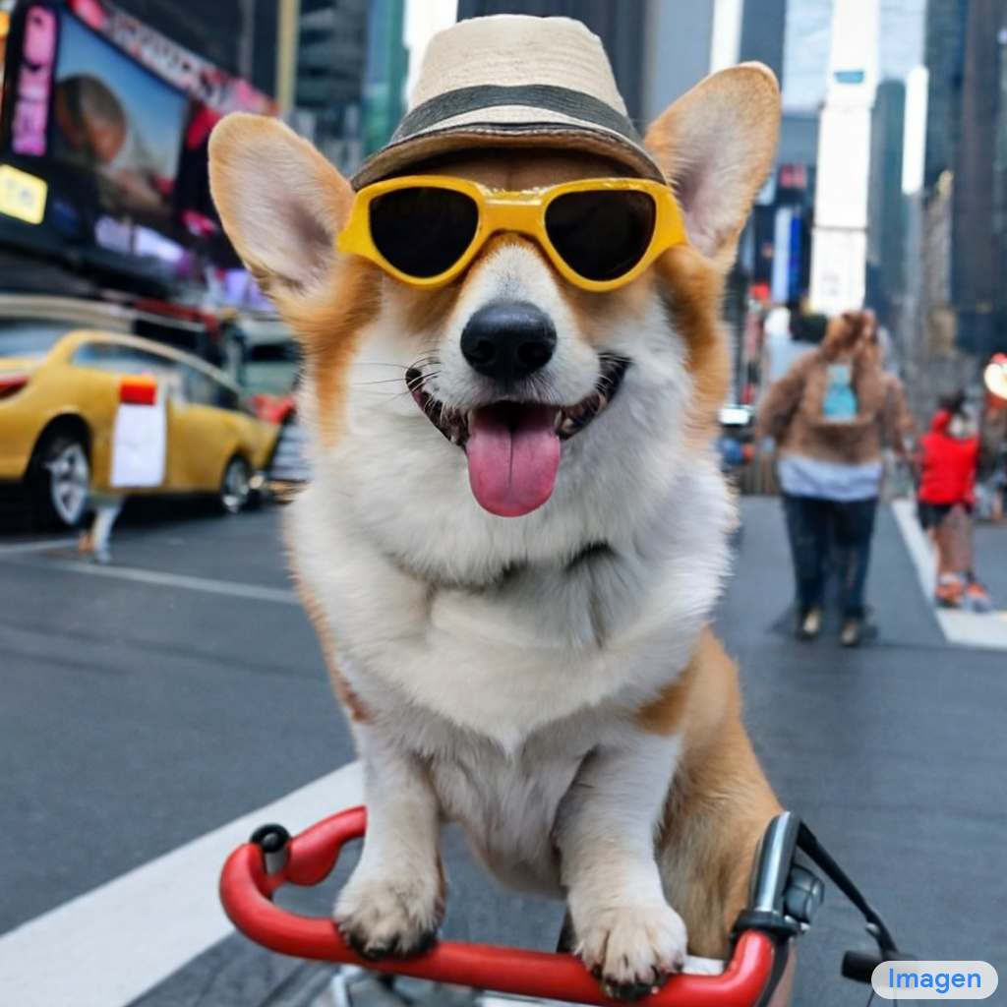
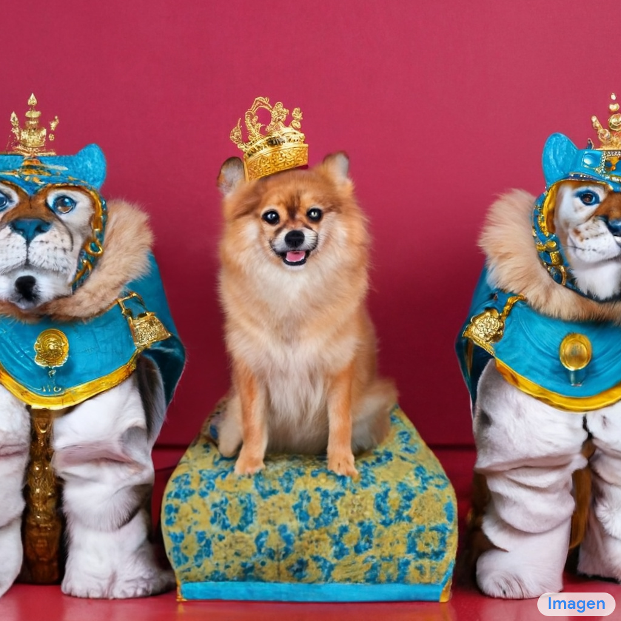
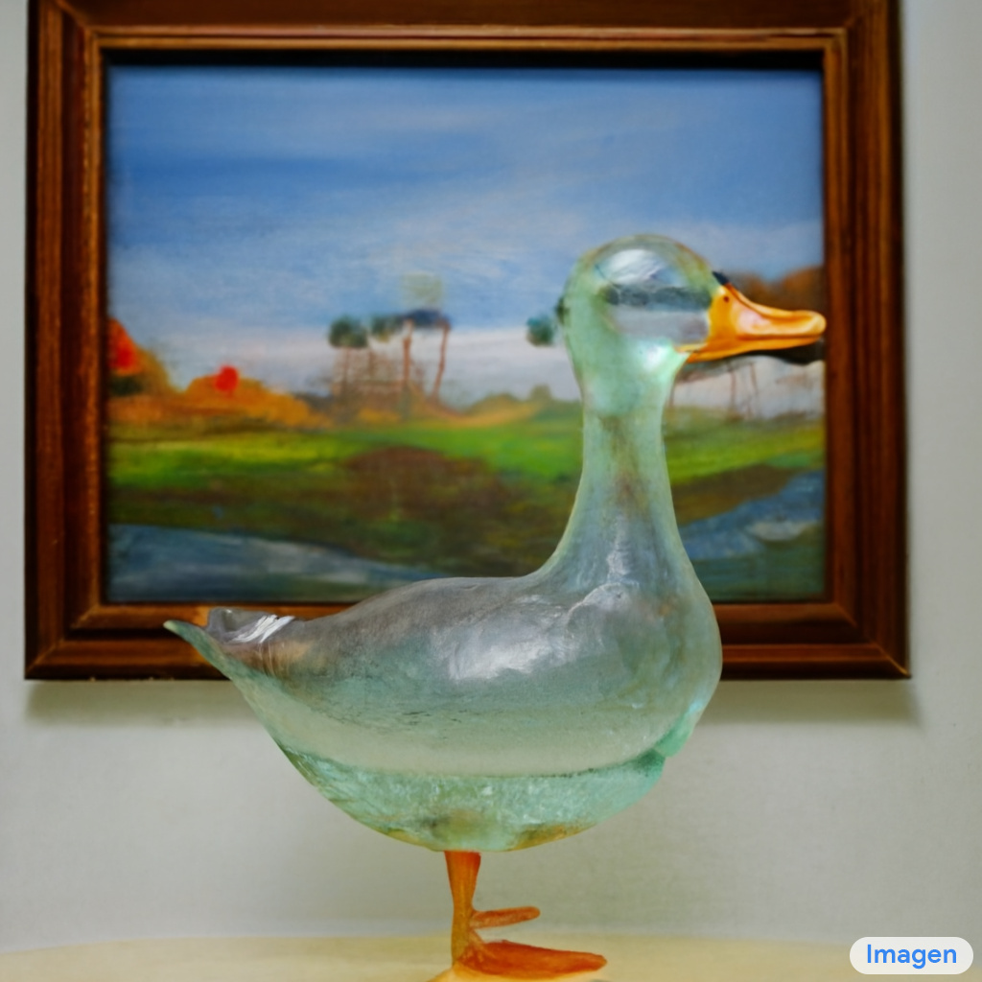
Motivation
GLIDE
A hedgehog using a calculator.
A corgi wearing a red bowtie and a purple party hat.
Zebras roaming in the field.
IMAGEN
A photo of a Corgi dog riding a bike in Times Square. It is wearing sunglasses and a beach hat.
Pomeranian king with tiger soldiers.
A transparent sculpture of a duck made out of glass.
Notes:
Diffusion models are well-known for the quality of the images generated with text descriptions. Here are a few more samples for this use-case, where we can see an impressive alignment between image content and text.

Slide 8
Outline
Motivation
High-level overview
Denoising diffusion probabilistic models
Noise Conditioned Score Network
Stochastic Differential Equations
Conditional Generation
Research directions
Notes:
Now, we will briefly overview how diffusion models work and then we go deeper into the details of each formulation

Slide 9
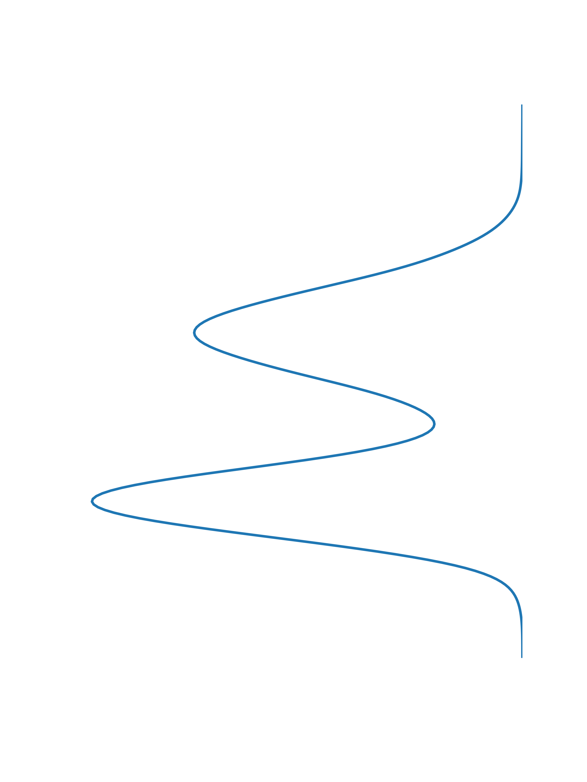
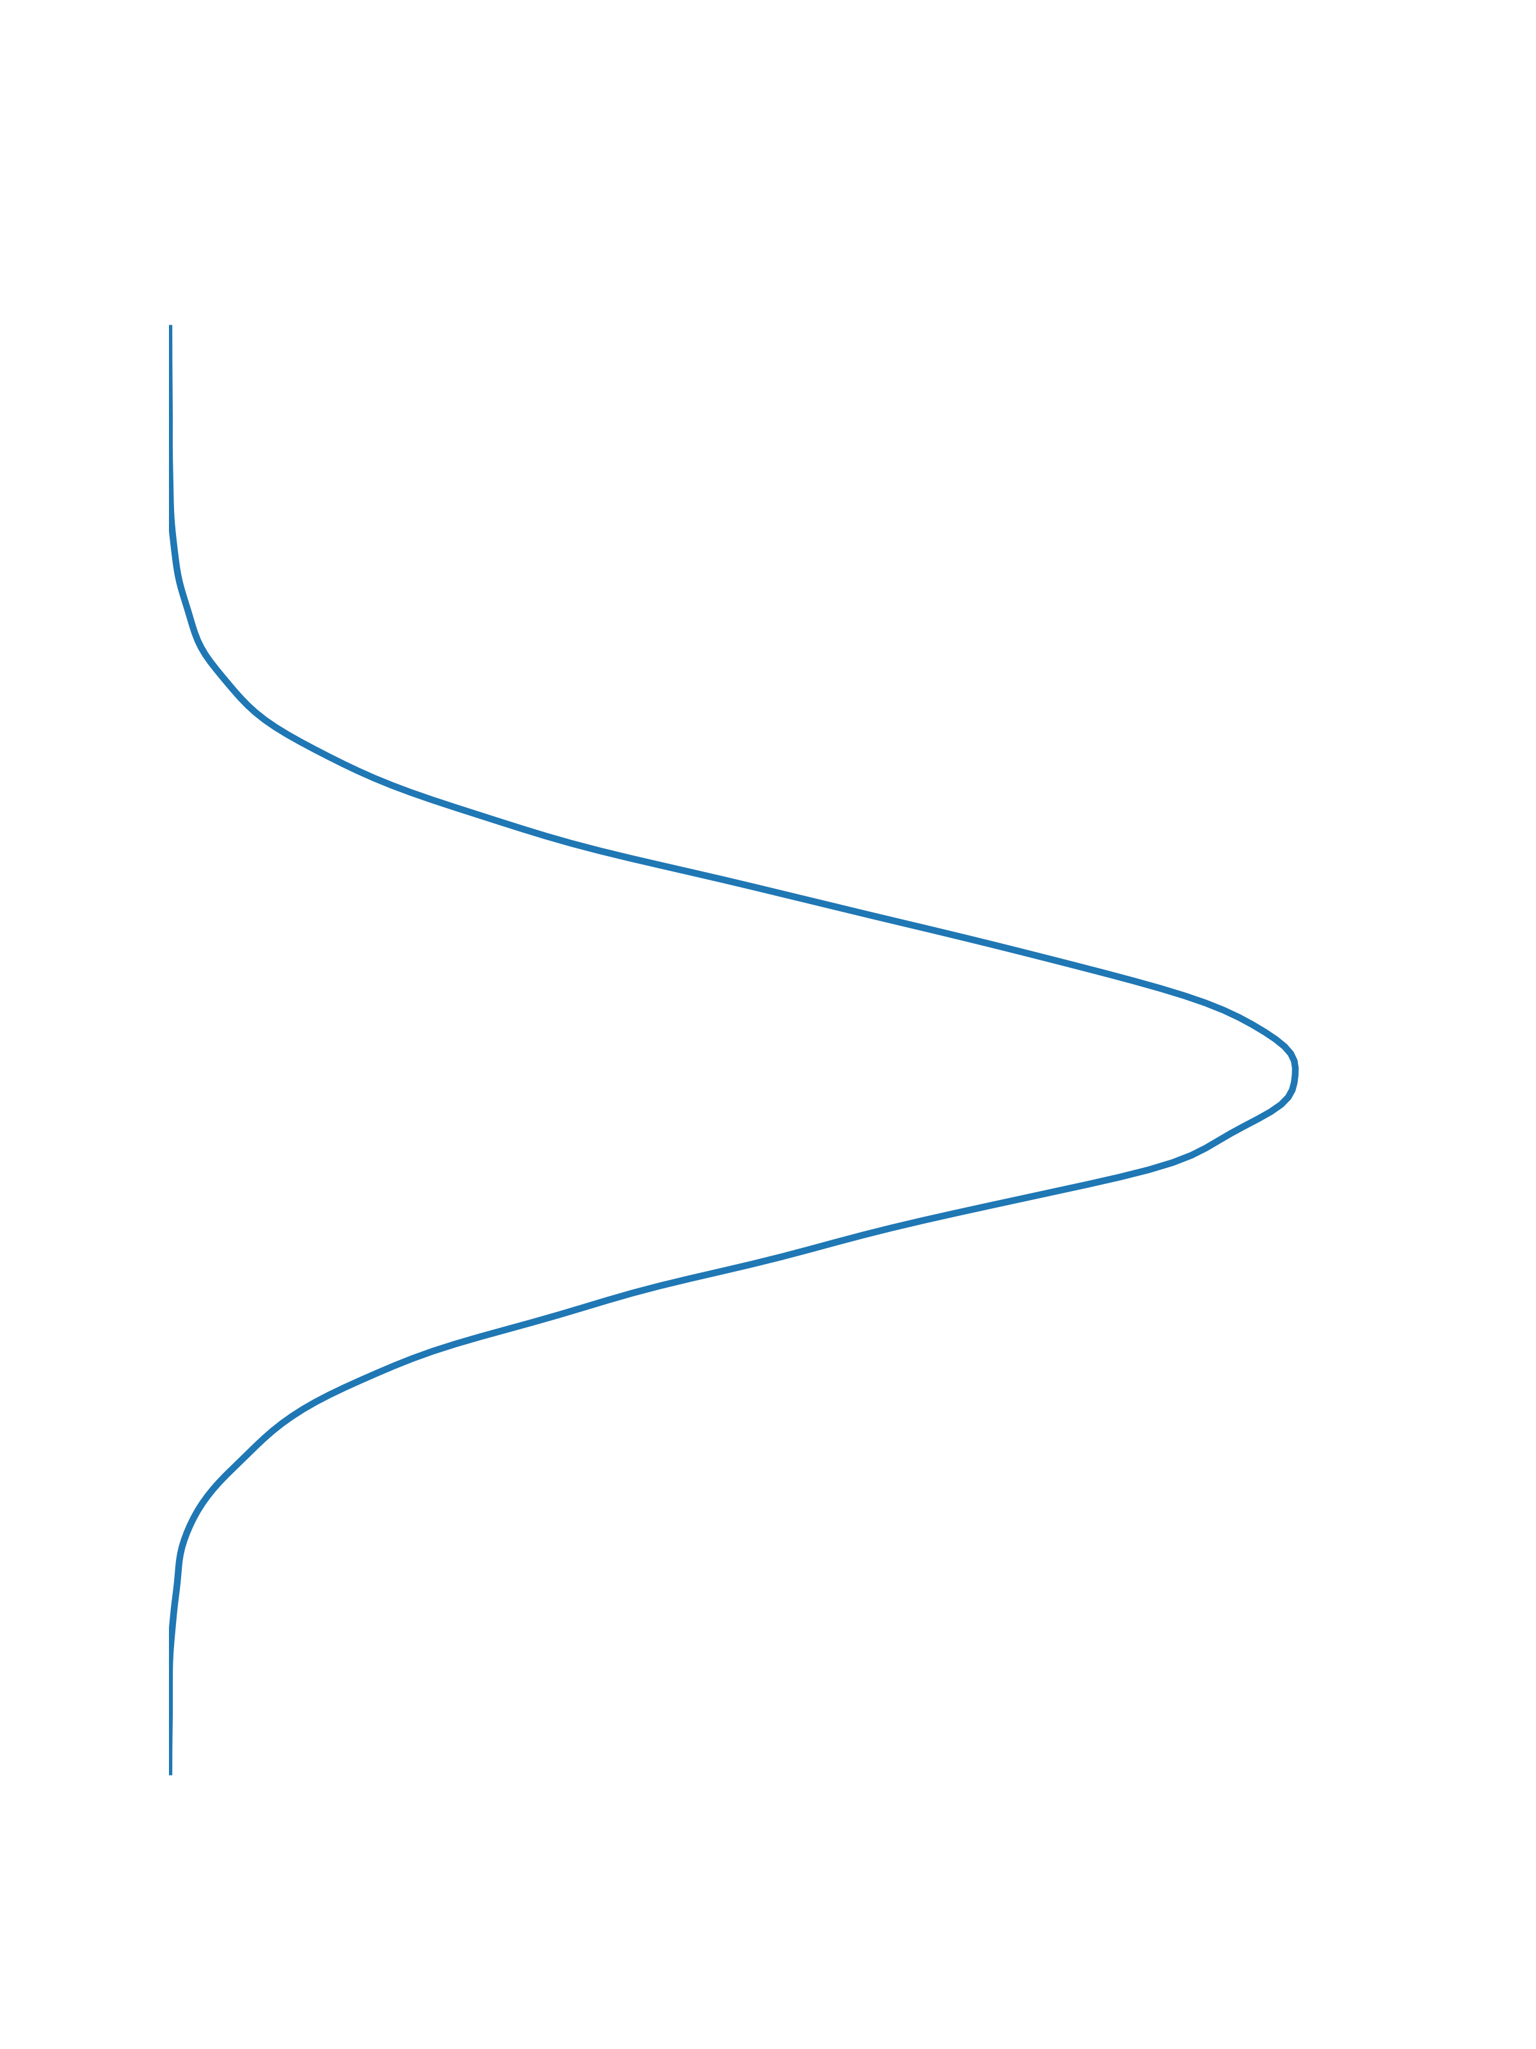
High-level overview
Diffusion models are probabilistic models used for generation.
They involve reversing the process of gradually degrading the data.
Consist of two processes:
The forward process: data is progressively destroyed by adding noise across multiple time steps.
The reverse process: using a neural network, noise is sequentially removed to obtain the original data.
reverse
Data distribution
Standard Gaussian
forward
Notes:
First of all, diffusion models are a type of generative models.
The sample generation is done via a process that maps standard gaussian noise with samples from the data distribution. The mapping is implemented with small steps, at each step a small amount of noise being removed.
(Animatie1)
The training consist of two process:
The forward process destroys the data across multiple time steps by adding small amounts of Gaussian noise
(Animatie2)
2. And the second one is the reverse process, the one responsible with sample generation. It uses a neural network to estimate the noise from a given image, and the respective noise is subtracted to get the image for the next iteration.

Slide 10
High-level overview
Can be categorized into three kinds, based on the approaches they employ:
Denoising Diffusion Probabilistic Models
Noise Conditioned Score Networks
Stochastic Differential Equations
Notes:
Diffusion models can be categorized into three classes, according to the perspectives which introduced them.
Denoising Diffusion Probabilistic Models
(Animatie 1)
Noise Conditioned Score Networks
(Animatie 2)
And based on Stochastic Differential Equations

Slide 11
Outline
Motivation
High-level overview
Denoising diffusion probabilistic models
Noise Conditioned Score Network
Stochastic Differential Equations
Conditional Generation
Research directions
Notes:
Let’s start with the first formulation of diffusion models, namely denoising diffusion probabilistic models.

Slide 12
Notations
$p\left(x_{0}\right)$ - data distribution
$𝒩\left(x;μ, σ⋅I\right)$ - Gaussian distribution
Sampled image
Mean
Covariance matrix. $I$ is the identity matrix with the same dimensionality as our images.
$$x= μ+ \sqrt{σ}⋅z, z\sim 𝒩(0, I)$$
Standard Gaussian noise
Notes:
But first, let’s clarify some notations that will appear regularly in the following slides.
(Animatie1)
We will denote the true data distribution by P(x_0). The zero stands for the fact that the data is uncorrupted, it is in its original form.
(Animatie 2)
With this notation we will refer to normal distributions (Animatie 3) with the mean denoted by mu and (animatie 4) the variance sigma. (Animatie 5) The x denotes the sample that will be produced by this distribution.
(Animatie 6)
The sampling from this distribution is equivalent with adding the mean mu to a standard gaussian sample which is scaled by the standard deviation, namely the square root of sigma.

Slide 13
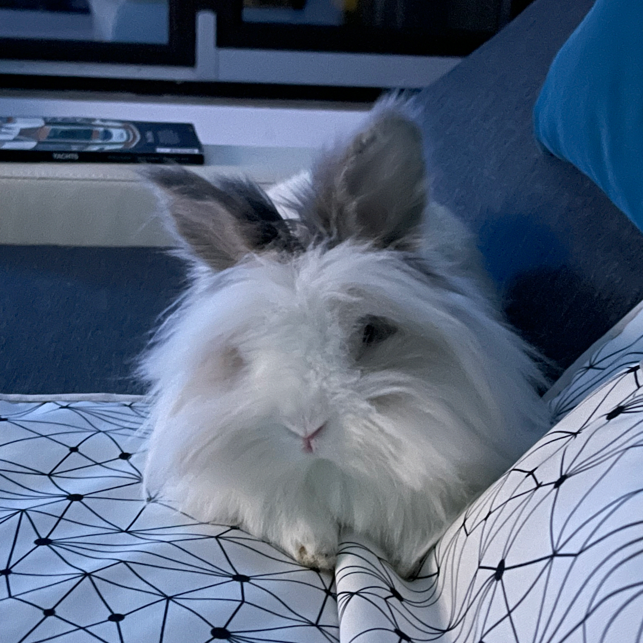
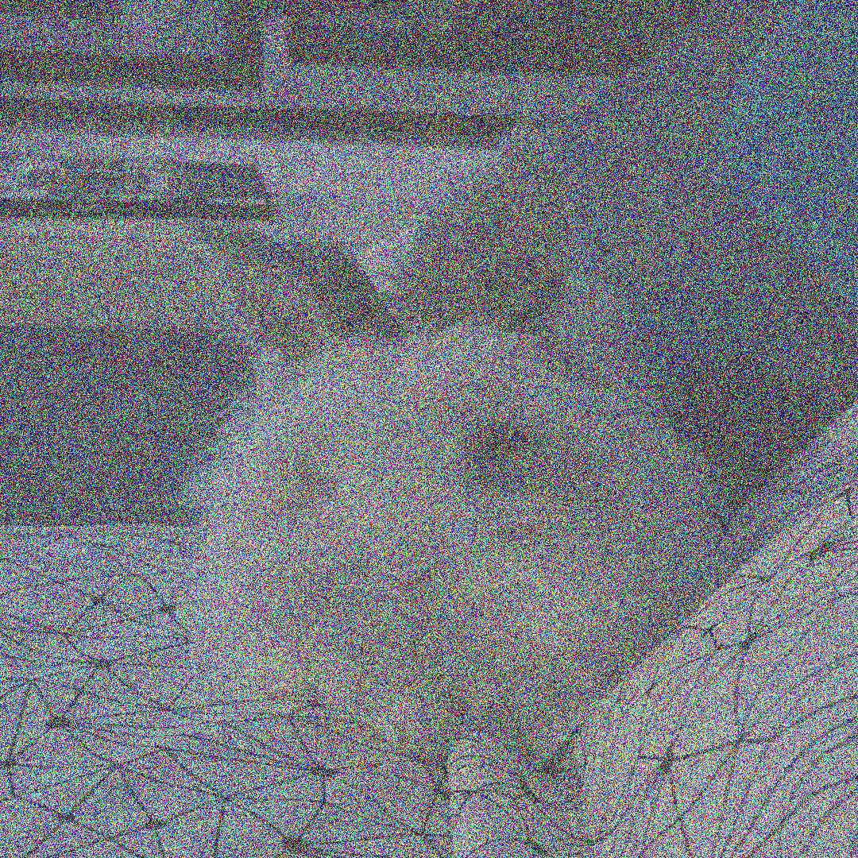
Denoising Diffusion Probabilistic Models (DDPMs)
Forward process
$$x_{0}$$
$$x_{T}$$
…
…
$$x_{0}\sim p(x_{0})$$
$$x_{T}\sim 𝒩(0, I)$$
Notes:
Going back to diffusion models, Remember that this type of models consists of two processes:
The forward process
And the reverse process
(Animatie 1)
The forward process starts with a data sample x_0 from the true data distribution, denoted by p(x_0), and it is transformed into standard gaussian noise by adding small amounts of noise at each step.

Slide 14
Denoising Diffusion Probabilistic Models (DDPMs)
$$x_{0}$$
$$x_{T}$$
…
…
$$x_{0}\sim p(x_{0})$$
Reverse process
$$x_{T}\sim 𝒩(0, I)$$
Notes:
The reverse process is the actual generative process. It starts with a sample from the standard Gaussian distribution and learns to remove the noise from each step so that at the end of the process, the result will be a sample from the data distribution.

Slide 15
Denoising Diffusion Probabilistic Models (DDPMs)
Forward process
$$x_{t}\sim p\left(x_{t} | x_{t−1}\right)= 𝒩(x_{t};\sqrt{1−β_{t}}∙x_{t−1}, β_{t}I)$$
…
…
$$x_{0}$$
$$x_{t−1}$$
$$x_{t}$$
$$x_{T}$$
Mean: the features of the image are gradually eradicated
Variance: adds the random gaussian noise
Notes:
The forward process of the DDPMs is a fixed Markovian process because the image at step t is sampled from a gaussian distribution, which has the mean close to the image of the previous step and a small variance.
Therefore, over many steps T, the pure noise is obtained by gradually removing the image information (Animatie 1) via changing the mean of the gaussian distributions and (Animatie 2) replacing it with noise modeled by Beta_t.
We emphasize that Beta_t is fixed, therefore the entire process is also fixed.

Slide 16
Denoising Diffusion Probabilistic Models (DDPMs)
Forward process. Ancestral sampling
Notations:
$${\hat{β}}_{t}= \prod_{i=1}^{t}{α_{i}}$$
$$α_{t}=1 − β_{t}$$
$$x_{t} \sim p\left(x_{t} | x_{0}\right)= 𝒩(x_{t}; \sqrt{{\hat{β}}_{t}}⋅x_{0}, \left(1−{\hat{β}}_{t}\right)I)$$
…
…
$$x_{0}$$
$$x_{t−1}$$
$$x_{t}$$
$$x_{T}$$
Notes:
An important property of this design for the forward process is the ancestral sampling.
Specifically, a sample for a random time step t can be directly computed from the data point x_0, (Animatie 1) by following this normal distribution.
This distribution is derived by applying iteratively all the transitions until the step t.
(Animatie 2)
Beta_hat_t is just a notation for the product of 1-Beta_i where i goes from 1 up to the current t. Note that each 1-Beta_i is denoted by alpha_i.
This property makes the training more efficient because we can select a random time step t and get the noisy image for that t without computing the previous unnecessary noisy images.

Slide 17
Denoising Diffusion Probabilistic Models (DDPMs)
$$x_{0}$$
$$x_{t−1}$$
$$x_{t}$$
$$x_{T}$$
…
…
$$p\left(x_{t−1} | x_{t}\right)$$
$≈𝒩(x_{t−1};μ\left(x_{t}, t\right), Σ\left(x_{t}, t\right)$)
Approximated by a neural network
Reverse process
Notes:
The reverse process starts with a sample from the standard Gaussian distribution and yields data points by ideally following (Animatie 1) the transitions denoted by p(x_t-1|x_t).
The problem is that the probability distributions p(x_t-1|x_t) are intractable. (Animatie 2) However, they can be approximated with gaussian distributions if the variance schedule of the forward process contains values much smaller than 1. (Animatie 3) Therefore, a generative model would only need to predict the mean and the covariance matrix of this gaussian, given the noisy image and the current step of the process.
Before deriving the training procedure of this generative neural network, we motivate in the following slides the need of having small Beta_ts.

Slide 18
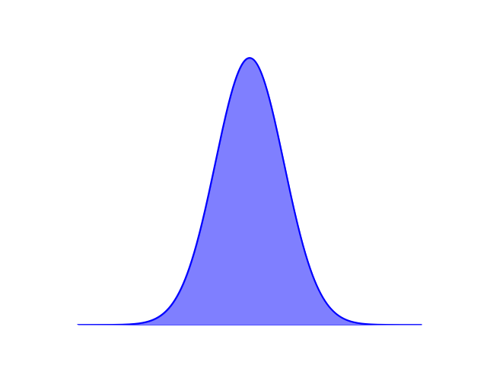
DDPMs. Properties of $β_{t}$
$${ β}_{t}≪1 , t=\overline{1, T}$$
$$x_{t}\sim p\left(x_{t} | x_{t−1}\right)= 𝒩(x_{t};\sqrt{1−β_{t}}∙x_{t−1}, β_{t}I)$$
If $x_{t}$ is created with a very small step modeled by $β_{t}$ in the forward process …
Then it becomes more likely that $x_{t−1}$ comes from a region close to where $x_{t}$ is observed, and we can model this region with a Gaussian distribution in the reverse process.
$$t−1$$
$$t$$
$$x_{t−1}\sim p\left(x_{t−1} | x_{t}\right)= 𝒩(x_{t −1}; μ\left(x_{t}, t\right), Σ\left(x_{t}, t\right))$$
Notes:
(Animatie 1)
When we know that xt is created with a very small step modeled by beta_t in the forward process.
(Animatie 2)
It becomes more likely that xt−1 comes from a region close to where xt is observed, which allows us to model this region with a Gaussian distribution in the reverse process.

Slide 19
DDPMs. Properties of $β_{t}$
$${ β}_{t}≪1 , t=\overline{1, T}$$
$$x_{t}\sim p\left(x_{t} | x_{t−1}\right)= 𝒩(x_{t};\sqrt{1−β_{t}}∙x_{t−1}, β_{t}I)$$
If the condition is not met in the forward process, meaning that ${ β}_{t}$ is not much smaller than 1 …
Then, in the reverse process, we do not have a clue where the previous step of the chain $x_{t−1}$ was.
$$t−1$$
$$t$$
?
Notes:
(Animatie1)
In contrast if each Beta_t is large, when we observe an x_t (Animatie2) we will be less certain where the previous step of the chain x_t-1 was, because we could have reached x_t from many more regions.

Slide 20
DDPMs. Properties of $β_{t}$
We need to have many iterations $T$ because:
The noise added at each step is small ($β_{t}≪1, t=\overline{1, T}$)
The final image ($x_{T}$) needs to be close to the standard Gaussian noise
$$x_{0}$$
$$x_{T}$$
$$T iterations$$
Notes:
The second property of the noise schedule Beta_t is that we need to have a large T, (Animatie 1) because the noise added at each step is small, (Animatie2) but, at the same time, the image must be destroyed. (Animatie) Hence, we need to perform many diffusion steps, which is equivalent to having a large T.

Slide 21
DDPMs. Training objective
Remember that:
Reverse process
$$x_{0}$$
$$x_{t−1}$$
$$x_{t}$$
$$x_{T}$$
…
…
$p\left(x_{t−1} | x_{t}\right)≈p_{θ}\left(x_{t−1} | x_{t}\right)= 𝒩(x_{t−1};μ_{θ}\left(x_{t}, t\right), Σ_{θ}\left(x_{t}, t\right)$)
Neural network weights
Approximated by a neural network
Notes:
Now we can go back to describing the training procedure.
(Animatie 1)
Remember that we need to train a neural network to approximate the posterior of the forward process with a gaussian distribution.
(Animatie 2)
The neural network must predict estimates for the mean and the covariance matrix of this gaussian.
(Animatie 3)
Theta denotes the weights of the neural network

Slide 22
DDPMs. Training objective
Simplification:
Reverse process
$$x_{0}$$
$$x_{t−1}$$
$$x_{t}$$
$$x_{T}$$
…
…
$p\left(x_{t−1} | x_{t}\right)≈p_{θ}\left(x_{t−1} | x_{t}\right)= 𝒩(x_{t−1};μ_{θ}\left(x_{t}, t\right),σ_{t}^{2}I$)
Neural network weights
Approximated by a neural network
Notes:
As a simplification, the authors of DDPMs observed that we can fix the variance instead of learning it. Thus, the neural network will predict only the mean of the gaussian distribution.

Slide 23
DDPMs. Training objective
$$μ_{θ}(x_{t}, t)$$
$$x_{t}$$
$$t$$
MLP
Sinusoidal time embeddings
$$\sim 𝒩\left(x_{t−1},μ_{θ}(x_{t}, t),σ_{t}^{2}I\right)$$
$$x_{t−1}$$
Notes:
To summarize, we need to train a U-Net-like neural network (Animatie 1) to approximate from a given image x_t (Animatie 2) and a time step t (Animatie 3) the mean of the probability distribution (animatie 4) from which we sample the next image (animatie 5).
(Animatie 6)
The time step t is represented with sinusoidal time embeddings, similar with the position embeddings used in transformers. (Animatie 7) These embeddings are processed by a multilayer perceptron before adding them to each residual block of the UNet

Slide 24
DDPMs. Training Objective
Objective function: variational bound on negative log likelihood as in VAEs, but in this case $x_{0}$ is the observed variable and $x_{1:T}$ are latent variables:
$$𝔼_{x_{0}\sim p(x_{0})}\left[− log{p_{θ}\left(x_{0}\right)}\right]≤{{𝔼_{x_{0}\sim p(x_{0})}𝔼}_{x_{1:T}\sim p\left(x_{1:T} | x_{0}\right)}\left[\log{\frac{p\left(x_{1:T} | x_{0}\right)}{p_{θ}\left(x_{0:T}\right)} }\right]}$$
$$p(x_{1:T}|x_{0})$$
$$x_{0}$$
$$𝒩(x_{1};\sqrt{1−β_{1}}∙x_{0}, β_{1}I)$$
$$x_{1}$$
…
$$x_{T}$$
$$p_{θ}(x_{0}|x_{1:T})$$
$$x_{0}$$
$$x_{1}$$
…
$𝒩(x_{t−1};μ_{θ}\left(x_{t}, t\right),σ_{t}^{2}I$)
$$x_{T}$$
$$p_{φ}(z|x)$$
$$p_{θ}(x′|z)$$
Encoder
Decoder
$$μ^{′}$$
$$μ$$
$$+$$
$$x$$
$$z$$
$$x′∼𝒩(μ^{′}, \sqrt{σ^{′}}I)$$
$$σ$$
$$σ^{′}$$
$$ε\sim 𝒩(0, I)$$
$$∗$$
Notes:
(Animatie 1)
We train the neural network by maximizing the data likelihood, p_theta(x_0), which is equivalent with minimizing the negative log likelihood. We can not minimize this directly, but we compute the variational bound as in VAEs.
And in fact, we can look at DDPMs as being a special case of VAEs, where:
(Animatie 2)
The forward process is a fixed encoder that produces the chain of images x1:T instead of the latent z. So, in this case x1:T plays the role of the latent variable.
And the reverse process is the decoder.

Slide 25
DDPMs. Training Objective
Objective function: variational bound on negative log likelihood as in VAEs, but in this case $x_{0}$ is the observed variable and $x_{1:T}$ are latent variables:
$$𝔼_{x_{0}\sim p(x_{0})}\left[− log{p_{θ}\left(x_{0}\right)}\right]≤{{𝔼_{x_{0}\sim p(x_{0})}𝔼}_{x_{1:T}\sim p\left(x_{1:T} | x_{0}\right)}\left[\log{\frac{p\left(x_{1:T} | x_{0}\right)}{p_{θ}\left(x_{0:T}\right)} }\right]}$$
This formulation is derived as follows:
Write the log likelihood as the log marginal of the joint probability $p_{θ}(x_{0:T})$:
$$\log{p_{θ}(}x_{0})= \log{\int{p_{θ}(}}x_{0:T}) ∂x_{1:T}$$
Introduce the joint probability of the forward process conditioned on initial image $x_{0}$, $p(x_{1:T}|x_{0})$:
$$\log{p_{θ}(}x_{0})= \log{\int{p\left(x_{1:T} | x_{0}\right) ⋅\frac{p_{θ}(x_{0:T})}{p\left(x_{1:T} | x_{0}\right)}}}∂x_{1:T}$$
Rewrite as expected value:
$$\log{p_{θ}(}x_{0})= \log{𝔼_{x_{1:T}\sim p\left(x_{1:T} | x_{0}\right)}}\left[\frac{p_{θ}(x_{0:T})}{p\left(x_{1:T} | x_{0}\right)}\right]$$
Finally, apply Jensen inequality and multiply with $−1:$
$$− log{p_{θ}\left(x_{0}\right)} ≤{𝔼_{x_{1:T}\sim p\left(x_{1:T} | x_{0}\right)}\left[\log{\frac{p\left(x_{1:T} | x_{0}\right)}{p_{θ}\left(x_{0:T}\right)} }\right]}$$
Notes:
(Animatie 1)
With this analogy in mind, we derive the bound by following the next steps:
(Animation 2)
We write the log likelihood as the log marginal of the joint probability $p_{θ}(x_{0:T})$ of the reverse process
(Animation 3)
We introduce the joint probability of the forward process conditioned on the initial image $x_{0}$ in the right-hand side
(Animation 4)
The result can be rewritten as an expected value of the forward process
(Animation 5)
And if we apply Jensen inequality and multiply with -1, we will get our bound.
The Jensen inequality states that given a random variable Y and a concave function f then f(E[Y]) >= E[f(Y)]. In our case f is the logarithm, and the random variable is the forward process.

Slide 26
DDPMs. Training Objective
Objective function: variational bound on negative log likelihood as in VAEs, but in this case $x_{0}$ is the observed variable and $x_{1:T}$ are latent variables:
$$𝔼_{x_{0}\sim p(x_{0})}\left[− log{p_{θ}\left(x_{0}\right)}\right]≤{{𝔼_{x_{0}\sim p(x_{0})}𝔼}_{x_{1:T}\sim p\left(x_{1:T} | x_{0}\right)}\left[\log{\frac{p\left(x_{1:T} | x_{0}\right)}{p_{θ}\left(x_{0:T}\right)} }\right]}$$
Extending further the above formulation of variational bound, the final objective becomes:
$$\min_{θ}{ 𝔼}_{x_{0}\sim p(x_{0})}\left[−\log{p_{θ}\left(x_{0} | x_{1}\right)+KL(p(x_{T}|x_{0})||p_{θ}\left(x_{T}\right))}+ \sum_{t=2}^{T}{KL(p\left(x_{t−1} | x_{t }, x_{0}\right)||p_{θ}\left(x_{t−1} | x_{t}\right))}\right]$$
This term can be ignored because $p_{θ}\left(x_{T}\right)$is $𝒩\left(0, Ι\right)$ $and does not depend on$ $θ.$
At each time step t, $p_{θ}\left(x_{t−1} | x_{t}\right)$ is as close as possible to the true posterior of the forward process when conditioned on the original image.
Notes:
(Animatie 1)
The previous bound can be further extended if we exploit the fact that the forward process is Markovian.
(Animatie 2)
This is the final result. You can find more details about this derivation in our survey.
(Animatie 3)
The middle term of this objective can be ignored because it does not depend on theta.
(Animatie 4)
The last term ensures that at each time step t, $p_{θ}\left(x_{t−1} | x_{t}\right)$ is as close as possible to the true posterior of the forward process when conditioned on the original image.

Slide 27
DDPMs. Training Objective. Simplifications
$$\min_{θ}{ 𝔼}_{x_{0}\sim p(x_{0})}\left[−\log{p_{θ}\left(x_{0} | x_{1}\right)}+ \sum_{t=2}^{T}{KL(p\left(x_{t−1} | x_{t }, x_{0}\right)||p_{θ}\left(x_{t−1} | x_{t}\right))}\right]$$
Tractable posterior:
$p\left(x_{t−1} | x_{t}, x_{0}\right)= 𝒩\left(x_{t−1}; \tilde{μ}\left(x_{t}, x_{0}\right), {\tilde{β}}_{t}I\right)$
$$\tilde{μ}\left(x_{t}, x_{0}\right)= \frac{1}{\sqrt{α_{t}}} \left(x_{t }− \frac{1 − α_{t}}{\sqrt{1−{\hat{β}}_{t}}} z_{t}\right), z_{t }\sim 𝒩(0, I)$$
$${\tilde{β}}_{t}= \frac{1−{\hat{β}}_{t−1}}{1−{\hat{β}}_{t}}{⋅β}_{t}$$
Notations:
$${\hat{β}}_{t}= \prod_{i=1}^{t}{α_{i}}$$
$$α_{t}=1 − β_{t}$$
Notes:
We can stop the derivation at this form because the KL divergences of the last term are between 2 gaussians, so they have a closed form which can actually be formulated as an L2 distance between the means of these distributions. Moreover, the first term of the loss basically measures the reconstruction error and can be addressed with an independent decoder.
But the DDPMs paper introduced two simplifications that led to a more simple objective that is based on the noise in the image.
(Animatie 1)
The first simplification starts, as we mentioned earlier, from the observation that the posterior of the forward process conditioned on x_0 is tractable and it has a closed form given by this normal distribution.
(Animatie 2)
Where the mean mu_tilde can be written as a function of x_t and the standard gaussian noise z_t , and the variance Beta_tilde is a combination of beta_t and beta_hat_t . we skip the derivation for simplicity, but one must use the Bayes rule and rearrange the terms in a particular manner to obtain these expressions.

Slide 28
DDPMs. Training Objective. Simplifications
$$\min_{θ}{ 𝔼}_{x_{0}\sim p(x_{0})}\left[−\log{p_{θ}\left(x_{0} | x_{1}\right)}+ \sum_{t=2}^{T}{KL(p\left(x_{t−1} | x_{t }, x_{0}\right)||p_{θ}\left(x_{t−1} | x_{t}\right))}\right]$$
Tractable posterior:
$p\left(x_{t−1} | x_{t}, x_{0}\right)= 𝒩\left(x_{t−1}; \tilde{μ}\left(x_{t}, x_{0}\right), {\tilde{β}}_{t}I\right)$
$$\tilde{μ}\left(x_{t}, x_{0}\right)= \frac{1}{\sqrt{α_{t}}} \left(x_{t }− \frac{1 − α_{t}}{\sqrt{1−{\hat{β}}_{t}}} z_{t}\right), z_{t }\sim 𝒩(0, I)$$
$$μ_{θ}\left(x_{t}, x_{0}\right)= \frac{1}{\sqrt{α_{t}}} \left(x_{t }− \frac{1 − α_{t}}{\sqrt{1−{\hat{β}}_{t}}} z_{θ}(x_{t}, t)\right)$$
$$KL(p\left(x_{t−1} | x_{t }, x_{0}\right)|\left|p_{θ}\left(x_{t−1} | x_{t}\right)\right)=𝔼_{p}\left[\frac{1}{2σ_{t}^{2}}{\left\|{\tilde{μ}\left(x_{t}, x_{0}\right) − μ}_{θ}\left(x_{t}, x_{0}\right)\right\|}_{2}^{2}\right]$$
Notations:
$${\hat{β}}_{t}= \prod_{i=1}^{t}{α_{i}}$$
$$α_{t}=1 − β_{t}$$
$${\tilde{β}}_{t}= \frac{1−{\hat{β}}_{t−1}}{1−{\hat{β}}_{t}}{⋅β}_{t}$$
$$⟹$$
$$⟹KL(p\left(x_{t−1} | x_{t }, x_{0}\right)|\left|p_{θ}\left(x_{t−1} | x_{t}\right)\right)= 𝔼_{z_{t} \sim 𝒩(0, I) }\left[\frac{β_{t}^{2}}{2σ_{t}^{2}α_{t}(1−{\hat{β}}_{t})}{\left\|z_{t} −z_{θ}(x_{t}, t)\right\|}_{2}^{2}\right]$$
Notes:
Now, the idea is to parameterize in the same way the mean of p_theta, but instead of using the noise z_t we use some noise estimation given by the neural network.
Animatie 1) And we know that the KL divergence is just an L2 distance between the means of the two gaussian distributions.
(Animatie 2)
If we replace the means with these parametrizations then we can rewrite the second term of the objective as an l2-distance between the real noise z_t and the noise predicted by the neural network given the image x_t and the time step t.

Slide 29
DDPMs. Training Objective. Simplifications
$$\min_{θ}{ 𝔼}_{x_{0}\sim p(x_{0})}\left[−\log{p_{θ}\left(x_{0} | x_{1}\right)}+ \sum_{t=2}^{T}{KL(p\left(x_{t−1} | x_{t }, x_{0}\right)||p_{θ}\left(x_{t−1} | x_{t}\right))}\right]$$
Tractable posterior:
$p\left(x_{t−1} | x_{t}, x_{0}\right)= 𝒩\left(x_{t−1}; \tilde{μ}\left(x_{t}, x_{0}\right), {\tilde{β}}_{t}I\right)$
$$\tilde{μ}\left(x_{t}, x_{0}\right)= \frac{1}{\sqrt{α_{t}}} \left(x_{t }− \frac{1 − α_{t}}{\sqrt{1−{\hat{β}}_{t}}} z_{t}\right), z_{t }\sim 𝒩(0, I)$$
$$μ_{θ}\left(x_{t}, x_{0}\right)= \frac{1}{\sqrt{α_{t}}} \left(x_{t }− \frac{1 − α_{t}}{\sqrt{1−{\hat{β}}_{t}}} z_{θ}(x_{t}, t)\right)$$
$$KL(p\left(x_{t−1} | x_{t }, x_{0}\right)|\left|p_{θ}\left(x_{t−1} | x_{t}\right)\right)=𝔼_{p}\left[\frac{1}{2σ_{t}^{2}}{\left\|{\tilde{μ}\left(x_{t}, x_{0}\right) − μ}_{θ}\left(x_{t}, x_{0}\right)\right\|}_{2}^{2}\right]$$
Notations:
$${\hat{β}}_{t}= \prod_{i=1}^{t}{α_{i}}$$
$$α_{t}=1 − β_{t}$$
$${\tilde{β}}_{t}= \frac{1−{\hat{β}}_{t−1}}{1−{\hat{β}}_{t}}{⋅β}_{t}$$
$$⟹$$
Ignored
$$⟹KL(p\left(x_{t−1} | x_{t }, x_{0}\right)|\left|p_{θ}\left(x_{t−1} | x_{t}\right)\right)= 𝔼_{z_{t} \sim 𝒩(0, I) }\left[\frac{β_{t}^{2}}{2σ_{t}^{2}α_{t}(1−{\hat{β}}_{t})}{\left\|z_{t} −z_{θ}(x_{t}, t)\right\|}_{2}^{2}\right]$$
Notes:
(Animatie1)
Moreover, the term is simplified even more by ignoring the time weight associated to the l2-distance.
And if we include t=1 in the sum of the second term then the first term of the objective is also covered by this noise prediction formulation.

Slide 30
DDPMs. Training Algorithm
$$\min_{θ}{ \frac{1}{T}\sum_{t=1}^{T}{𝔼_{x_{0}\sim p\left(x_{0}\right), z_{t}\sim 𝒩\left(0,I\right)}}}_{ }{{\left\|z_{t} −z_{θ}(x_{t}, t)\right\|}_{2}^{2}}$$
$$ℒ_{simple}$$
Training algorithm. We repeat until convergence the following steps:
We sample batches of images ($x_{0}),$time steps ($t$) and noise samples ($z_{t}$):
$$x_{0}\sim p\left(x_{0}\right)$$
$$t\sim 𝒰\left(\left\{1,…, T\right\}\right)$$
$$z_{t}\sim 𝒩\left(0,I\right)$$
We apply the ancestral sampling property to determine the batch of noisy images ($x_{t}$):
$$x_{t}= \sqrt{{\hat{β}}_{t}}⋅x_{0}+ \sqrt{\left(1−{\hat{β}}_{t}\right)}z_{t}$$
Finally, we use the gradients of $ℒ_{simple}$to update the neural network weights:
$$θ= θ −lr ⋅ ∇_{θ}ℒ_{simple}(z_{t},z_{θ}\left(x_{t}, t\right))$$
Notes:
In conclusion, the final objective requires only the noise prediction from noisy images.
(Animatie 1)
This objective was named L_simple.
(Animatie 2)
The training algorithm is now straight forward.
(Animatie 3)
We sample batches of images ($x_{0}),$time steps ($t$) and noise samples ($z_{t}$)
(Animatie 4)
We compute the noisy images with the ancestral sampling formulation.
(Animatie 5)
We pass the batches $x_{t }$and $t$ to the neural network to get the noise estimations, $z_{θ}\left(x_{t}, t\right)$. Finally, We update the neural network using the gradient of the L_simple loss.

Slide 31
DDPMs. Sampling
$$x_{t}$$
$$z_{θ}(x_{t}, t)$$
$$t$$
MLP
$$μ_{θ}(x_{t}, t)$$
$$\sim 𝒩\left(x_{t−1},\frac{1}{\sqrt{α_{t}}} \left(x_{t }− \frac{1 − α_{t}}{\sqrt{1−{\hat{β}}_{t}}} z_{θ}\left(x_{t}, t\right)\right),σ_{t}^{2}I\right)$$
$$x_{t−1}$$
Notes:
For sampling we repeat the following procedure for T steps:
We pass the current noisy image along with the time embeddings to the neural network (animatie)
With the result z_theta, we compute the mean of the gaussian distribution (animatie)
We sample the image x_t-1 for the next iteration (animatie)

Slide 32
Outline
Motivation
High-level overview
Denoising diffusion probabilistic models
Noise Conditioned Score Network
Stochastic Differential Equations
Conditional Generation
Research directions
Notes:
That was all with the first formulation of diffusion models, let’s continue with the second one.

Slide 33
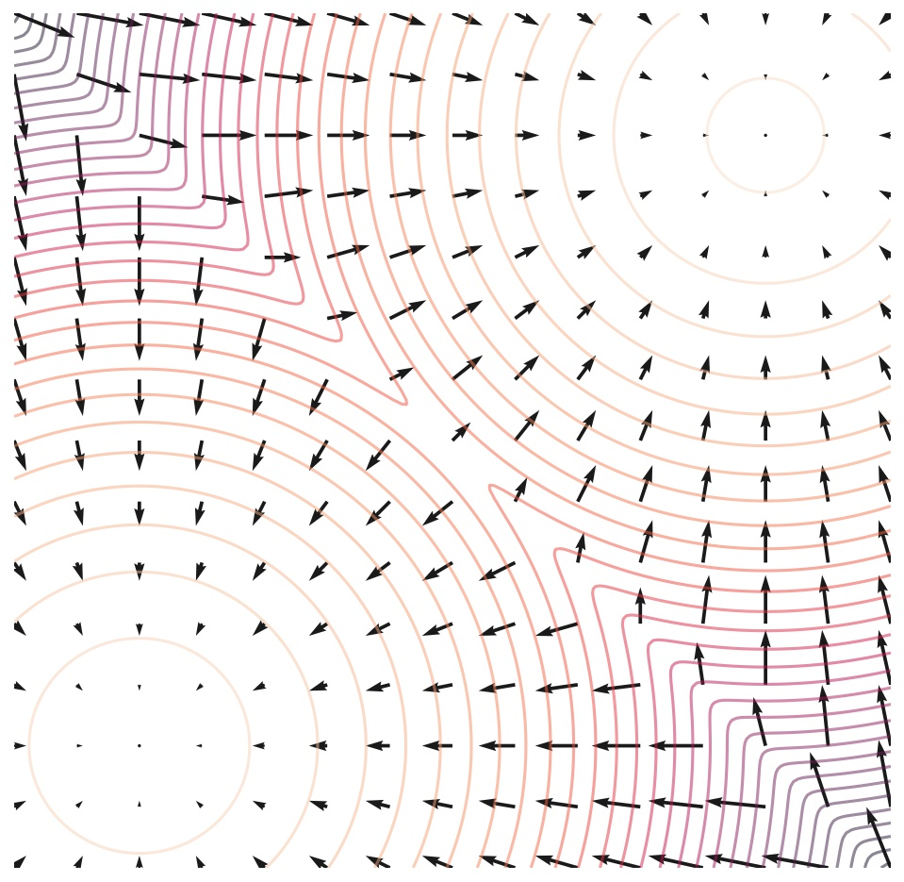
Naïve score-based model
Score: gradient of the logarithm of the probability density with respect to the input
Score function for a mixture of Gaussians
$$∇_{x}\log{p(x)}$$
Credit image Yang Song: https://yang-song.net/blog/2021/score/
Notes:
The second formulation of diffusion models is based on the score function of the probability density. Even if this perspective is totally different from the first formulation, we will see, at the end, that they have many aspects in common.
(Animatie 1)
The score function of a probability density is the gradient with respect to the input of the log density. This function tells us in what direction we need to change the input x such that the density becomes greater.
(Animatie 2)
In the image we have an example of a mixture of two Gaussians and the score function is illustrated by the black arrows. We can see how it points to the regions with high density.

Slide 34
Naïve score-based model
$$∇_{x}\log{p(x)}$$
Applying the annealed Langevin dynamics iteratively for a fixed number of iterations. Samples from the original data distribution are produced starting from random samples
$$x_{i}=x_{i−1}+ \frac{γ}{2}∇_{x}\log{p\left(x\right)}+ \sqrt{γ}⋅ω_{i}$$
Step size – controls the magnitude of the update in the direction of the score
Score – estimated by the score network
Noise – random gaussian noise N(0, I)
Notes:
(Animatie 1)
Based on the directions given by this score function, the method called Langevin dynamics starts from a random sample and applies iterative updates (animatie 2) with the score function to modify the sample so that the result will have a higher chance of being a sample of the true distribution p(x). (Animatie 3) The last term of the update is some Gaussian noise that helps the method, in practice, to escape the local minima.
(Animatie 4)
Gamma is just a parameter that controls the magnitude of the updates.
Therefore, a very simple generative process can be based on Langevin dynamics updates, if we have access to the score function.

Slide 35
Naïve score-based model
The score is approximated with a neural network.
Score network is trained using score matching:
$$𝔼_{x\sim p(x)}{\left\|s_{θ}\left(x\right)− ∇_{x}\log{p(x)}\right\|}_{2}^{2}$$
Denoising score matching:
Add small noise to the data:
Objective:
$$𝔼_{x^{′}\sim p_{σ}(x^{′})}{\left\|s_{θ}\left(x^{′}\right) −∇_{x^{′}}\log{p_{σ}(x^{′})}\right\|}_{2}^{2}$$
After training:
$$s_{θ}\left(x\right)≈∇_{x}\log{p (x)}$$
$$x^{′} \sim 𝒩\left(x^{′}, x, σ⋅I\right)=p_{σ}(x^{′})$$
Notes:
Fortunately, the score function can be estimated by a neural network, (Animatie 1) using the score matching objective for training.
In practice, this is intractable to compute, and the methods used are denoising score matching or sliced score matching.
(Animatie 2)
For example, the denoising score matching works as follows:
(Animatie 3)
Some small noise is added to each example of the data set
(Animatie 4)
The resulting samples x’ are now coming from a normal distribution which has a tractable form for the score function. And we can apply score matching using this score as a target.
(Animatie 5)
After training, the neural network will provide good estimations of the true score function because we choose the noise sigma to be small.

Slide 36
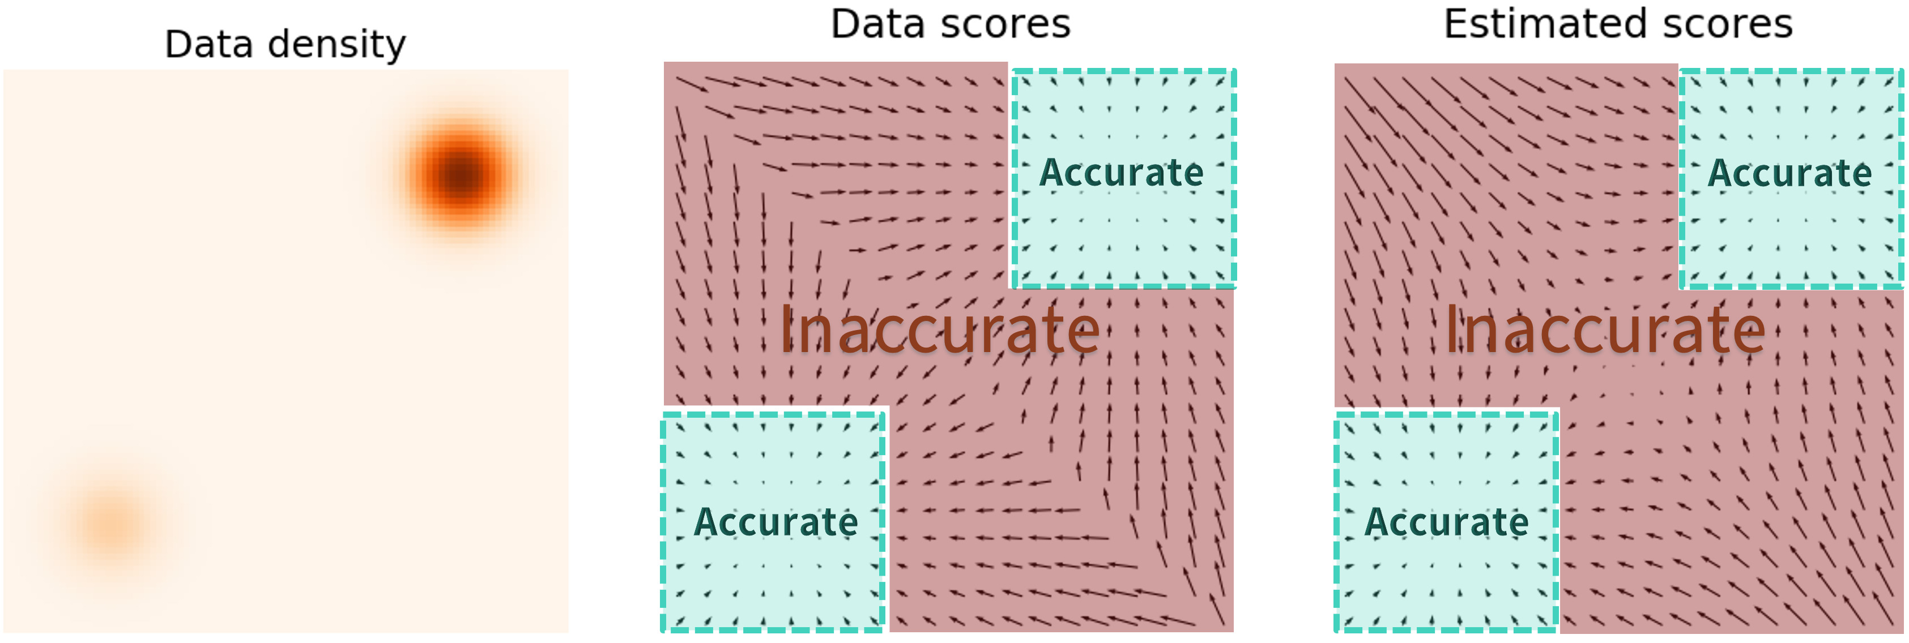
Naïve score-based model. Problems
According to the manifold hypothesis, real data resides on low dimensional manifolds, causing issues for the score matching objective, e.g. the score (gradient) is undefined outside these low dimensional manifolds.
Data being concentrated in regions results in further issues:
Incorrectly estimating the score within the low-density regions.
Langevin dynamics slowly, potentially never converging to the high-density region.
Credit images Yang Song: https://yangsong.net/blog/2021/score/
Notes:
However, this naïve approach has a few drawbacks linked with the estimation of the score function.
(Animatie 1)
Real data resides on low dimensional manifolds and this implies that the score function is undefined outside these manifolds.
(Animatie 2)
So, when starting with random points in the Langevin dynamics, those points will probably be outside the manifolds, and the estimation of the score function will be wrong, because the real one is undefined.
(Animatie 3)
In the image, we have a mixture of two Gaussians, and we can see that for most of the space, the estimated scores are inaccurate. This means that if the Langevin dynamics starts with a point in the red zone, then the method will probably not converge to the high density (green) regions.

Slide 37
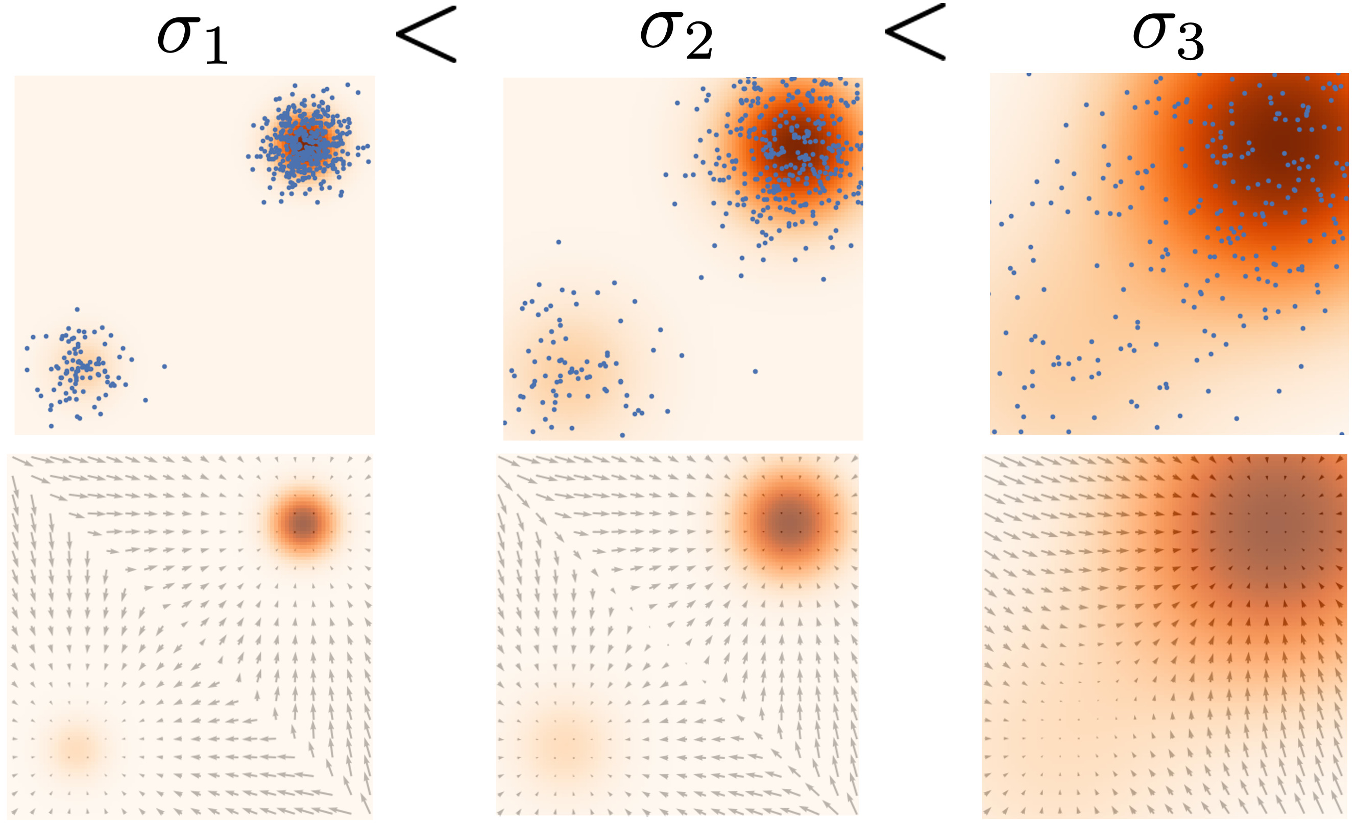
Noise Conditioned Score Network (NCSNs)
Solution:
Perturb the data with random Gaussian noise at different scales.
Learn score estimations for the resulting noisy distributions via a single noise conditioned score network.
Credit images Yang Song: https://yang-song.net/blog/2021/score/
Notes:
Animatie 1
The solution for the previous issues is to perturb the data with random Gaussian noise at different scales and learn the score functions of the resulting distributions.
At sampling time, we start with the larger noise scales and the Langevin dynamics is used for each noise scale at a time. The result from one noise scale will then be provided as input for the iterations of the next scale. We can see in the image, that this strategy helps us to cover the space much better.
Animatie 2
This approach can be addressed with a single network, if we learn to estimate the score functions conditioned on the noise level.

Slide 38
Noise Conditioned Score Network (NCSNs)
Given a sequence of Gaussian noise scales σ₁ < σ₂ < · · · < σ_{T} such that:
$p_{σ_{1}}\left(x\right)≈p(x_{0})$
$p_{σ_{T}}\left(x\right)≈ 𝒩(0, I)$
And the forward process, i.e. noise perturbation:
$$p_{σ_{t}}\left(x_{t}| x\right)=𝒩\left(x_{t};x, σ_{t}^{2}⋅I\right)= \frac{1}{σ_{t}⋅\sqrt{2π}} ⋅exp⁡\left(\frac{−1}{2} ⋅{\left(\frac{x_{t }−x}{σ_{t}}\right)}^{2}\right)$$
The gradient can be written as:
$$∇_{x_{t}}\log{p_{σ_{t}}\left(x_{t}| x\right)=− \frac{x_{t }−x}{σ_{t}^{2}}}$$
Notes:
(Animatie 1)
Formally, the new distributions are built such that the first one is approximating the true data distribution and the last one is almost equal with the standard gaussian distribution.
(Animation 2)
The noise perturbation is formally described by sampling from this normal distribution, where sigma_t is the noise scale for the time step t.
(Animation 3)
The score function of these normal distributions can be computed given the original image x. So, all the components are available for training the network via score matching.

Slide 39
Noise Conditioned Score Network (NCSNs)
Training the NCSN with denoising score matching, the following objective is minimized:
$$ℒ_{dsm}= \frac{1}{T}\sum_{t=1}^{T}{𝔼_{p(x)}𝔼_{p_{σ_{t}}(x_{t}|x)}}{\left\|s_{θ}\left(x_{t}, σ_{t}\right)+ \frac{x_{t} −x}{σ_{t}^{2}}\right\|}_{2}^{2}$$
Notes:
Using the denoising score matching objective, which was previously mentioned, we obtain this final objective to train the noise conditioned score networks.

Slide 40
Noise Conditioned Score Network (NCSNs)
To train the NCSN with denoising score matching, the following objective is minimized:
$$ℒ_{dsm}= \frac{1}{T}\sum_{t=1}^{T}{λ\left(σ_{t}\right)𝔼_{p(x)}𝔼_{p_{σ_{t}}(x_{t}|x)}}{\left\|s_{θ}\left(x_{t}, σ_{t}\right)+ \frac{x_{t} −x}{σ_{t}^{2}}\right\|}_{2}^{2}$$
Weighting function
Notes:
Moreover, the objective is enhanced with a weighting function which depends on the noise level that can be used to assign higher importance to the larger noise scales.

Slide 41
Noise Conditioned Score Network (NCSNs). Sampling
Annealed Langevin dynamics
Parameters:
$N$ – number of iterations for Langevin dynamics
$σ_{0}<σ_{1}<$ … < $σ_{T}$ - noise scales
${\{γ}_{t}\left| t=1, T\right\}$ - update magnitude
Algorithm:
$$x_{T}^{0} \sim 𝒩(0,I)$$
for t $=T,1$ do:
for $i=1, N$ do:
$z_{t}\sim 𝒩(0,I)$
$x_{t}^{i}= x_{t}^{i−1}+ \frac{γ_{t}}{2} ⋅s_{θ}\left(x_{t}^{i−1}, σ_{t}\right)+ \sqrt{γ_{t}}z_{t}$
$x_{t−1}^{0}= x_{t}^{N}$
return $x_{0}$
Notes:
(Animatie 1)
The sampling procedure of the noise conditioned score networks is called Annealed Langevin dynamics.
(Animatie 2)
The parameters of this procedure are the following:
(Animatie 3)
N is the number of iterations of the Langevin dynamics method
(Animatie 3)
The noise scales
(Animatie 4)
And gamma which is the update magnitude used in the Langevin dynamics iterations
(Animatie 5)
The steps of the Annealed Langevin dynamics procedure are the following:
(Animatie 6)
We sample some standard gaussian noise
(Animatie 7)
We start from the largest noise scale, which is denoted by the time step T.
(Animatie 8)
And then, for N iterations, we execute the Langevin dynamics updates
(Animatie 9)
For that, we need some noise for the last term and the score estimation from our neural network
(Animatie 10)
At the end, we transfer the result to the next noise scale and restart the process.
(Animatie 11)
The final output is the sample obtained for the smallest noise scale.

Slide 42
DDPM vs NCSN. Losses
DDPM: $ℒ_{simple }={ \frac{1}{T}\sum_{t=1}^{T}{𝔼_{x_{0}\sim p\left(x_{0}\right), z_{t}\sim 𝒩\left(0,I\right)}}}_{ }{{\left\|z_{θ}\left(x_{t}, t\right)−z_{t}\right\|}_{2}^{2}}$
NCSN: $ℒ_{dsm}= \frac{1}{T} \sum_{t=1}^{T}{λ(σ_{t})𝔼_{x_{0}\sim p\left(x_{0}\right), {x_{t}\sim p}_{σ_{t}}(x_{t}|x_{0})}{\left\|s_{θ}\left(x_{t}, σ_{t}\right)+\frac{x_{t} − x_{0}}{σ_{t}^{2}}\right\|}_{2}^{2}}$
In $ℒ_{simple}$, the weighting function is missing because the authors observed better sample quality when the weight is set to 1.
We can rewrite the noise ${ z}_{t}$ as follows:
$x_{t} \sim 𝒩\left(x_{t}; x_{0}, σ_{t}^{2}Ι\right)⇒x_{t}=x_{0}+ σ_{t}⋅z_{t},{ z}_{t} \sim 𝒩\left(0, I\right)⇒ { z}_{t}= \frac{x_{t} −x_{0}}{σ_{t}}$
So, $s_{θ}\left(x_{t}, σ_{t}\right)$ learns to approximate a scaled negative noise $\frac{{−z}_{t}}{σ_{t}}$.
Notes:
Now that we have the two formulations covered, let’s go again through their losses and sampling procedures to see that they are actually very similar.
(Animatie 1)
If we look closer at the two loss functions for DDPM and NCSN, we can observe common aspects between them.
(Animatie 2)
First of all, the weighting function is missing from L_simple because it was a choice made by the authors based on empirical evidence. Therefore, the two losses are actually identical from this point of view.
(Animatie 3)
Secondly, one can say that the two losses are different because one approximates the noise from the image and the other the score function. However, the score function is actually proportional with the negative noise and this is compensated by the sampling procedure.

Slide 43
DDPM vs NCSN. Sampling
From the sampling equations, we can see that the iterative updates are based on subtracting some form of noise from the noisy image.
This is true also for NCSN because $s_{θ}\left(x_{t}^{i−1}, σ_{t}\right)$approximates the negative of the noise.
DDPM: $x_{t −1}= \frac{1}{\sqrt{α_{t}}} \left(x_{t }− \frac{1 − α_{t}}{\sqrt{1−{\hat{β}}_{t}}} z_{θ}\left(x_{t}, t\right)\right)+ \sqrt{β_{t}}⋅z_{t}$
NCSN: $x_{t}^{i}= x_{t}^{i−1}+ \frac{γ_{t}}{2} ⋅s_{θ}\left(x_{t}^{i−1}, σ_{t}\right)+ \sqrt{γ_{t}}{⋅z}_{t}$
Therefore, the generative processes defined by NCSN and DDPM are very similar.
Notes:
(Animatie 1)
From the sampling equations, we can see that the iterative updates are based on subtracting some form of noise from the noisy image.
(Animatie 2)
This is true also for NCSN because $s_{θ}\left(x_{t}^{i−1}, σ_{t}\right)$ approximates the negative of the noise.
(Animatie 3)
Therefore, the generative processes defined by NCSN and DDPM are very similar.

Slide 44
Outline
Motivation
High-level overview
Denoising diffusion probabilistic models
Noise Conditioned Score Network
Stochastic Differential Equations
Conditional Generation
Research directions
Notes:
Further, we will see that the previous two formulations can be generalized under the same framework.

Slide 45
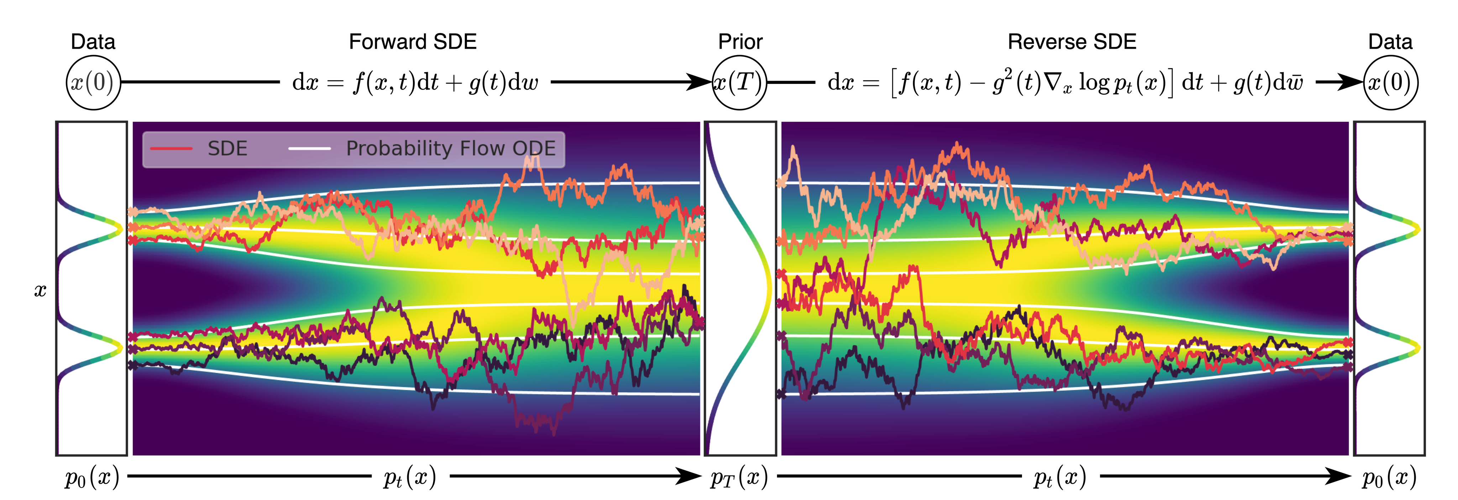
Stochastic Differential Equations (SDEs)
The original data distribution $p_{0}(x)$ is transformed into the noise distribution $pT(x)$ according to the SDE
The original data is generated back (undoing the forward process) by reversing the SDE
As it can be seen in the Reverse SDE, the score is also used , same as for NCSNs
The Probability Flow ODE represents a deterministic ODE after which the backward diffusion process can be done (mostly by removing the Wiener process)
The speed of the sampling is increased at the expense of the quality of synthesis
Credit images: Song, Yang, et al. "Score-based generative modeling through stochastic differential equations." arXiv preprint arXiv:2011.13456 (2020).
Notes:
The third formulation of diffusion considers the forward and reverse processes to be continuous and defines them via stochastic differential equations.
(Animatie 1)
The principle is the same, gradually transforms the data into noise and reverse the process to obtain samples from the true data distribution.

Slide 46
Stochastic Differential Equations (SDEs)
The forward diffusion process is represented by the following SDE:
$$\frac{∂x}{∂t}=f\left(x, t\right)+σ\left(t\right)ω_{t} ⟺∂x=f\left(x, t\right)∂t+ σ(t)⋅∂ω_{t}$$
Notation for: $𝒩(0, ∂t)$
Function for drift coefficient: gradually nullifies the data x0
White Gaussian
noise
Function for diffusion coefficient: controls how much Gaussian noise is added
Notes:
(Animatie 1)
The SDE of the forward process is also called the forward SDE and basically shows that the transformation of the image x into noise is performed via very small changes in x.
(Animatie 2)
These changes are defined by the function f and the noise addition w_t, (animatie 3) the noise additions are scaled with the diffusion coefficient sigma_t.
We emphasize that different choices of f and sigma will imply different forward processes, and this is what happened with the previous two formulations. They are slightly different because f and sigma are different.

Slide 47
Stochastic Differential Equations (SDEs)
The reverse-time SDE is defined as:
$$∂x=[f\left(x, t\right) − {σ\left(t\right)}^{2} ⋅∇_{x}log p_{t}\left(x\right)]∂t+ σ(t) ⋅∂\hat{ω}$$
The training objective is similar to NCSN, but adapted for continuous time:
$$ℒ_{dsm}^{∗}=𝔼_{t}\left[λ\left(t\right)𝔼_{p(x_{0})}𝔼_{p_{t}(x_{t}|x_{0})}{\left\|s_{θ}\left(x_{t}, t\right)+∇_{x_{t}}\log{p_{t}\left(x_{t} | x_{0}\right)}\right\|}_{2}^{2}\right]$$
The score function is used in the reverse-time SDE:
It employs a neural network to estimate the score function.
Then uses a numerical SDE solver to generate samples.
Notes:
An important result shows that the reverse of the previous forward process is also a diffusion process running backwards in time. (Animatie 1) And it is described by this SDE, called the reverse-time SDE.
This equation is very intuitive if we think about it as in Langevin dynamics iterations, where we updated x to go from low density regions to regions with higher density. The same thing is happening here, we use the score function with the same purpose, but the formulation is generalized to the continuous case.
( Animatie 2)
The training objective remains the same as in NCSN, because the goal is to estimate the score function.
(Animatie 3)
The sampling is performed by employing numerical methods to solve the reverse-time SDE.

Slide 48
Stochastic Differential Equations (SDEs). NCSN
The Markovian process of NCSN:
$$x_{t} \sim 𝒩\left(x_{t};x_{t−1}, {(σ}_{t}^{2} − σ_{t−1}^{2})⋅I\right)⇒ x_{t}= x_{t−1}+ \sqrt{{(σ}_{t}^{2} − σ_{t−1}^{2})}⋅z_{t}$$
We can reformulate the above expression to look like a discretization of an SDE:
$$x_{t}− x_{t−1}= \sqrt{\frac{{(σ}_{t}^{2} − σ_{t−1}^{2})}{t −(t−1)}}⋅z_{t}$$
Translating the above discretization in the continuous case, will result in the forward SDE of NCSN:
$$∂x=\sqrt{\frac{ ∂σ^{2}\left(t\right)}{∂t}}∂ω(t)$$
Notes:
We will briefly show how to transform the noise perturbations of NCSN and DDPM into their corresponding forward SDE.
We start with NCSN, and we do it by rewriting the forward process (Animatie 1) as an SDE discretization (Animatie 2).
(Animatie 3)
After that, we adapt the expression for the continuous case. So, all the variables are now time-dependent functions, and the changes of these functions are now measured for an infinitesimal small change of time.
A small observation for this case, is that the drift coefficient f is constant, being equal to 0.

Slide 49
Stochastic Differential Equations (SDEs). DDPM
The Markovian process of DDPM:
$$x_{i}\sim 𝒩\left(x_{i};\sqrt{1−β_{i}}∙x_{i−1}, β_{i}I\right)⇒x_{i}=\sqrt{1−β_{i}}∙x_{i−1}+ \sqrt{β_{i}}⋅z_{i}$$
If we consider time step size $∆t= \frac{1}{T}$, instead of 1, and $β\left(t\right)=β\left(\frac{i}{T}\right)=β_{i}$:
$$x_{t}=\sqrt{1−β(t)∆t}∙x_{t−∆t}+ \sqrt{β(t)∆t}⋅z_{t}$$
Using Taylor expansion because $∆t≪1$:
$x_{t}≈x_{t−∆t} − \frac{β\left(t\right)∆t}{2}∙x_{t−∆t}+ \sqrt{β\left(t\right)∆t}⋅z_{t} ⟺x_{t} − x_{t−∆t}= − \frac{β\left(t\right)∆t}{2}∙x_{t}+ \sqrt{β\left(t\right)∆t}⋅z_{t}$
For the continuous case, the above becomes:
$∂x=−\frac{1}{2} β\left(t\right)x_{t}∂t+ \sqrt{β(t)}∂ω(t)$
Notes:
(Animatie 1)
Similar to NCSN, for DDPM, we start from the markovian formulation of the forward process.
(Animatie 2)
We replace Beta_t with a product between delta_t and Beta(t), where delta_t is 1/T and Beta(t) is Beta_t multiplied with capital T. So, these changes are just a rewriting of Beta_t, they are necessary because the link with the SDE formulation will be more obvious with these notations.
(Animatie 3)
We extend the square root of the first term from the right-hand side of the equality with the Taylor expansion, we only limit ourselves to the first 2 terms of this expansion because delta_t is very close to zero and the following terms would contain this value at increasing powers.
After this operation, we are able to describe the change in x in the discrete setting.
(Animatie 4)
Generalizing this change for the continuous case, we obtain the forward SDE of DDPM.

Slide 50
Outline
Motivation
High-level overview
Denoising diffusion probabilistic models
Noise Conditioned Score Network
Stochastic Differential Equations
Conditional Generation
Research directions
Notes:
Let’s see now how to use this models to perform conditional generation.

Slide 51
Conditional generation
Diffusion models estimate the score function, $∇_{x_{t}}log p_{t}\left(x_{t}\right)$to sample from a distribution$p\left(x\right)$.
Sampling from the conditional $p\left(x | y\right)$ requires the score function of this probability density, $∇_{x_{t}}\log{p_{t}\left(x_{t} | y\right)}.$
Solution 1. Conditional training: just train the model with an additional input $y$ to estimate $∇_{x_{t}}\log{p_{t}\left(x_{t} | y\right)}.$
$s_{θ}\left(x_{t}, t, y\right)≈$ $∇_{x_{t}}\log{p_{t}\left(x_{t} | y\right)}$
$$x_{t}$$
$$t$$
MLP
One-hot encoding
$$y$$
MLP
Notes:
(Animatie 1)
So far, we saw how to use diffusion models for unconditional image sampling by estimating the score function.
(Animatie 2)
Another equally interesting application is conditional sampling. Given an additional input y (such as a class label or text) the task is to generate images that correspond to this input. In other words, we want to sample from p(x|y), instead of p(x).
(Animatie 3)
One option is to train the model with an additional input y so that the model learns to estimate the score function of p(x|y).
(Animatie 4)
If y is a class, we can represent it as a one-hot encoding. (Animatie 5) And this representation is processed by a multi-layer perceptron before using it in the U-Net layers.
If y is a text, we can use the representation resulting from a transformer.

Slide 52
Conditional generation. Classifier Guidance
Diffusion models estimate the score function, $∇_{x_{t}}log p_{t}\left(x_{t}\right)$, to sample from a distribution$p\left(x\right)$.
Sampling from the conditional $p\left(x | y\right)$ requires the score function of this probability density, $∇_{x_{t}}\log{p_{t}\left(x_{t} | y\right)}.$
Solution 2. Classifier guidance:
$$p_{t}\left(x_{t} | y\right)=\frac{p_{t}\left(y | x_{t}\right)⋅p_{t}(x_{t})}{p_{t}(y)}⟺$$
Logarithm:
$$\log{p_{t}\left(x_{t} | y\right)=\log{p_{t}\left(y | x_{t}\right)+\log{p_{t}\left(x_{t}\right)−\log{p_{t}\left(y\right)} ⟺}}}$$
Gradient:
$$∇_{x_{t}}\log{p_{t}\left(x_{t} | y\right)=∇_{x_{t}}\log{p_{t}\left(y | x_{t}\right)+∇_{x_{t}}\log{p_{t}(x_{t})} −∇_{x_{t}}\log{p_{t}(y)}}}⟺$$
$$∇_{x_{t}}\log{p_{t}\left(x_{t} | y\right)=∇_{x_{t}}\log{p_{t}\left(y | x_{t}\right)+∇_{x_{t}}\log{p_{t}(x_{t})}}}$$
Classifier
Unconditional diffusion model
Notes:
(Animatie 1)
The second option to implement conditional sampling is called classifier guidance which basically requires an unconditional generative model and a classifier trained on noisy images.
(Animatie 2)
If we apply Bayes rule on the conditional p_t(x_|y), we have this equality.
(Animatie 3)
But the score function uses the logarithm of the probability density, so we apply the logarithm on both sides.
(Animatie 4)
Lastly, if we compute the gradients with respect to x_t the last term becomes zero, because it does not depend on x_t.
(Animatie 5)
The resulting expression states that we can compute the score function of p(x_t|y) as a sum between the score function of p(y|x_t) and p(x).
(Animatie 6)
The latter is what diffusion models already learn, (animatie 7)while the first conditional p(y|x) is what the standard classifiers learn.
So, in order to use the score function of p(x|y) in the denoising steps of diffusion models it is sufficient to have an unconditional diffusion model and a classifier that is robust on noisy images.

Slide 53
Conditional generation. Classifier Guidance
Solution 2. Classifier guidance:
$$∇_{x_{t}}\log{p_{t}\left(x_{t} | y\right)={s ⋅∇}_{x_{t}}\log{p_{t}\left(y | x_{t}\right)+∇_{x_{t}}\log{p_{t}(x_{t})}}}$$
Guidance weight
Here, the guidance weight is $s=1$
Here, the guidance weight is $s=10$
The image contains samples generated with classifier guidance for the class “hamster”.
We can see that the images are more aligned to the conditional class when the weight is larger, but the diversity of the samples decreases.
Notes:
(Animatie 1)
An improvement that can be done, in order to force the generation to be more precise, is to add a weight to the guidance term.
(Animatie 2)
On the left-hand side the guidance weight is equal to 1.
(Animatie 3)
And on the right-hand side the guidance weight is equal to 10.
(Animatie 4)
As we can observe in the figure, when the weight is large the images are more class-consistent, and the diversity of the samples decreases.

Slide 54
Conditional generation. Classifier-free Guidance
Solution 3. Classifier-free guidance
$$∇_{x_{t}}\log{p_{t}\left(x_{t} | y\right)={s ⋅∇}_{x_{t}}\log{p_{t}\left(y | x_{t}\right)+∇_{x_{t}}\log{p_{t}(x_{t})}}}$$
Bayes rule:
$$p_{t}\left(y | x_{t}\right)= \frac{p_{t}\left(x_{t}\right|y) ⋅p_{t}(y)}{p_{t}(x_{t})}$$
Logarithm:
$$\log{p_{t}\left(y | x_{t}\right)=\log{p_{t}\left(x_{t} | y\right)−\log{p_{t}\left(x_{t}\right)+\log{p_{t}(y)}}}}$$
Gradient:
$$∇_{x_{t}}\log{p_{t}\left(y | x_{t}\right)=∇_{x_{t}}\log{p_{t}\left(x_{t} | y\right)−∇_{x_{t}}\log{p_{t}(x_{t})}}}$$
$$∇_{x_{t}}\log{p_{t}\left(x_{t} | y\right)={s ⋅(∇}_{x_{t}}\log{p_{t}\left(x_{t} | y\right)−∇_{x_{t}}\log{p_{t}(x_{t})})+∇_{x_{t}}\log{p_{t}\left(x_{t}\right)}}}$$
$$∇_{x_{t}}\log{p_{t}\left(x_{t} | y\right)={s ⋅∇}_{x_{t}}\log{p_{t}\left(x_{t} | y\right)+{\left(1−s\right)⋅∇}_{x_{t}}\log{p_{t}\left(x_{t}\right)}}}$$
Learned by a single model
Notes:
The main problem of the second solution is the classifier, because we need to have good estimates for the gradients at each step of the denoising process, thus we need a classifier that is robust to noise added to the image. This often means training the classifier on noisy data, which can be problematic. This issue is what the second guidance technique addresses, which is called classifier-free guidance.
(Animatie 1)
If we expand the conditional p(y|x_t) with the Bayes rule and then (animatie 2) apply the logarithm on both sides, we obtain this.
(Animatie 3)
If we compute the gradients with respect to the noisy image x_t, we have an expression for the classifier gradients.
(Animatie 4)
We can use this to replace it in the classifier guidance formulation and we obtain the following.
(Animatie 5)
The result is a combination between conditional and unconditional models, but with a small trick (animatie 6) we train a single neural network for both cases

Slide 55
Conditional generation. Classifier-free Guidance
$$s_{θ}\left(x_{t}, t,y \right)≈∇_{x_{t}}\log{p_{t}\left(x_{t} | y\right)}$$
$$x_{t}$$
$$t$$
MLP
$$y$$
MLP
Notes:
The two score functions can be learned at the same time by a single model, we just need at training time to discard y with a fixed probability.

Slide 56
Conditional generation. Classifier-free Guidance
$$s_{θ}\left(x_{t}, t,y/0 \right)≈∇_{x_{t}}\log{p_{t}\left(x_{t} | y\right)}/∇_{x_{t}}\log{p_{t}(}x_{t})$$
$$x_{t}$$
$$t$$
MLP
$y$/$0$
MLP
Notes:
The discard of y is done by setting its embedding to a vector that has all of its elements equal to 0.

Slide 57
Outline
Motivation
High-level overview
Denoising diffusion probabilistic models
Noise Conditioned Score Network
Stochastic Differential Equations
Conditional Generation
Research directions
Notes:
Finally, we will cover shortly the main directions of research for diffusion models

Slide 58
Research directions
Unconditional image generation:
Sampling efficiency
Image quality
Conditional image generation:
Text-to-image generation
Complex tasks in computer vision:
Image editing, even based on text
Super-resolution
Image segmentation
Anomaly detection in medical images
Video generation
Notes:
The most frequent tasks on which diffusion models were employed are the unconditional and conditional image generation.
(Animatie 1)
For the unconditional case the focus was on improving the efficiency and the quality of the generated images.
(Animatie 2)
While the conditional case become very popular with text-to-image generation.
(Animatie 3)
Besides these two tasks, this type of models were also employed in:
(Animatie 4)
Image editing and even editing based on text input
(Animatie 5)
Super-resolution
(Animatie 6)
Image segmentation
(Animatie 7)
Anomaly detection in medical images
Or
(Animatie 8)
Video generation.

Slide 59
Future directions
Since diffusion models have already surpassed GANs and other generative models, the early phase of the research results in plenty future directions:
Increase the efficiency of sampling.
Multiple applications within computer vision: dehazing, video anomaly detection, etc.
Discriminative tasks:
Directly on classification or regression tasks.
Indirectly, by increasing / augmenting the training set.
Simulate the continuation of videos.
Notes:
Although the results of diffusion models is promising, even surpassing GANs, the early phase of the research gives us plenty of future directions

