Slide 1
Fooling CNNs. Adversarial Examples. Robustness to Adversarial Examples. Copying Black-Box Models
Radu Ionescu, Prof. PhD.
raducu.ionescu@gmail.com
Faculty of Mathematics and Computer Science
University of Bucharest

Slide 2
Presentation Overview
Intriguing Properties of Neural Networks (2014)
Deep Neural Networks are Easily Fooled: High Confidence Predictions for Unrecognizable Images (2015)
Deep Dream (2015)
Explaining and Harnessing Adversarial Examples (2015)
Towards Deep Neural Network Architectures Robust to Adversarial Examples (2015)
Black-Box Ripper: Copying black-box models using generative evolutionary algorithms (2020)

Slide 3
Intriguing Properties of Neural Networks
Christian Szegedy, Wojciech Zaremba, Ilya Sutskever, Joan Bruna, Dumitru Erhan, Ian Goodfellow, Rob Fergus
ICLR 2014

Slide 4
Intriguing Findings
No distinction between individual high-level units and their random linear combinations
Networks can misclassify an image if we apply certain specific hardly perceptible perturbations to the image
These distorted images or adversarial examples generalize fairly well even with different hyperparameters as well as data sets

Slide 5
Experimental setup
1. Fully-connected layers with softmax layer trained on MNIST dataset – "FC"
2. Krizhevsky et al. architecture trained on ImageNet dataset – "AlexNet"
3. Unsupervised trained network trained on 10M image samples from Youtube – "QuocNet"

Slide 6
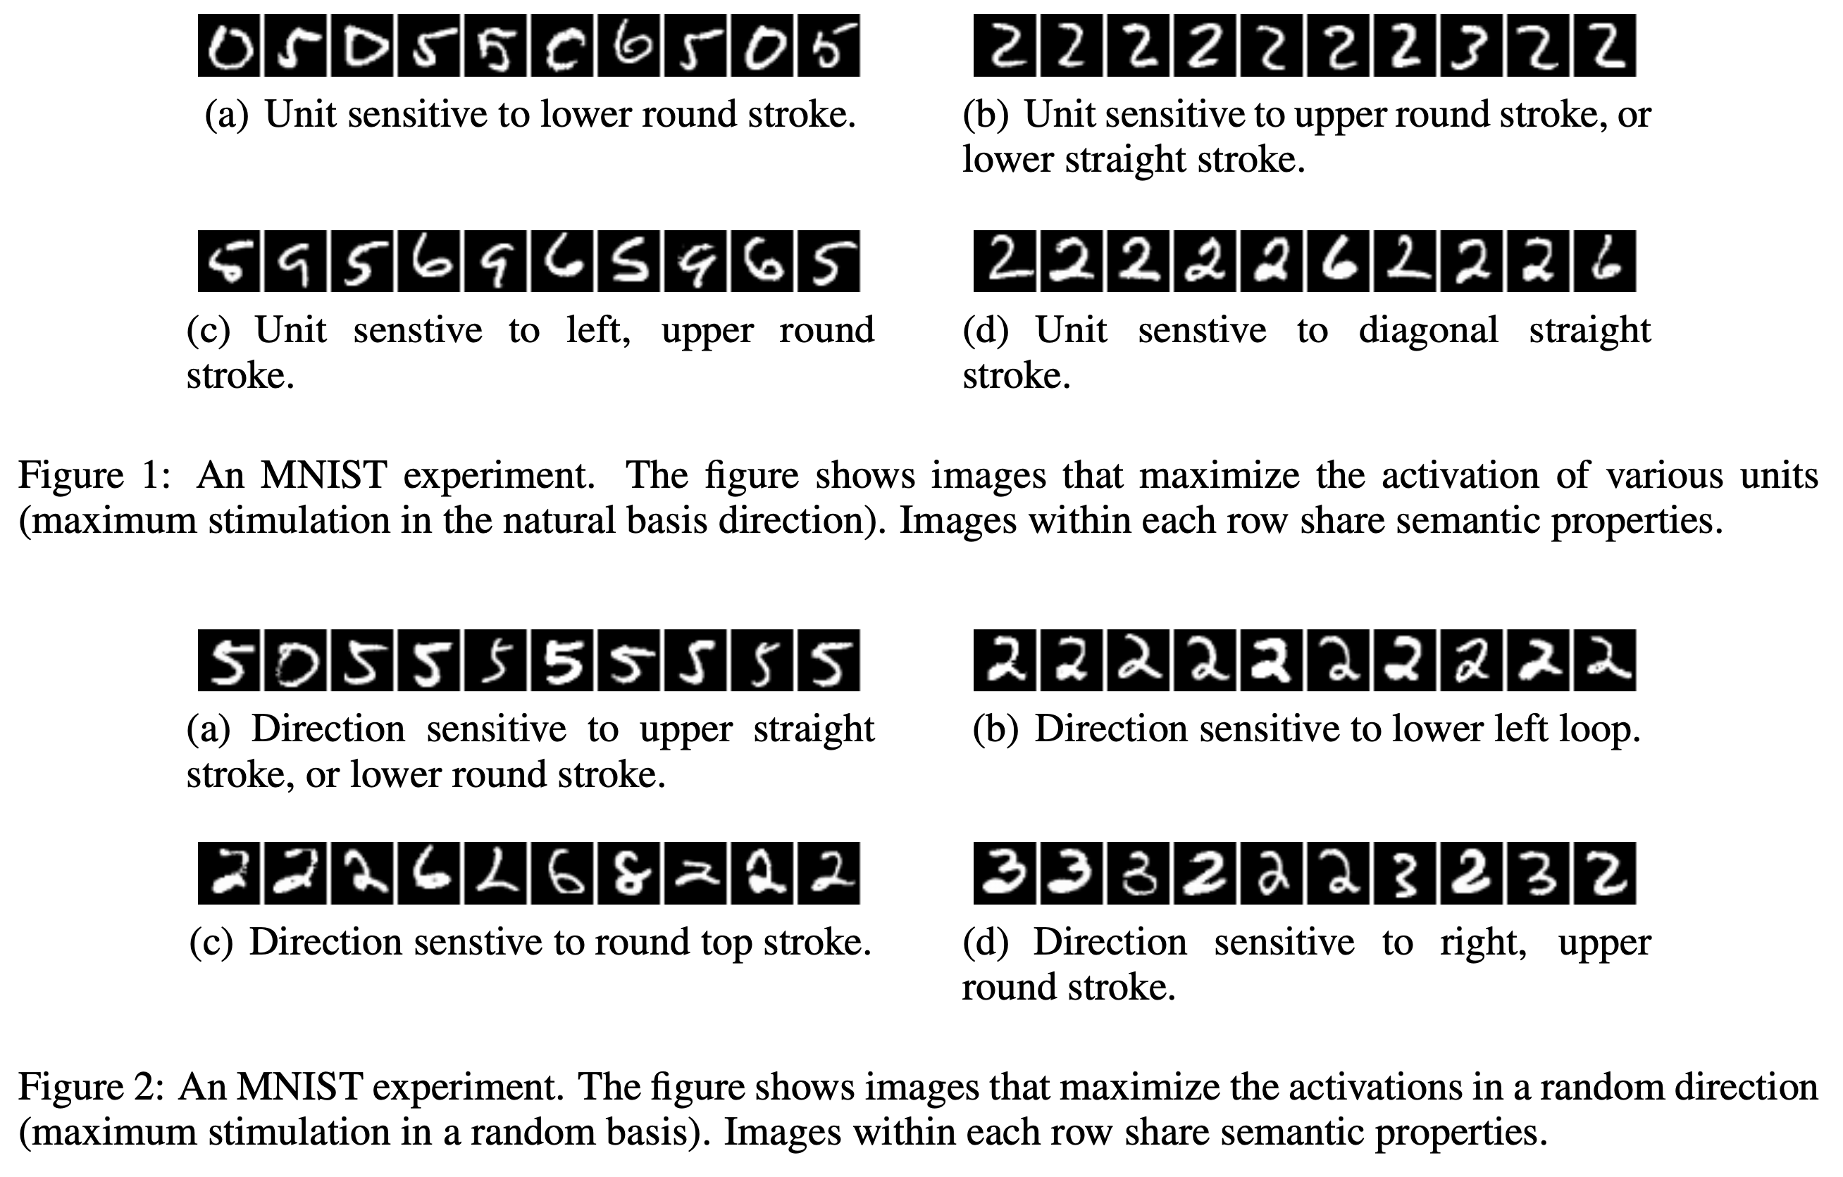
Interpretation of Higher Units
Notes:
Images that maximize activations in basis direction, image that maximize activations in random directions
Images in both cases are quite similar the space of these units rather than individual units contain the semantic information
This suggests that the natural basis is not better than a random basis for inspecting the properties
of φ(x). This puts into question the notion that neural networks disentangle variation factors across
coordinates.

Slide 7
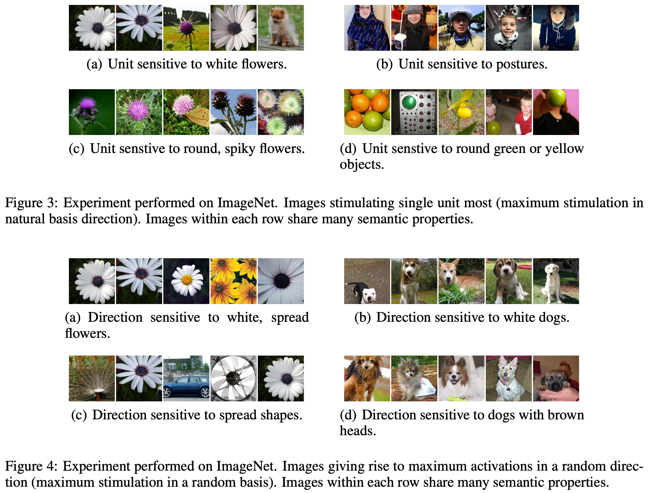
Interpretation of Higher Units
Notes:
Images that maximize activations in basis direction, image that maximize activations in random directions
Images in both cases are quite similar the space of these units rather than individual units contain the semantic information
This suggests that the natural basis is not better than a random basis for inspecting the properties
of φ(x). This puts into question the notion that neural networks disentangle variation factors across
coordinates.

Slide 8
Generating Adversarial Examples
Changing an image, originally correctly classified, in a way imperceptible to human eyes, can cause a net to label the image as something else entirely.
Notes:
Deep Neural
Networks learn input-output mappings that are
discontinuous to a significant extent.

Slide 9
Generating Adversarial Examples
Notes:
Deep Neural Networks learn input-output mappings that are
discontinuous to a significant extent.
L-BFGS an optmization algorithm like gradient descent

Slide 10
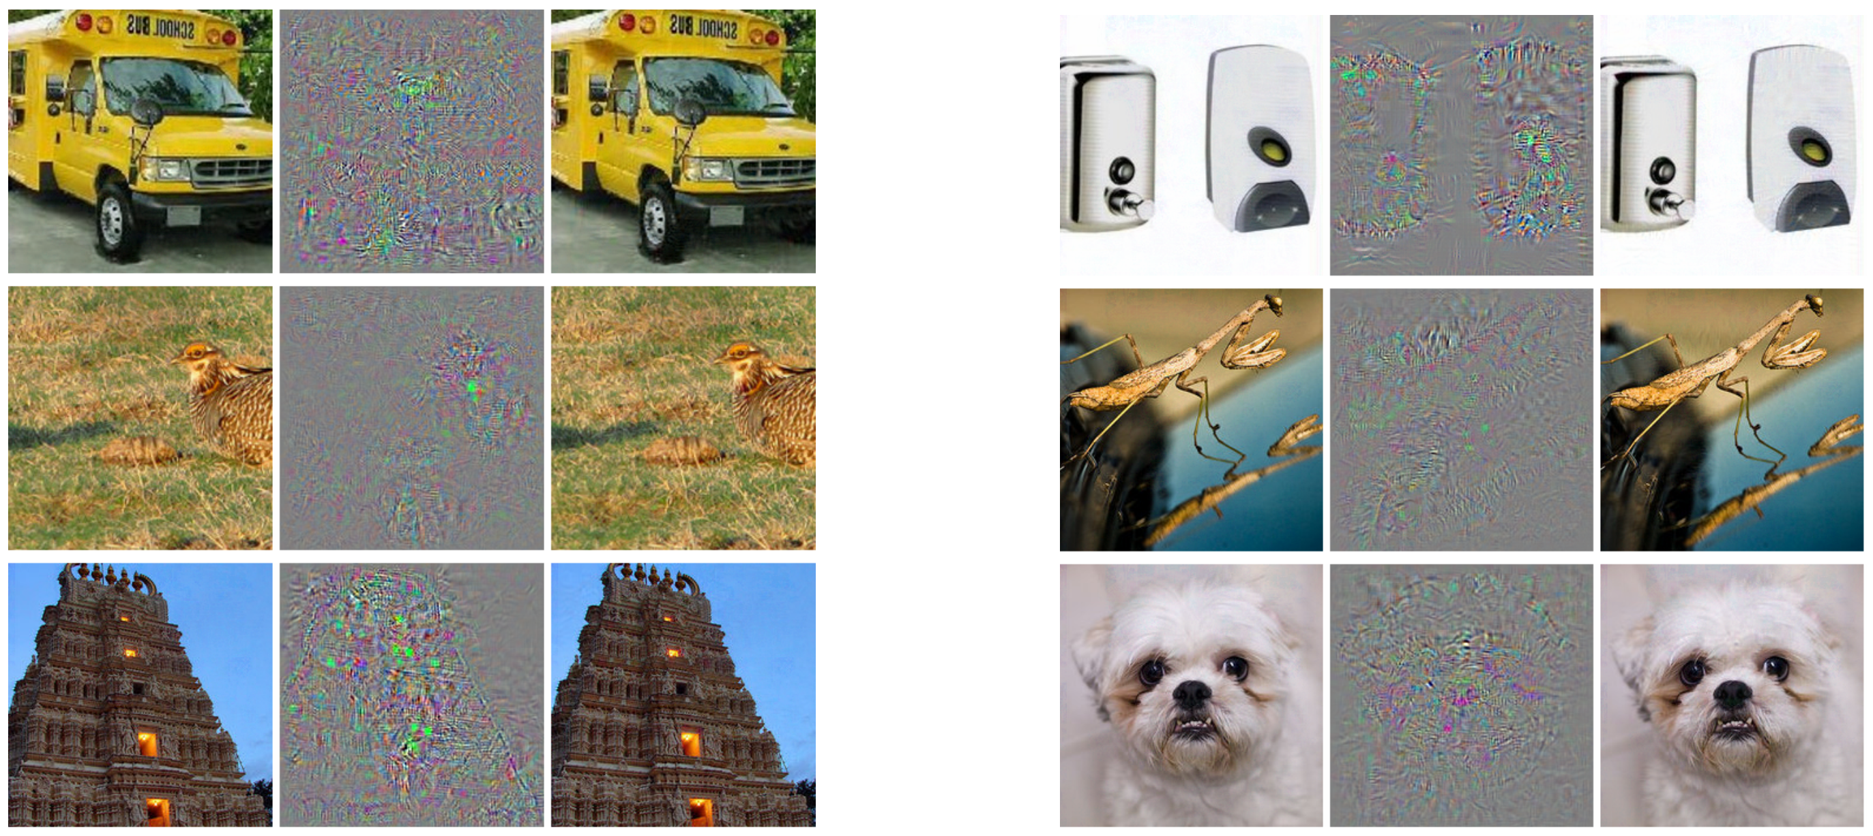
Adversarial Examples
All images in the right column are classified as ostrich.
Notes:
Deep Neural
Networks learn input-output mappings that are
discontinuous to a significant extent.

Slide 11
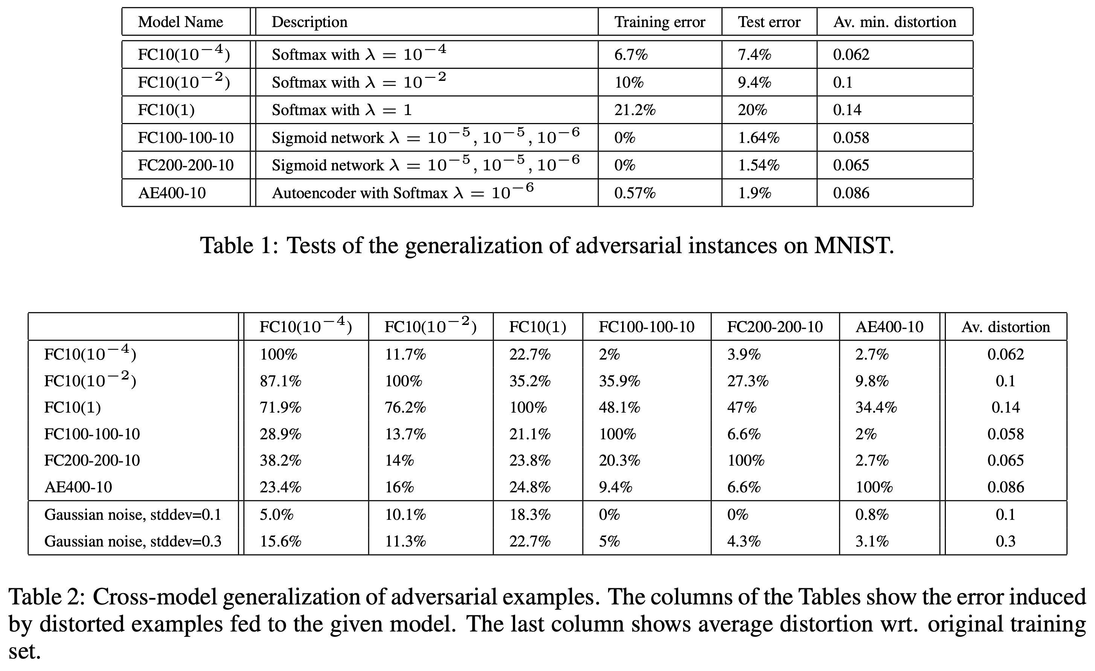
Cross generalization over hyperparameters
Last column is the minimum average pixel level distortion necessary to reach 0% accuracy on the training set. Last two rows show the error induced when distorting by the given amounts of Gaussian noise.
Notes:
The general conclusion is that adversarial examples tend to stay hard even for models trained with different hyperparameters.
Although the autoencoder based version seems most resilient to adversarial examples, it is not fully immune either.

Slide 12
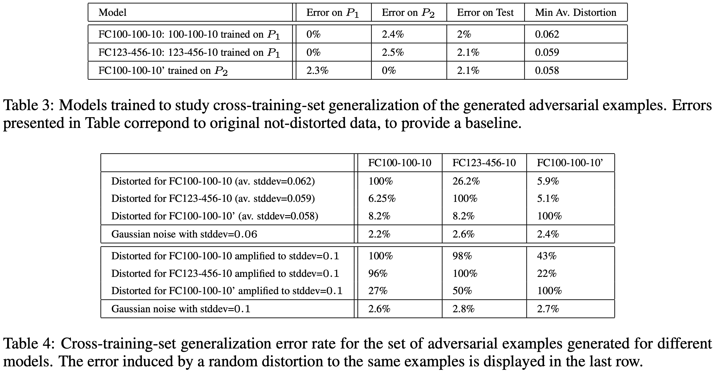
Cross generalization over datasets
To study cross-training-set generalization, the authors partitioned the 60000 MNIST training images into two parts P1 and P2 of size 30000 each and trained 3 non-convolutional networks with sigmoid activations.
Notes:
The intriguing conclusion is
that the adversarial examples remain hard for models trained even on a disjoint training set, although
their effectiveness decreases considerably

Slide 13
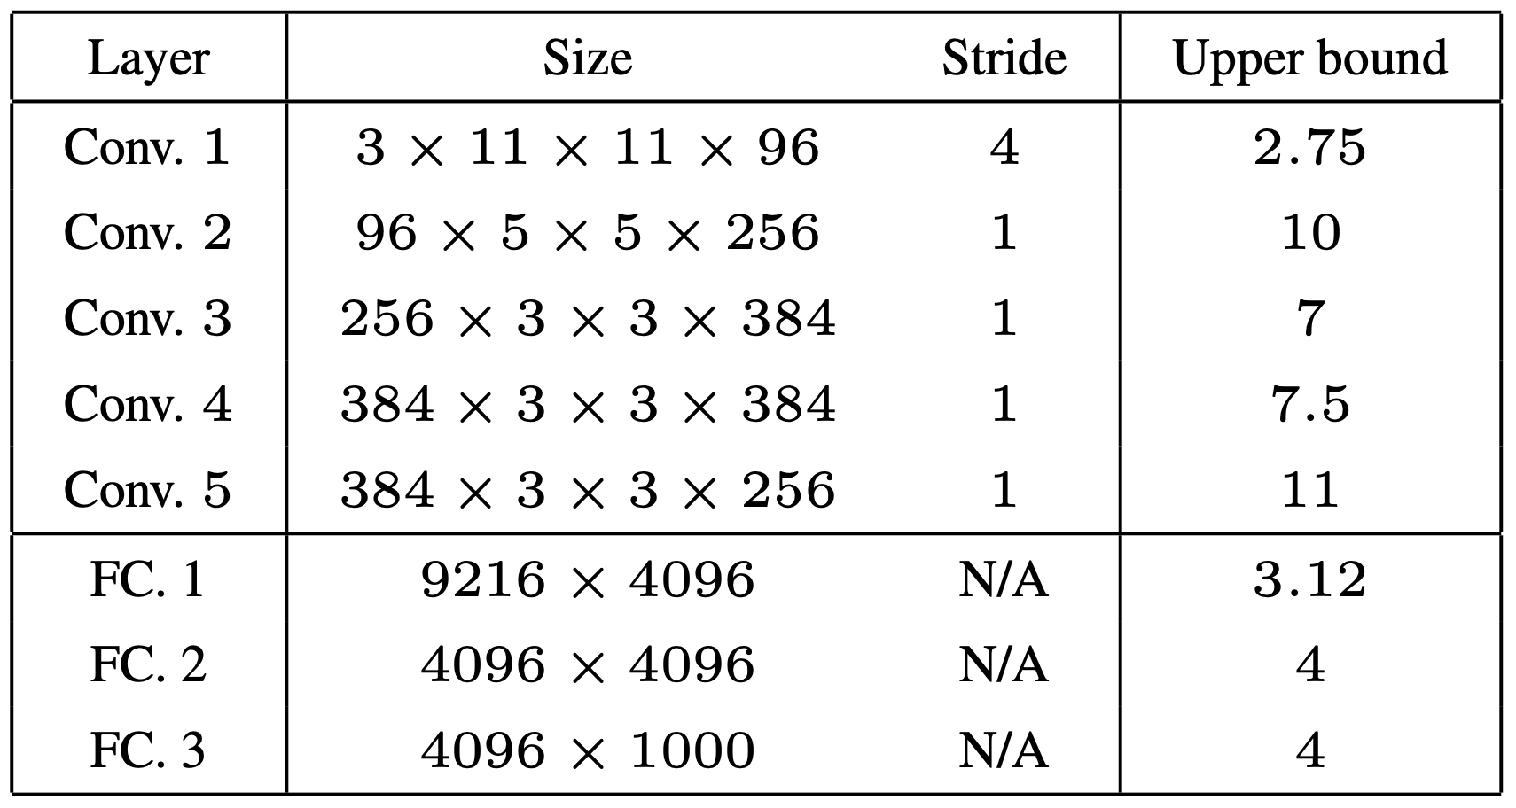
Spectral Analysis of Instability
φ(x) denotes the output of a network of K layers:
The instability of φ(x) can be explained by inspecting the upper Lipschitz constant of each layer:
Large bounds do not automatically translate into existence of adversarial examples; however, small bounds might guarantee that no such examples can appear.
Notes:
The instability of φ(x) can be explained by inspecting the upper Lipschitz constant of each layer.
Large bounds do not automatically translate into existence of adversarial examples; however, small bounds might guarantee that no such examples
can appear.

Slide 14
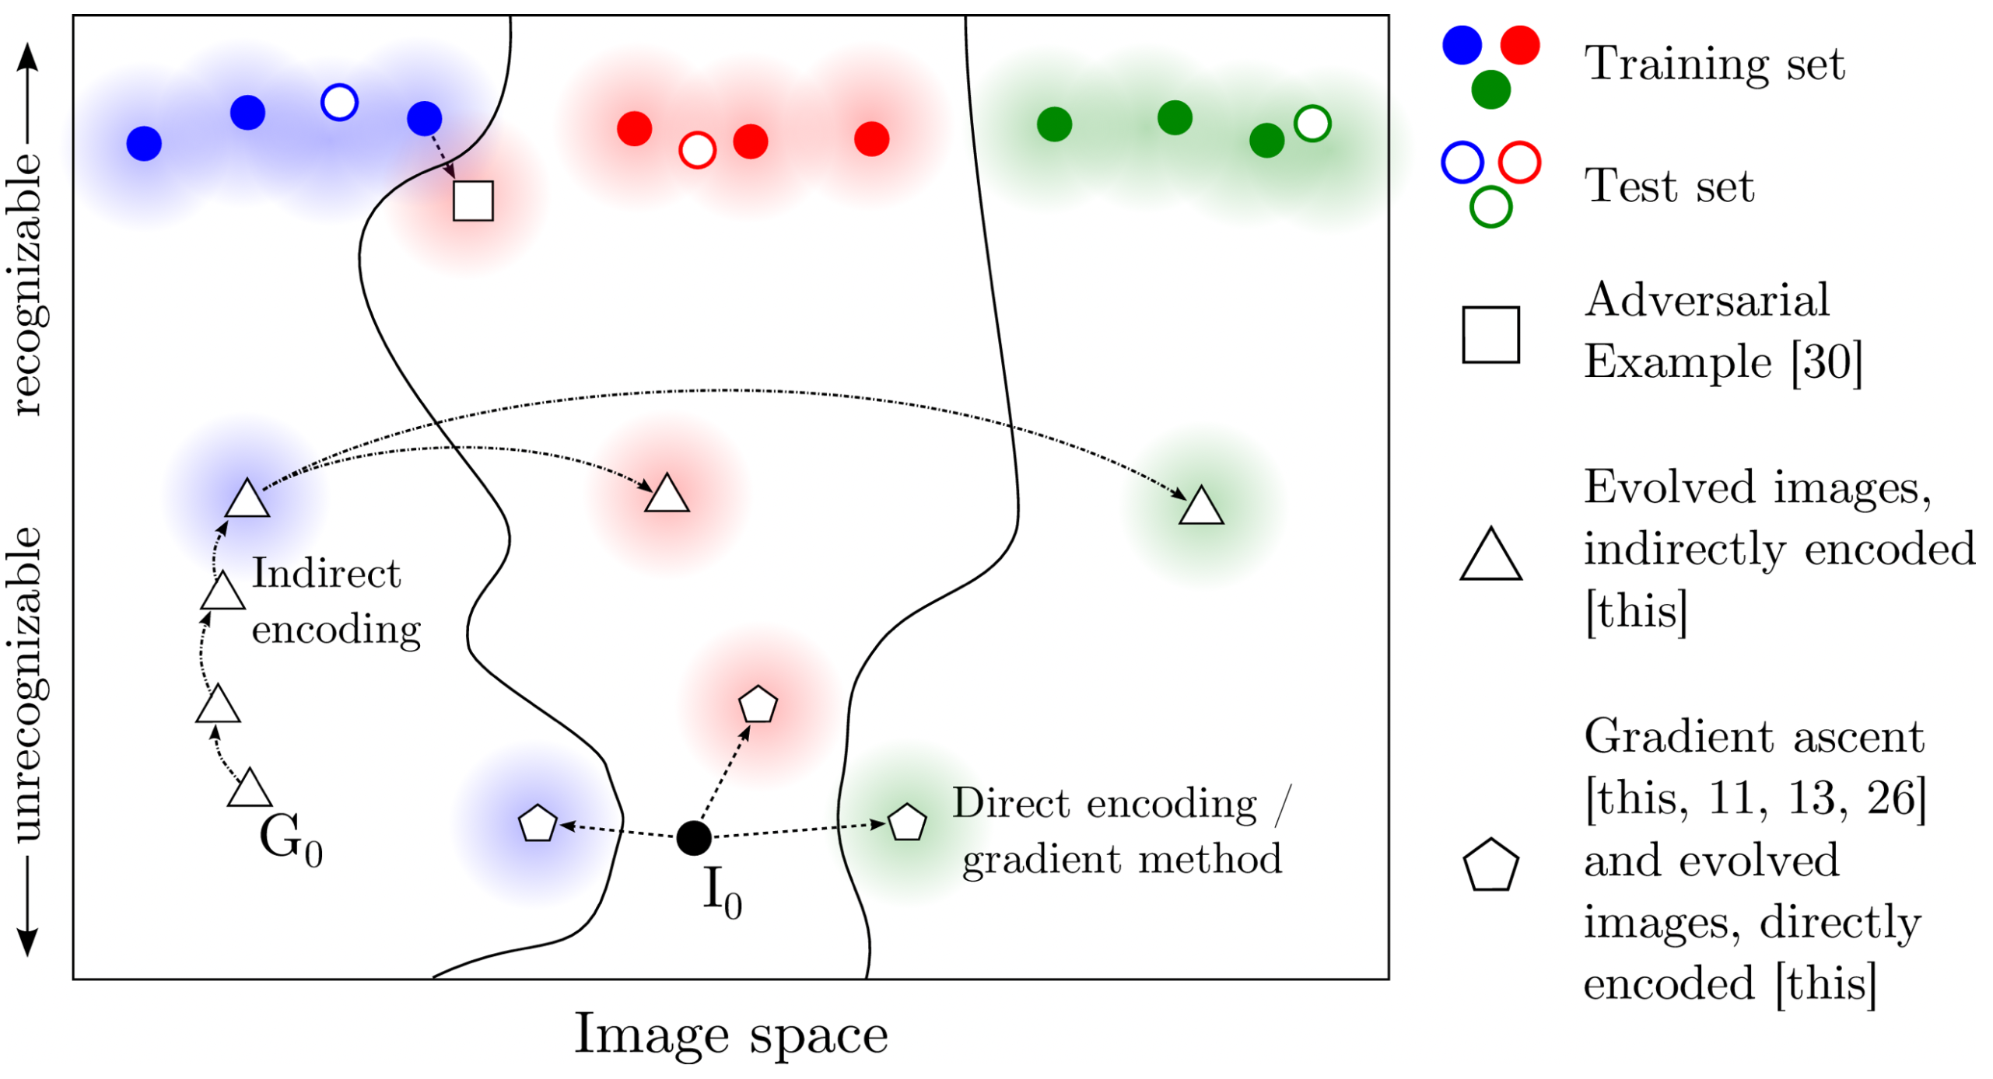
Why adversarial examples exist?
In discriminative models, decision boundary is loose. Data points occupy much less space than what is assigned to them.
Generative models would not be easily fooled.

Slide 15
Why adversarial examples exist?
Adversarial examples can be explained as a property of high-dimensional dot products.
They are a result of models being too linear, rather than too nonlinear.
The generalization of adversarial examples across different models can be explained as a result of:
adversarial perturbations being highly aligned with the weight vectors of a model
different models learning similar functions when trained to perform the same task
Goodfellow et al., ICLR 2015
Notes:
Too non linear, low regularization, insufficient averaging

Slide 16
Deep Neural Networks Are Easily Fooled: High Confidence Predictions for Unrecognizable Images
Anh Nguyen, Jason Yosinski, Jeff Clune
CVPR 2015

Slide 17
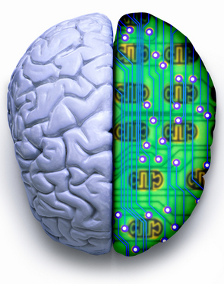
Human vs. Computer Object Recognition
Given the near-human ability of DNNs to classify objects, what differences remain between human and computer vision?
Slide credit : Bella Fadida Specktor

Slide 18
Summary
https://youtu.be/M2IebCN9Ht4

Slide 19
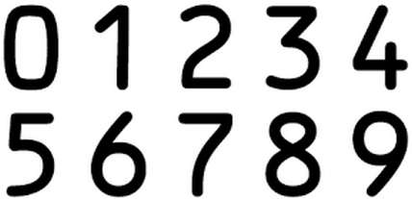
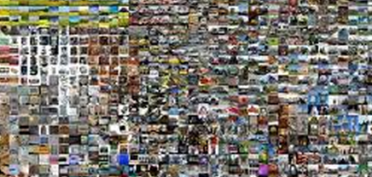
Experimental setup
1. LeNet model trained on MNIST dataset – "MNIST DNN"
2. AlexNet DNN trained on ImageNet dataset – "ImageNet DNN" (larger dataset, bigger network)
Slide credit : Bella Fadida Specktor

Slide 20
Evolution Algorithms (EA)
Notes:
one or a small set of objective function
MAP Elite : simultaneously evolve a population that contains individuals that score well on many classes. MAP-Elites works by keeping the best individual found so far for each objective. Random image -> mutation/crossover -> updates champions if has higher score
.

Slide 21
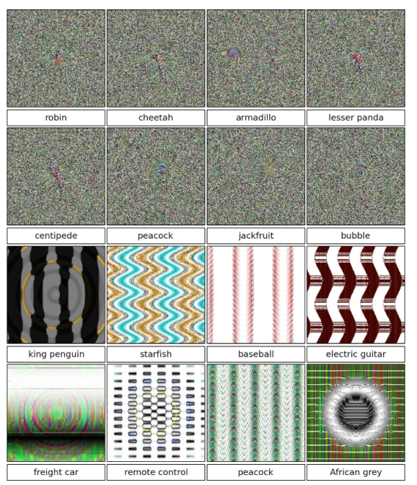
Direct Encoding
Grayscale values for MNIST, HSV values for ImageNet. Each pixel value is initialized with uniform random noise within the [0, 255] range. Those numbers are independently mutated.
Slide credit : Bella Fadida Specktor
Notes:
first by determining which numbers are mutated, via a rate that starts at 0.1 (each number has a 10% chance of being chosen to be mutated) and drops by half every 1000 generations. The numbers chosen to be mutated are then altered via the polynomial mutation operator [8] with a fixed mutation strength of 15

Slide 22
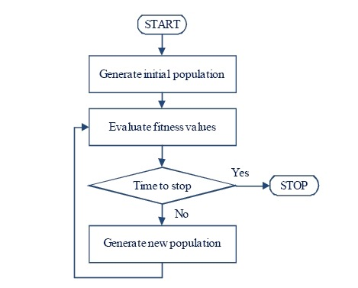
Direct Encoding
Random Grayscale Images
Mutate/Crossover
pixels directly
Notes:
first by determining which numbers are mutated, via a rate that starts at 0.1 (each number has a 10% chance of being chosen to be mutated) and drops by half every 1000 generations. The numbers chosen to be mutated are then altered via the polynomial mutation operator [8] with a fixed mutation strength of 15

Slide 23
CPPN (Compositional Pattern-Producing Network) Encoding
This encoding is more likely to produce "regular" images, e.g. contains symmetry and repetition
Similar to ANNs, but with different nonlinear functions
Slide credit : Bella Fadida Specktor
Notes:
each image is a CPNN, pertubations are made by changing network topology, activation functions, weights
idea is that CPNN evolve images which are similarly recognized by humans and DNNs
sine, linear, gaussian

Slide 24
CPPN (Compositional Pattern-Producing Network) Encoding
CPPN with no hidden layers
Changing CPPN parameters
Notes:
each image is a CPNN, pertubations are made by changing network topology, activation functions, weights
idea is that CPNN evolve images which are similarly recognized by humans and DNNs
sine, linear, gaussian

Slide 25
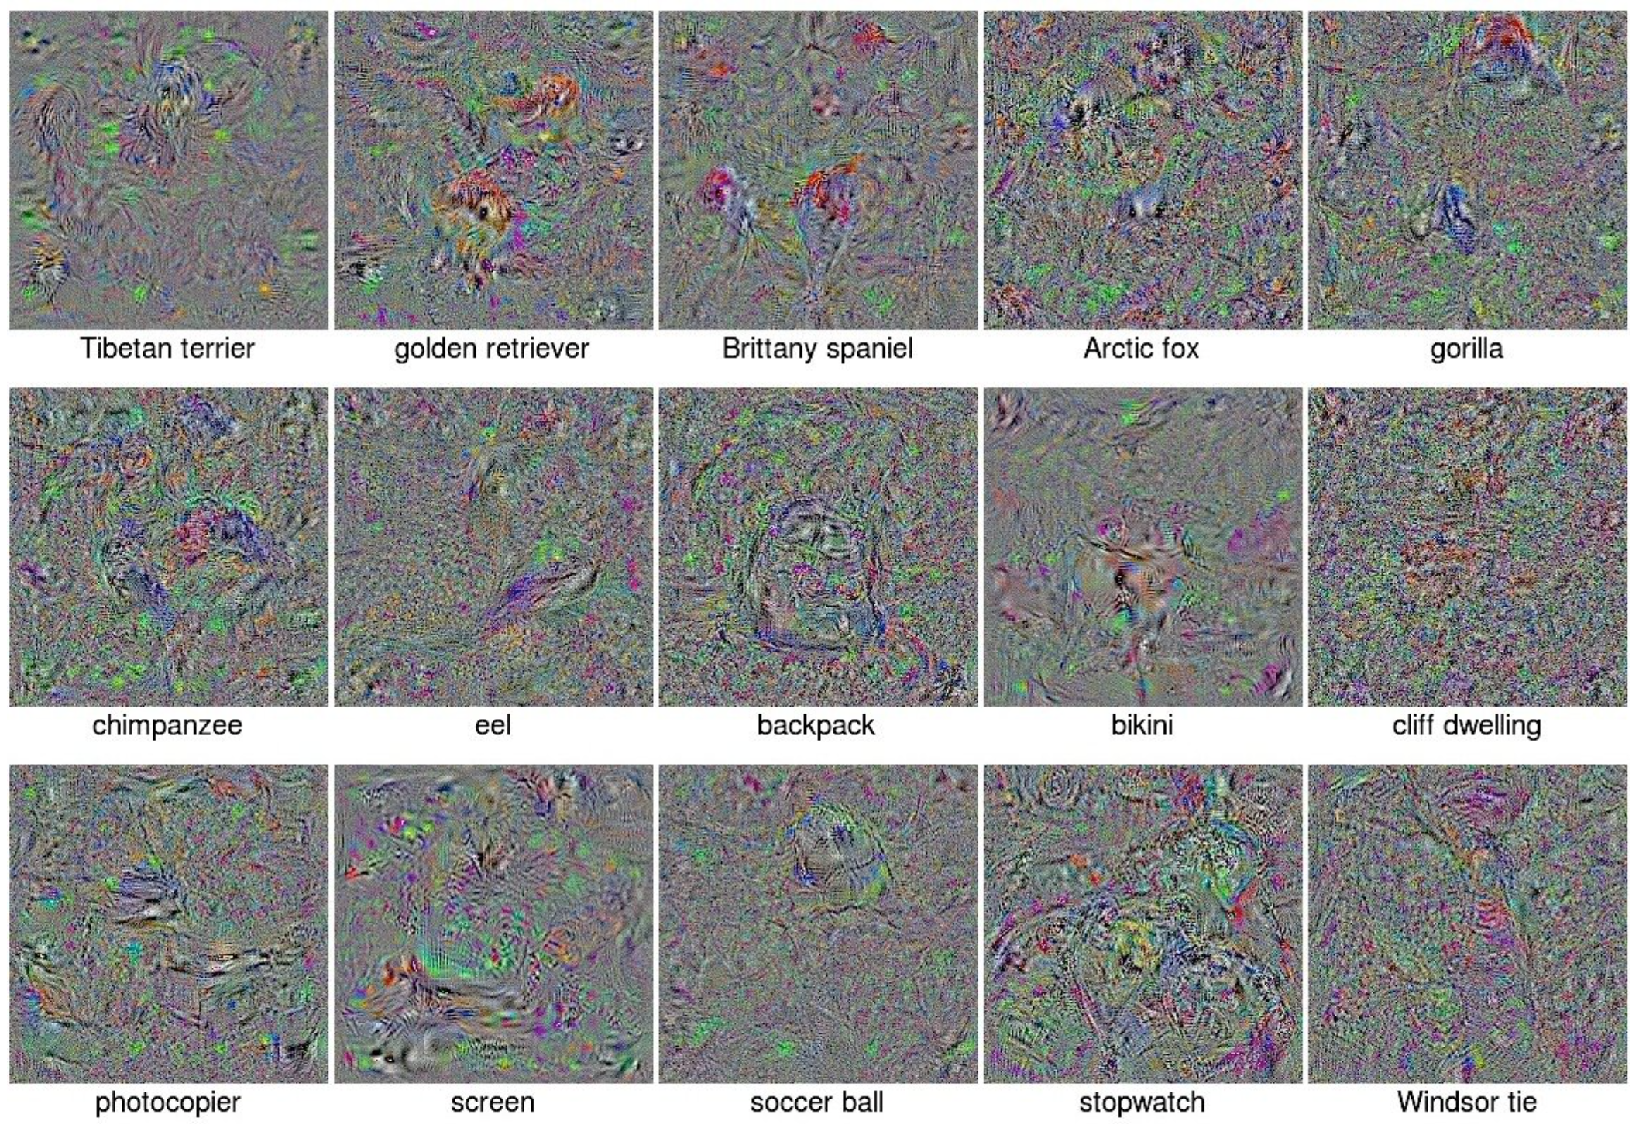
Fooling images via Gradient Ascent
Following the direction of gradient of the posterior probability for a specific class
Notes:
Calculating the gradient of the posterior probability for a specific class — here, a softmax output unit of the DNN — with respect to the input image using backprop, and then following the gradient to increase a chosen unit’s activation.

Slide 26
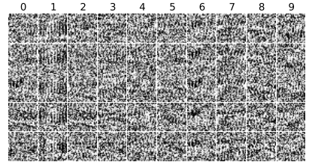
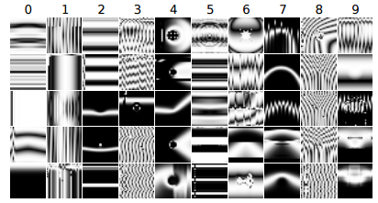
Results – MNIST
In less than 50 generations, each run of evolution produces unrecognizable images classified by MNIST DNNs with ≥ 99.99% confidence.
MNIST DNNs labelled unrecognizable images as digits with 99.99% confidence after only a few generations.
Slide credit : Bella Fadida Specktor
Notes:
By 200 generations, median confidence is 99.99%.

Slide 27
Results – ImageNet Dataset
Directly encoded EA
CPPN Encoding
Even after 20,000 generations, evolution failed to produce high-confidence images for many categories, but produced images with ≥ 99% confidence for 45 categories. 21.59% Median Confidence
Many images with DNN confidence scores ≥99.99%, but that are unrecognizable. After 5000 generations, Median Confidence score is 88.11%, similar to that for natural images
Slide credit : Bella Fadida Specktor
Notes:
smaller dataset could lead to overfitting. in some cases if target class was told one might relate the features
Dogs and cats are overrepresented in Image net, more images, less overfitting, less fooling
Another explanation is DNN find it hard to get images that score high in say one specific dog category

Slide 28
CPPN Encoding on ImageNet
Evolution produces images which has most discriminative features of a class
Notes:
Diversity is interesting coz it’s shown that class label can be changed by imperceptible changes to the image. second paper
evolution produced images high scoring for all the classes,
some classes are closely related so images produced are similar

Slide 29
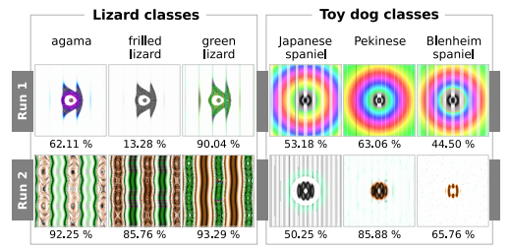
CPPN Encoding on ImageNet
Many images are related to each other phylogenetically, which leads evolution to produce similar images for closely related categories
Different runs of evolution produce different image types
Slide credit : Bella Fadida Specktor
Notes:
More than one discriminative features. More ways to fool the net.

Slide 30
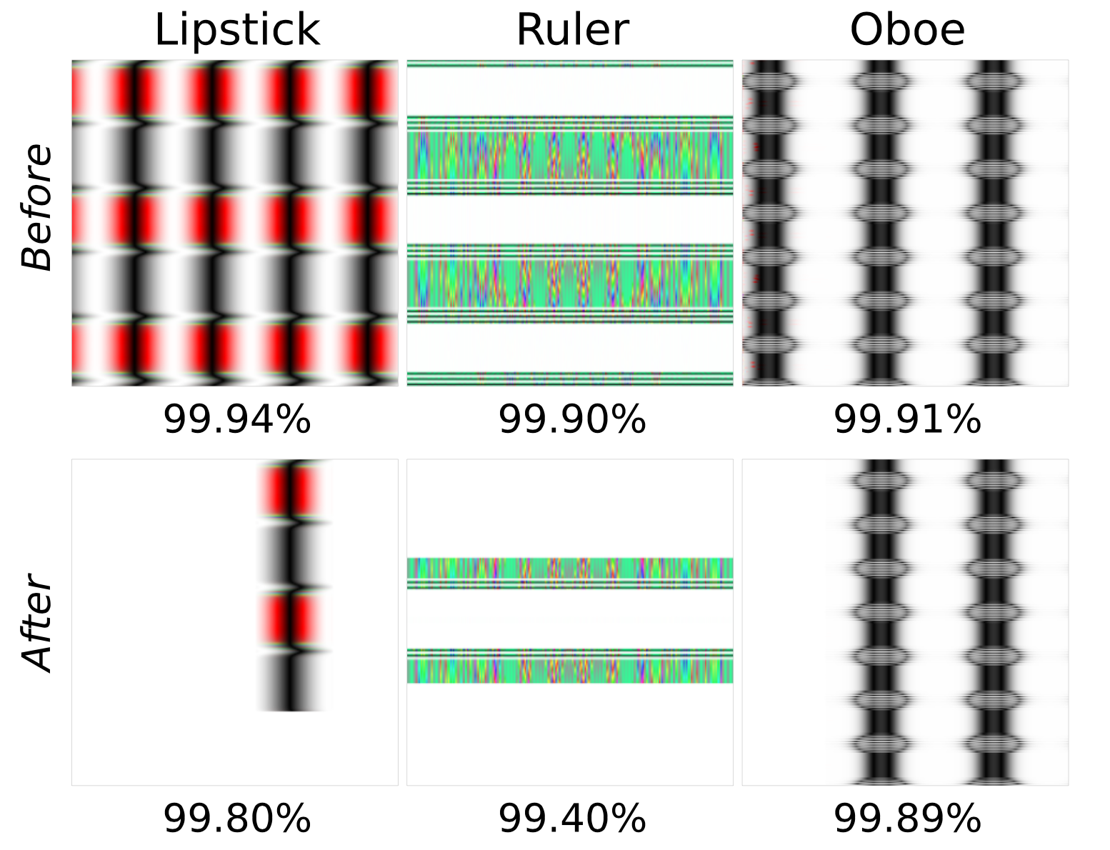
Repetition Ablation Study
To test whether repetition improves the confidence scores, some of the repeated elements were ablated.
In many images, ablation leads to a small performance drop
Notes:
extra copies make DNNs more confident. Thus DNNs tend to focus on low-mid level features rather the global structure.

Slide 31
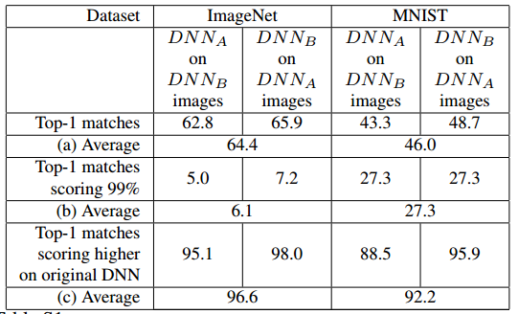
Do different DNNs learn the same discriminative features?
Slide credit : Bella Fadida Specktor
Notes:
which means that mostly they do

Slide 32
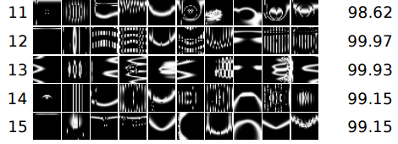
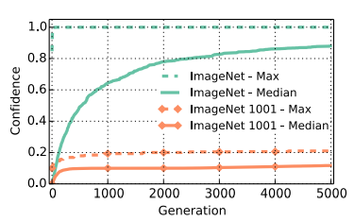
Adding “Fooling Images” class
It is easier to learn to tell CPPN images apart from natural images than it is to tell CPPN images from MNIST digits.
Slide credit : Bella Fadida Specktor
Notes:
an extra class to the DNN . the class of fooling images
also retrained model learns features specific of CPPN

Slide 33
DeepDream
Google, Inc.
Notes:
How to fool a network? We were essentially looking at what a deep net ‘sees’ in a n class ?

Slide 34
What is a deep dream?
Simply feed the network an arbitrary image or photo and let the network analyze the picture.
Pick a layer and ask the network to enhance whatever it detects
DNN “hallucinates” various low/high level features depending upon which layers is picked

Slide 35
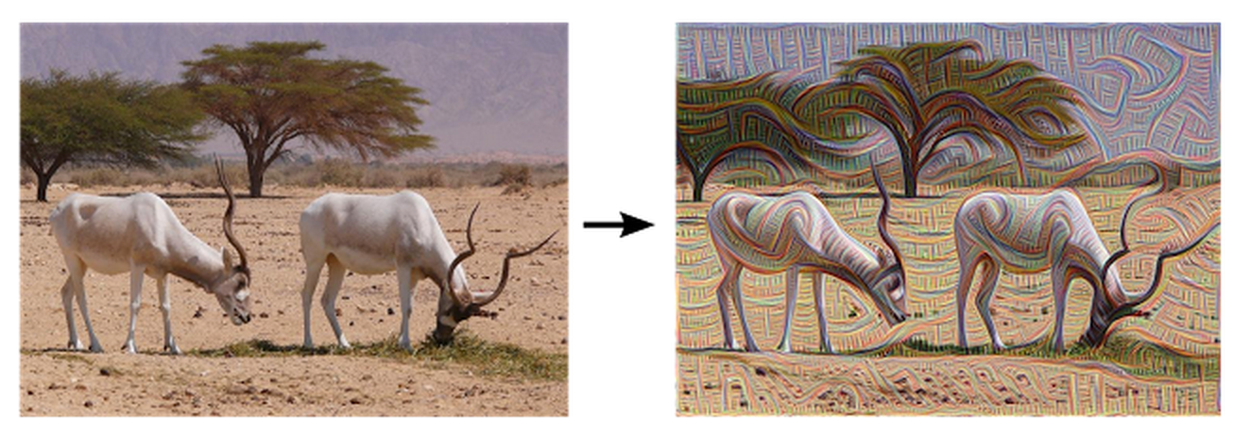
What is a deep dream?
Notes:
Too non linear, low regularization, insufficient averaging

Slide 36
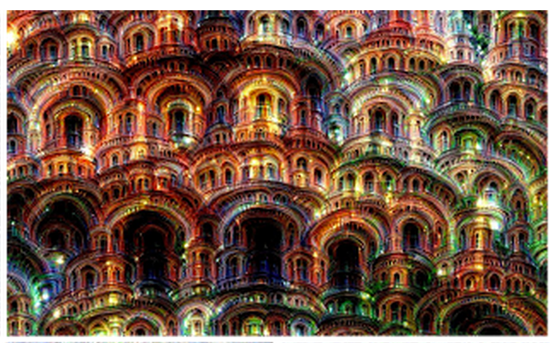
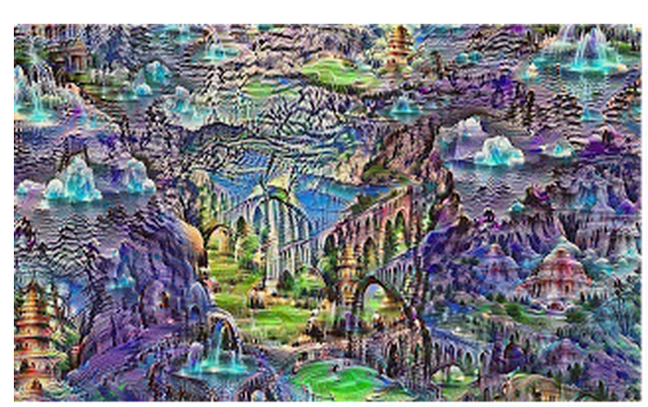
What is a deep dream?
Notes:
The algorithm is iteratively applied on its own outputs and apply some zooming after each iteration, we can get an endless stream of new impressions.
We can even start this process from a random-noise image, so that the result becomes purely the result of the neural network.

Slide 37
Setup
GoogLeNet trained on ImageNet dataset

Slide 38
Producing Dreams
It is just a gradient ascent process that tries to maximize the L2 norm of activations of a particular DNN layer. Here are a few simple tricks that were useful for getting good images:
offset image by a random jitter
normalize the magnitude of gradient ascent steps
apply ascent across multiple scales (octaves)

Slide 39
Controlling Dreams
The optimization objective can be tweaked to improve the generated image diversity.
For example, instead of maximizing the L2-norm of current image activations, maximize the dot-products between activations of current image, and their matching correspondences from the guide image.

Slide 40
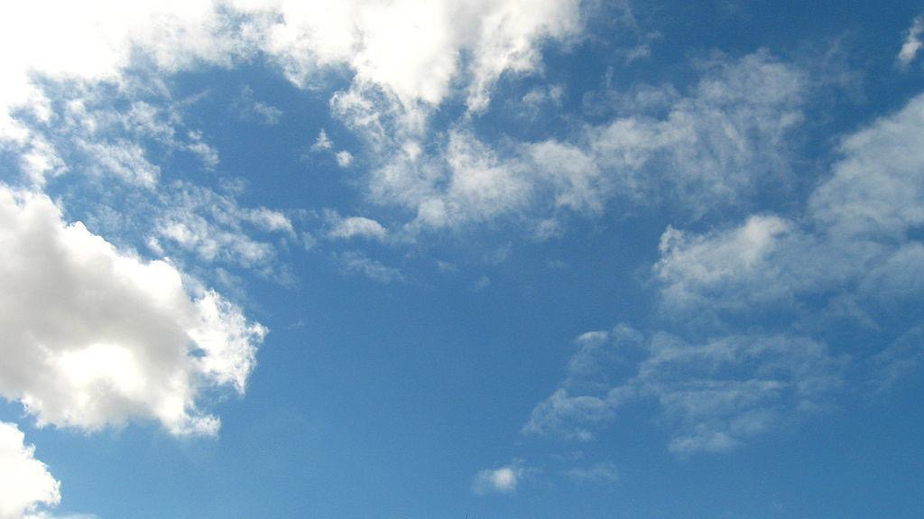
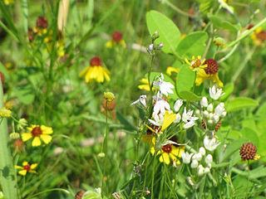
Controlling Dreams

Slide 41
Controlling Dreams

Slide 42
Links
https://github.com/google/deepdream/
http://deepdreamgenerator.com/

Slide 43
Explaining and Harnessing Adversarial Examples
Ian Goodfellow, Jonathon Shlens, Christian Szegedy

Slide 44
Highlights
Adversarial examples: speculative explanations
Flaws in the linear nature of models
Fast gradient sign method
Adversarial training of deep networks
Why adversarial examples generalize?
Alternate Hypothesis

Slide 45
Introduction
Szegedy et al. (2014b) : Vulnerability of machine learning models to adversarial examples
A wide variety of models with different architectures trained on different subsets of the training data misclassify the same adversarial example – fundamental blind spots in training algorithms?
Speculative explanations:
Extreme non-linearity
Insufficient model averaging and insufficient regularization
Linear behavior - real culprit!

Slide 46
Linear explanation of adversarial examples
Adversarial example:
Consider the dot product:
Activations grow linearly!
Maximizes growth!

Slide 47
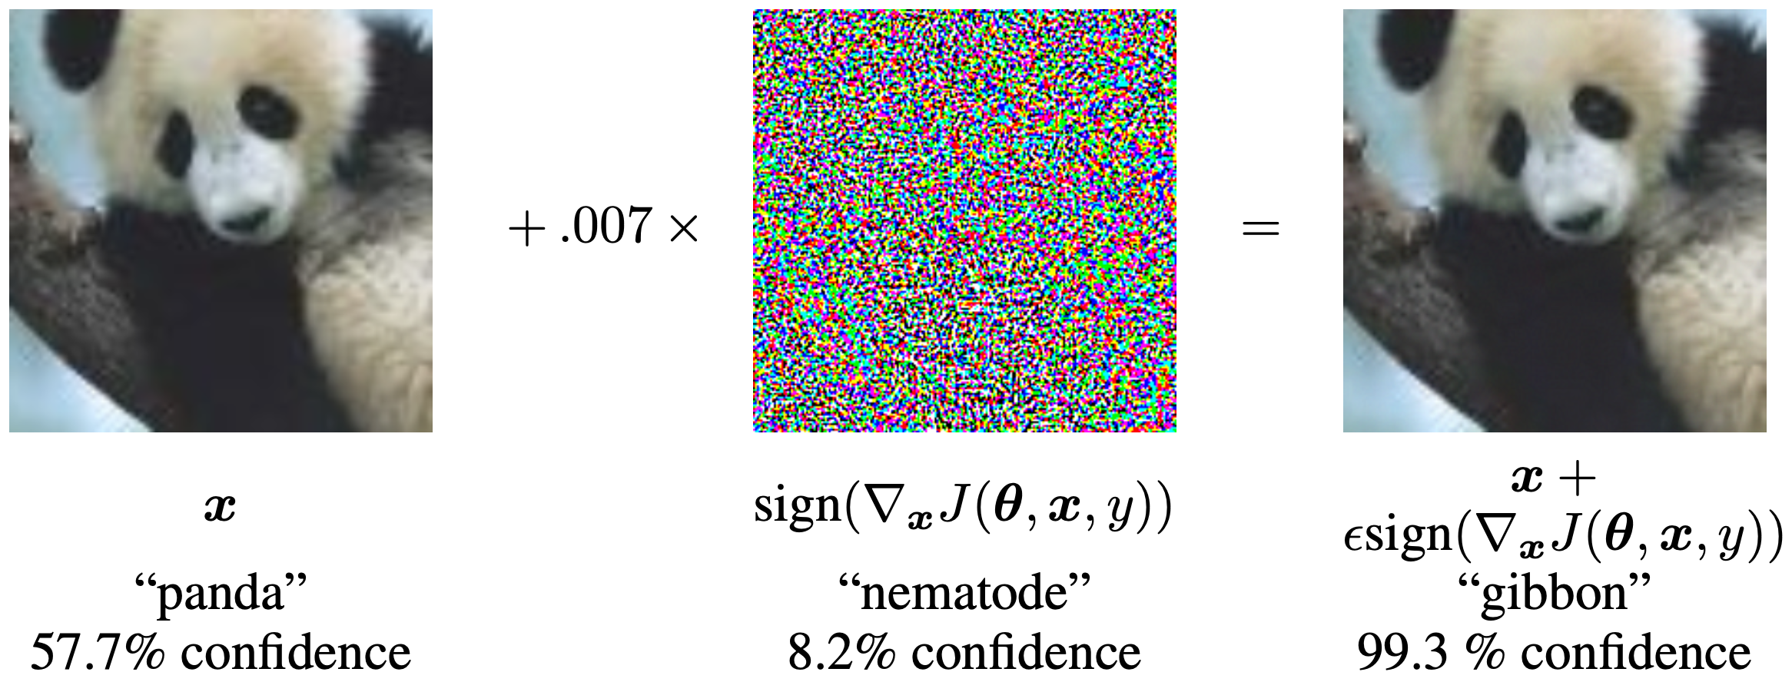
Linear perturbation of non-linear models
ReLUs, maxout networks etc. - easier to optimize linear networks
“Fast gradient sign method”
Image from reference paper

Slide 48
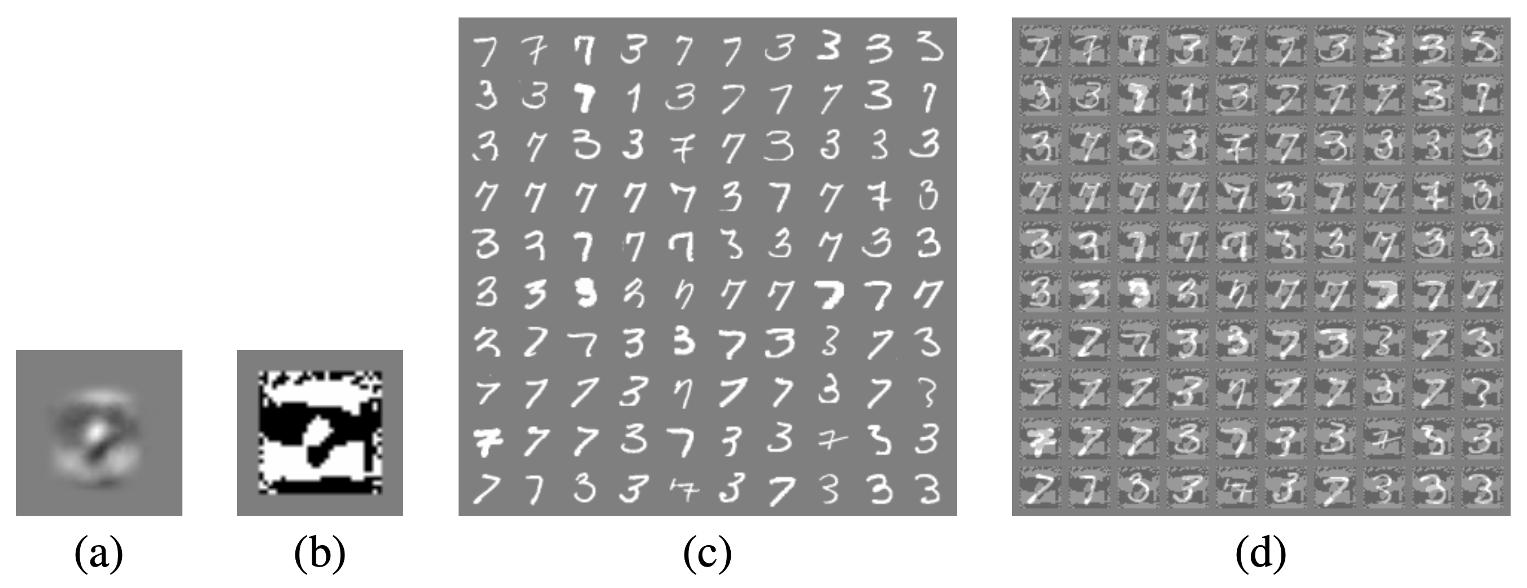
Fast gradient sign – logistic regression
weights
sign of weights
1.6% error rate 99% error rate
Image from reference paper

Slide 49
Adversarial training of deep networks
Deep networks are vulnerable to adversarial examples - misguided assumption (the same applies to linear models, deep networks can represent functions that resist adversarial peturbation)
How to overcome adversarial examples?
Training with an adversarial objective function based on the fast gradient sign method
Error rate reduced from 0.94% to 0.84%

Slide 50
Different kinds of model capacity
Low capacity – unable to make many different confident predictions?
Incorrect. RBF can.
RBF networks are naturally immune to adversarial examples – low confidence when they are fooled:
RBF network
Shallow RBF network with no hidden layer: error rate of 55.4% on MNIST
Confidence on mistaken examples is only 1.2%
Drawback: Not invariant to any significant transformations so they cannot generalize very well

Slide 51
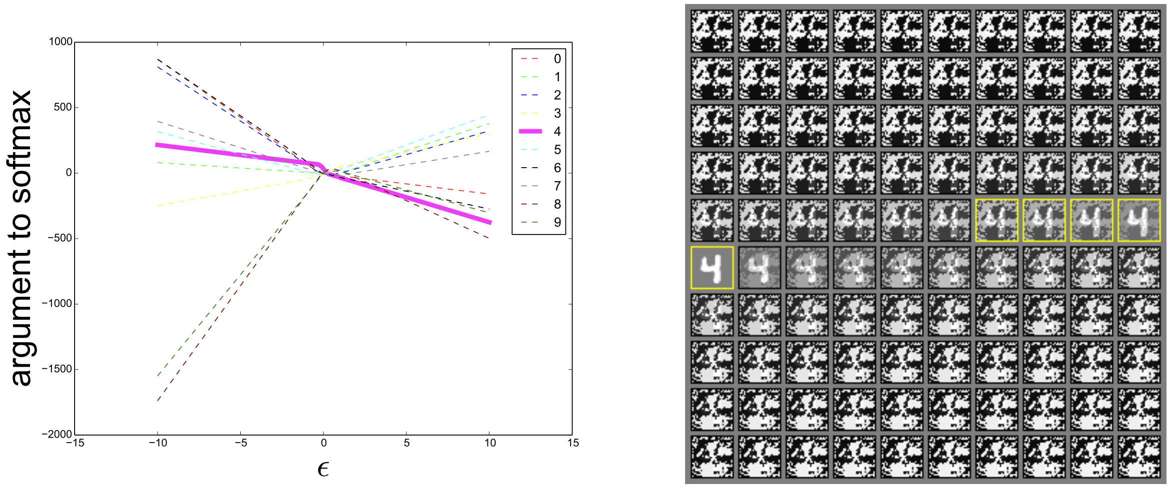
Why do adversarial examples generalize?
Under the linear view, adversarial examples occur in broad subspaces.
The direction needs only have positive dot product with the gradient of the cost function, and ε need only be large enough.
Image from reference paper
A significant proportion of errors are consistent with linear behavior being a major cause of cross-model generalization!

Slide 52
Alternate Hypothesis
Generative training
MP-DBM: ϵ of 0.25, error rate of 97.5% on adversarial examples generated from the MNIST
Being generative alone is not sufficient
Ensemble training
Ensemble of 12 maxout networks on MNIST: ϵ of 0.25, 91.1% error on adversarial examples on MNIST
One member of the ensemble: 87.9% error
Ensembling provides only limited resistance to adversarial perturbation

Slide 53
Summary
Adversarial examples are a result of models being too linear
Generalization of adversarial examples across different models occurs as a result of adversarial perturbations being highly aligned with the weight vector
The direction of perturbation rather than space matters the most
Introduces fast methods of generating adversarial examples
Adversarial training can result in regularization
Models easy to optimize are easy to perturb

Slide 54
Summary
Linear models lack the capacity to resist adversarial perturbation; only structures with a hidden layer can
RBF networks are resistant to adversarial examples
Models trained to model the input distribution are not resistant to adversarial examples.
Ensembles are not resistant to adversarial examples

Slide 55
Towards Deep Neural Network Architectures Robust to Adversarial Examples
Shixiang Gu, Luca Rigazio
ICLR 2015 Workshops

Slide 56
Highlights
Pre-processing and training strategies to improve the robustness of DNNs
Corrupting with additional noise and preprocessing with Denoising Autoencoders (DAEs)
Stacking with DNN makes the network even more weak to adversarial examples
Neural network’s sensitivity to adversarial examples is more related to intrinsic deficiencies in the training procedure and objective function than to model topology
The crux of the problem is then to come up with an appropriate training procedure and objective function
Deep Contractive Network (DCN)

Slide 57
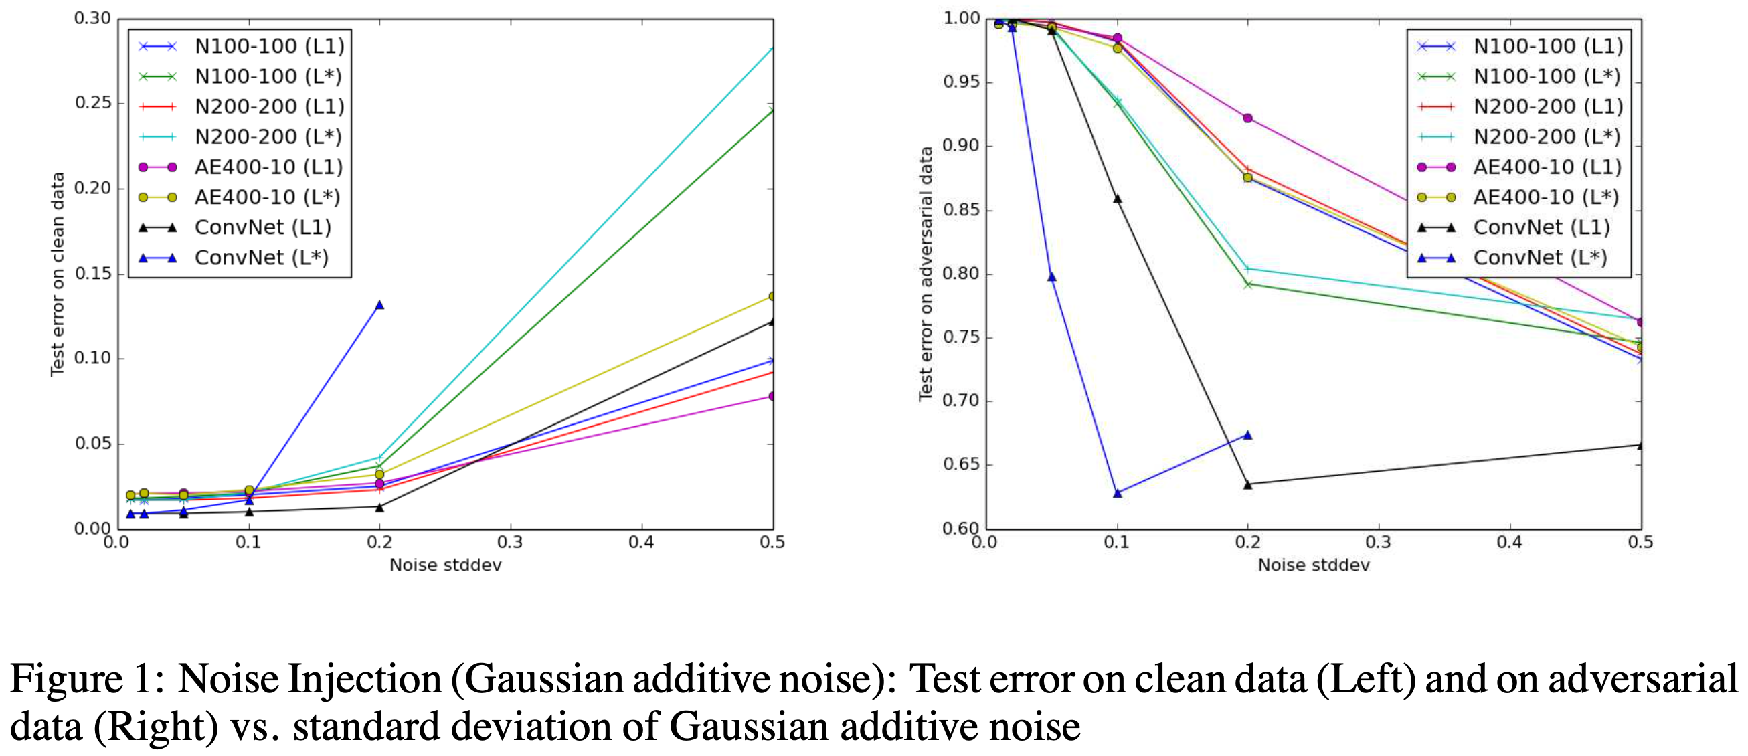
Noise Injection – Gaussian Additive Noise
Plot from reference paper

Slide 58
Noise Injection – Gaussian Blurring
Table from reference paper

Slide 59
Conclusion
Neither Gaussian additive noises or blurring is effective in removing enough noise such that its error on adversarial examples could match that of the error on clean data.

Slide 60
Contractive autoencoders
$$\hat{x}$$
We are still trying to avoid uninteresting features.
Here we add a regularization term $Ω\left(x\right)$ to our loss function to limit the hidden layer.
$$w′$$
$$w$$
$$x$$

Slide 61
Contractive autoencoders
$$\hat{x}$$
Idea: We wish to extract features that only reflect variations observed in the training set. We would like to be invariant to the other variations.
Points close to each other in the input space maintain that property in the latent space.
$$w′$$
$$w$$
$$x$$

Slide 62
Contractive autoencoders
Definitions and reminders:
Frobenius norm (L2): ${\left\|A\right\|}_{F}=$
Jacobian Matrix: $J_{f}\left(x\right)$ = $\frac{∂f(x)}{∂x}$ = $\left[\begin{matrix}\frac{∂f{\left(x\right)}_{1}}{∂x_{1}} & ⋯ & \frac{∂f{\left(x\right)}_{1}}{∂x_{n}} \\ ⋮ & ⋱ & ⋮ \\ \frac{∂f{\left(x\right)}_{m}}{∂x_{1}} & ⋯ & \frac{∂f\left(x\right)m}{∂x_{n}}\end{matrix}\right]$
$$\sqrt{Σ_{i,j}{\left|a_{ij}\right|}^{2}}$$

Slide 63
Contractive autoencoders
Our new loss function would be:
$$L^{∗}\left(x\right)=L\left(x\right)+λΩ\left(x\right)$$
where $Ω\left(x\right)={\left\|J_{f}\left(x\right)\right\|}_{F}^{2}$ or simply: $\sum_{i,j}{{\left(\frac{∂f{\left(x\right)}_{j}}{∂x_{i}}\right)}^{2}}$
and where $λ$ controls the balance of our reconstruction objective and the hidden layer “flatness”.

Slide 64
Contractive autoencoders
Our new loss function would be:
$$L^{∗}\left(x\right)=L\left(x\right)+λΩ\left(x\right)$$
$L\left(x\right)$ - would be an encoder that keeps good information ($λ→0$)
$Ω\left(x\right)$ - would be an encoder that throws away all information ($λ→∞$)
Combination would be an encoder that keeps only good information.

Slide 65
Deep Contractive Networks
DCN is a generalization of the contractive autoencoder (CAE) to a feed-forward neural network
For a network with H hidden layers, let f_{i} denote the function for computing the hidden representation at hidden layer I
The model should penalize the following objective:
output
target

Slide 66
Results
Table from reference paper

Slide 67
Discussions and Future work
DCNs can
Successfully be trained to propagate contractivity around the input data through the deep architecture without significant loss in final accuracies
Future work
Evaluate the performance loss due to layer-wise penalties
Exploring non-Euclidean adversarial examples

Slide 68
Black-Box Ripper: Copying black-box models using generative evolutionary algorithms
Antonio Barbalau, Adrian Cosma, Radu Tudor Ionescu,
Marius Popescu
NeurIPS 2020

Slide 69
Introduction
Complete lack of information regarding the model
Training dataset, architecture and parameters are concealed
The only way to access the black-box model is to make calls with input samples and observe its output
Similar to machine learning APIs
Our approach is among the very few to jointly consider no access to the training data, model architecture and parameters, in a functionality stealing scenario

Slide 70
Black-box Ripper
Novel generative evolutionary algorithm for stealing the functionality of black-box classification models
Does not require information about: training data, architecture and parameters
Applicable for APIs
Outperforms existing functionality stealing methods, even matching or surpassing the state-of-the-art data-free knowledge distillation approach [1]
[1] S. Addepalli et. al - DeGAN : Data-Enriching GAN for Retrieving Representative Samples from a Trained Classifier - AAAI 2020

Slide 71
Problem statement
where:
S is the student
represents the parameters of the student
T is the black-box teacher
X and X’ are the original training and test sets
Z is the proxy dataset
up and down arrows represent backward and forward passes

Slide 72
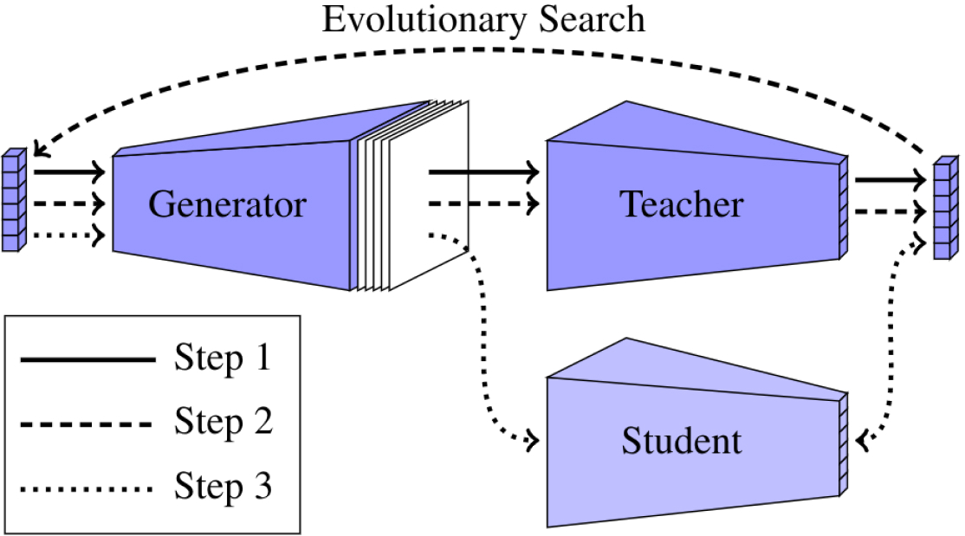
Method
Step 1: Generating random samples and observing the predictions of the black-box model
Step 2: Employing the evolutionary algorithm in order to morph the samples into inputs that elicit a high response from the teacher towards a certain class
Step 3: Distill the knowledge of the teacher into the student by training the student to replicate teacher predictions on the evolved samples

Slide 73
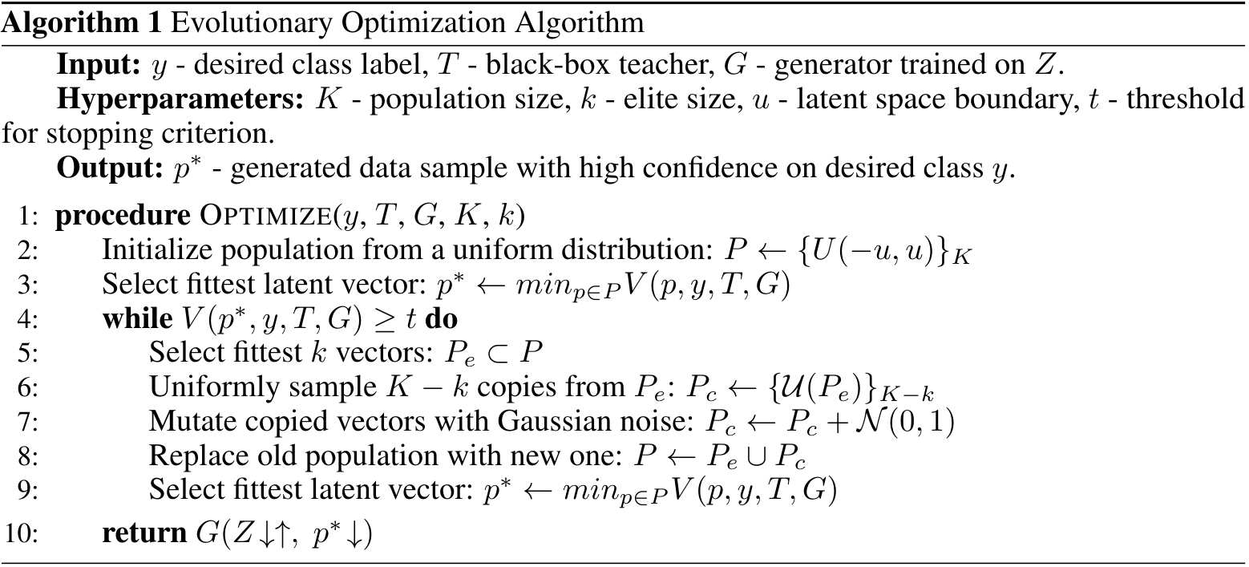
Algorithm

Slide 74
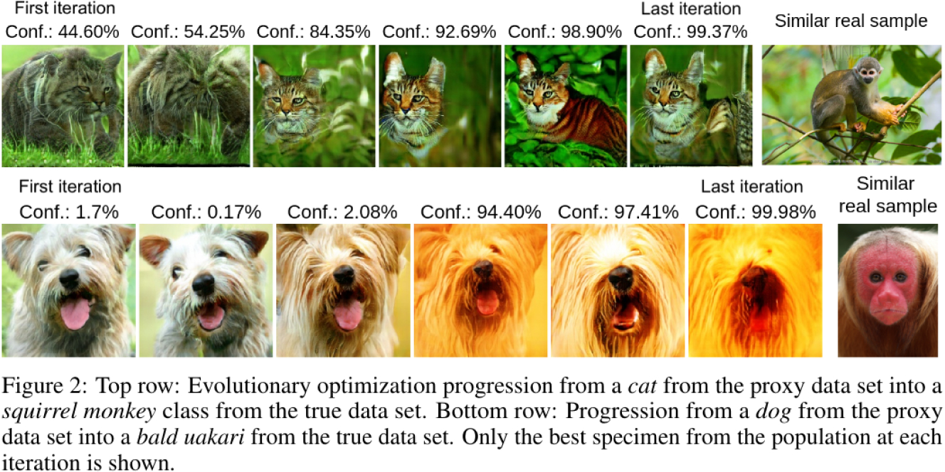
Visualizing the evolutionary algorithm

Slide 75
Baselines
Knockoff Nets
T. Orekondy et al. - Knockoff Nets: Stealing Functionality of Black-Box Models - CVPR 2019
Zero-Shot Knowledge Distillation
G.K. Nayak et al. - Zero-Shot Knowledge Distillation in Deep Networks - ICML 2019
DeGAN
S. Addepalli et. al - DeGAN: Data-Enriching GAN for Retrieving Representative Samples from a Trained Classifier - AAAI 2020

Slide 76
Results

Slide 77
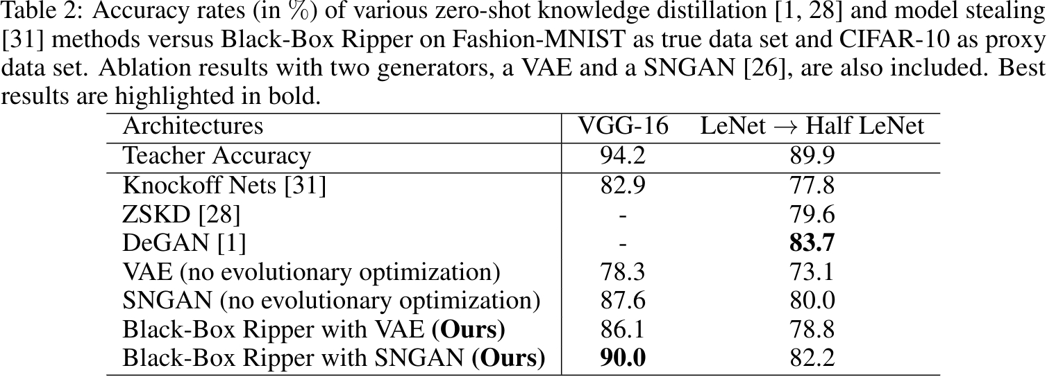
Results

Slide 78
Results

Slide 79
Summary
Novel generative evolutionary algorithm for stealing the functionality of black-box classification models
Does not require information about: training data, architecture and parameters
Applicable for APIs
Outperforms existing functionality stealing methods, even matching or surpassing the state-of-the-art data-free knowledge distillation approach [1]
[1] S. Addepalli et. al - DeGAN : Data-Enriching GAN for Retrieving Representative Samples from a Trained Classifier - AAAI 2020

