Slide 1
Multi-Head Self-Attention.
Language Transformers.
Vision Transformers.
Radu Ionescu, Prof. PhD.
raducu.ionescu@gmail.com
Faculty of Mathematics and Computer Science
University of Bucharest

Slide 2
Outline
"NLP's ImageNet Moment": ELMO / ULMFit
Transformers
  Attention in detail
  BERT, GPT-2, GPT-3, DistillBERT, T5
  ViT, DINO, CvT, CyTran

Slide 3
Beyond embeddings
Word2Vec and GloVe embeddings became popular in ~2013-14
Boosted accuracy on many tasks by low single-digit %
But these representations are shallow:
  only first layer would have benefit of seeing all of Wikipedia
  rest of the model (LSTMs, etc.) would be trained only on the task dataset (much smaller)
  Why not pre-train more layers, and thus disambiguate words (e.g. rule in "to rule" vs "a rule"), learn grammar, etc?

Slide 4

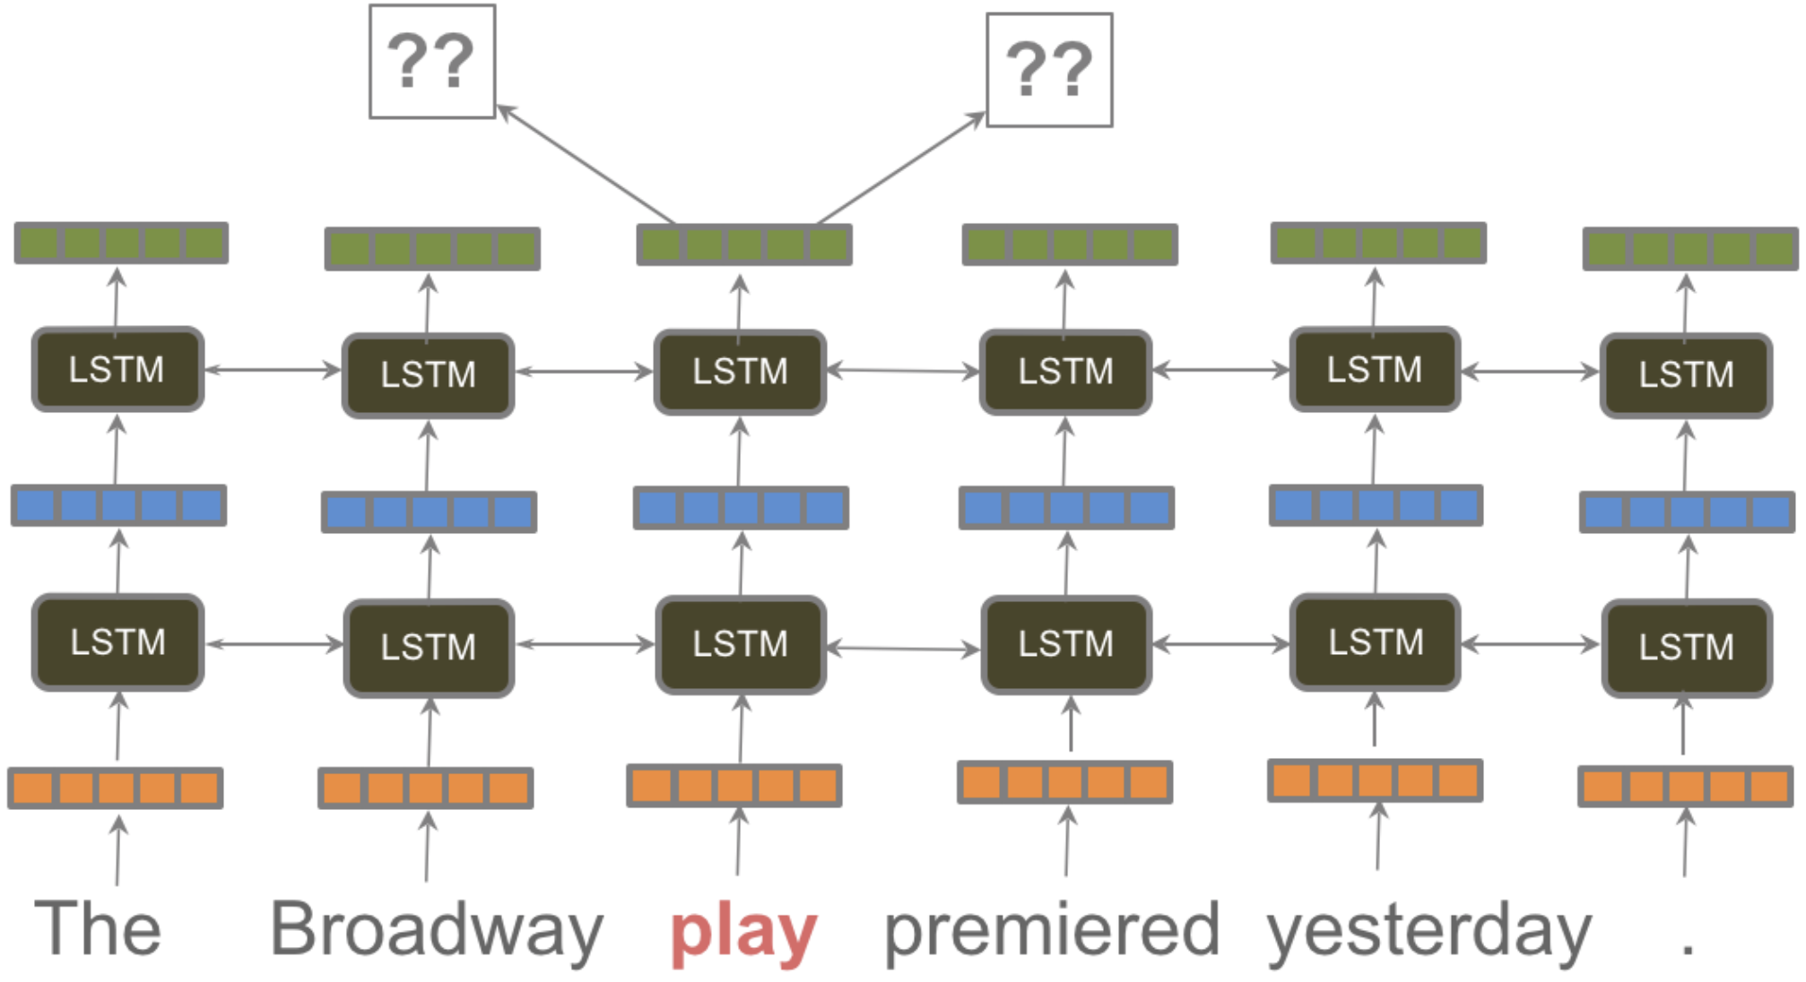
ELMo (2018)
Embeddings from Language Models
Bidirectional stacked LSTM!
https://ruder.io/nlp-imagenet/

Slide 5
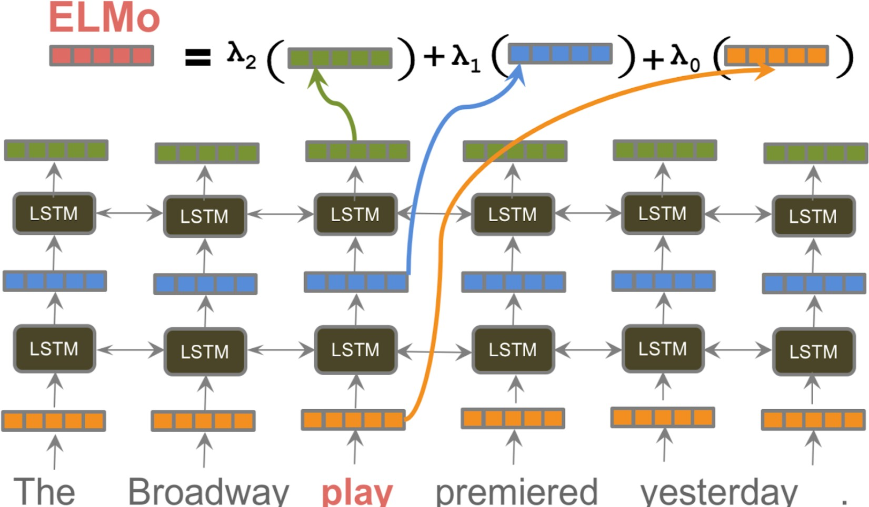
ELMo (2018)

Slide 6
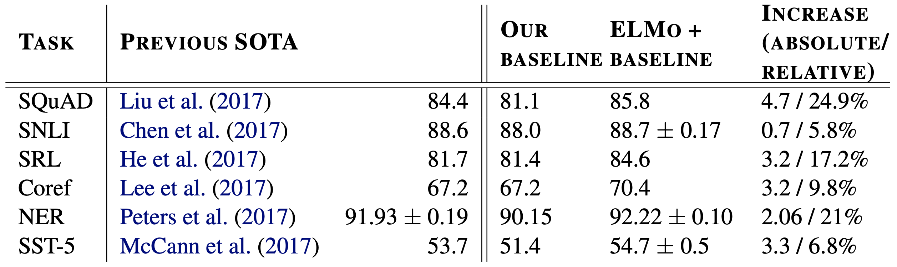
ELMo (2018)
Q&A
Textual entailment
Semantic role labeling
Coreference resolution
Named entity recognition
Sentiment analysis

Slide 7
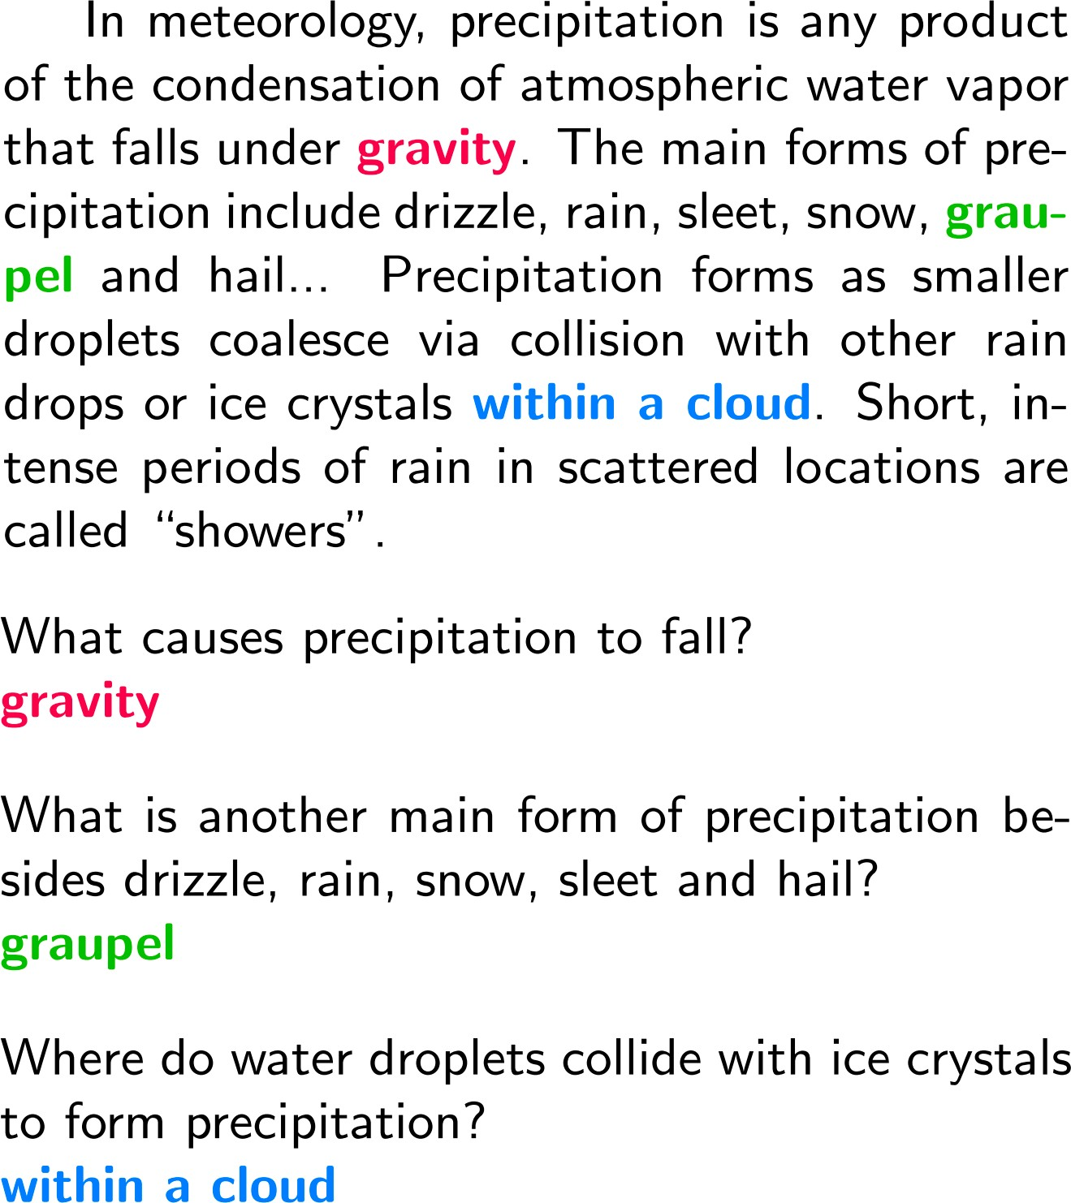
Q&A: SQuAD
100K question-answer pairs
Answers are always spans in the question
https://arxiv.org/abs/1606.05250

Slide 8
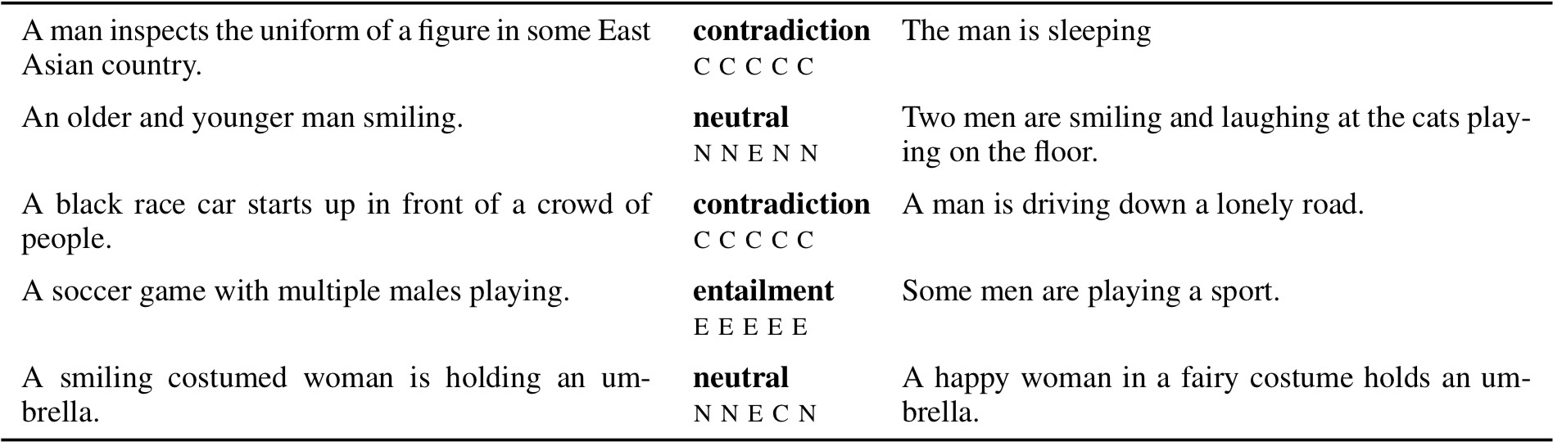
Natural Language Inference: SNLI
What relation exists between a piece of text and a hypothesis?
570K pairs
https://nlp.stanford.edu/pubs/snli_paper.pdf

Slide 9
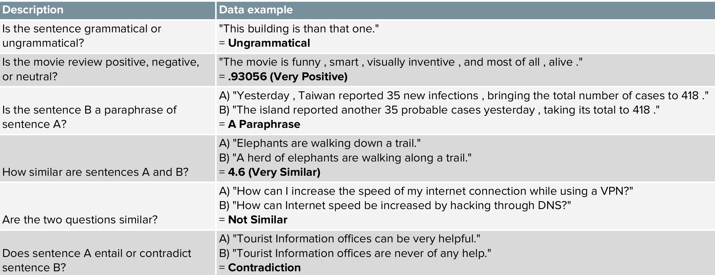
GLUE
https://mccormickml.com/2019/11/05/GLUE/

Slide 10
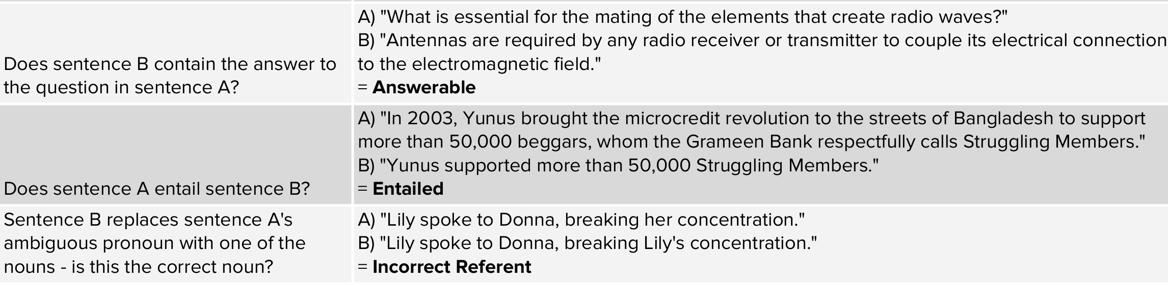
GLUE
9 tasks, model score is averaged across them
https://mccormickml.com/2019/11/05/GLUE/

Slide 11


ULMFit (2018)
https://humboldt-wi.github.io/blog/research/information_systems_1819/group4_ulmfit/

Slide 12
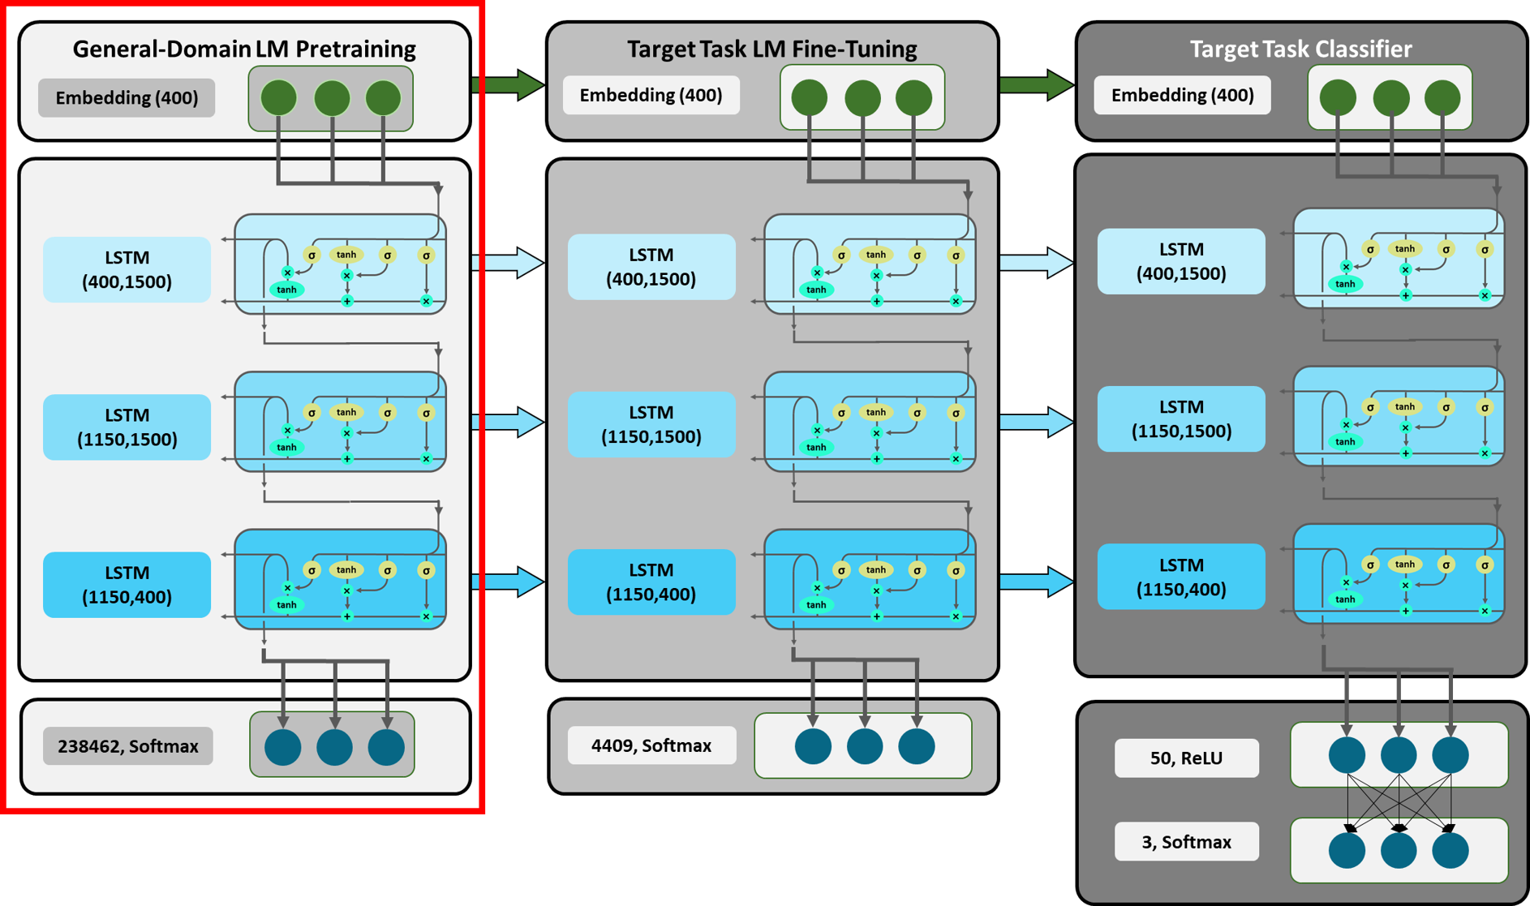
ULMFit (2018)
https://humboldt-wi.github.io/blog/research/information_systems_1819/group4_ulmfit/

Slide 13
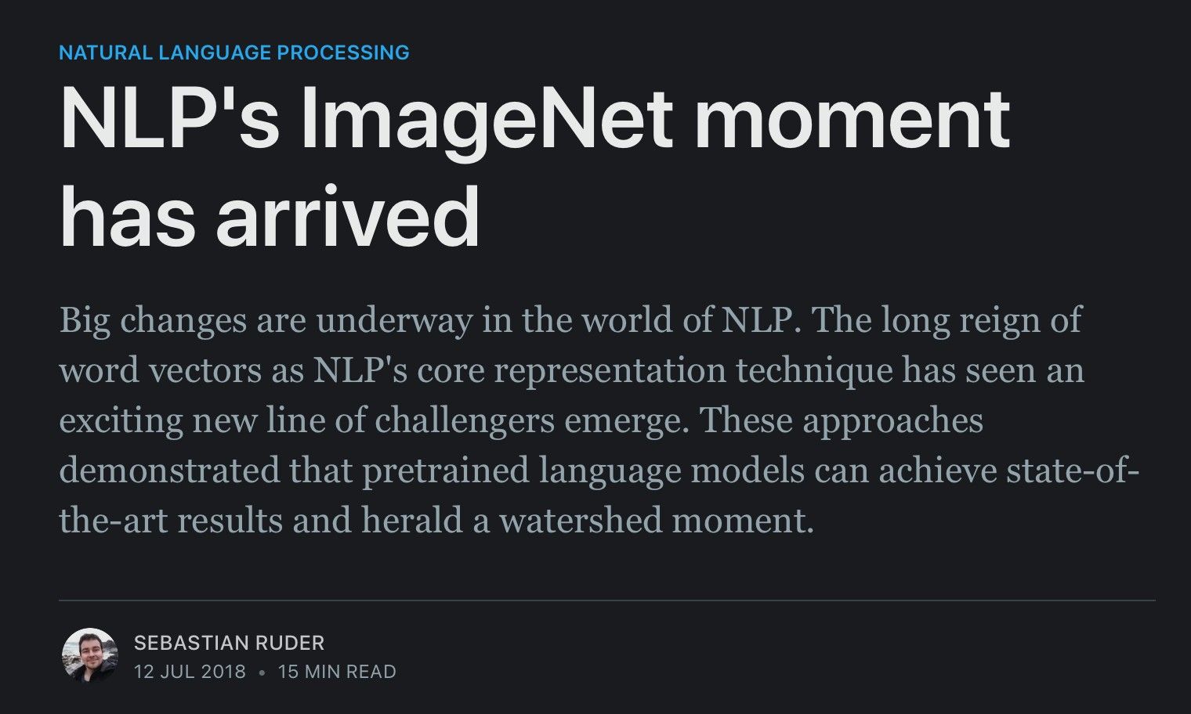
Pre-training is here!

Slide 14

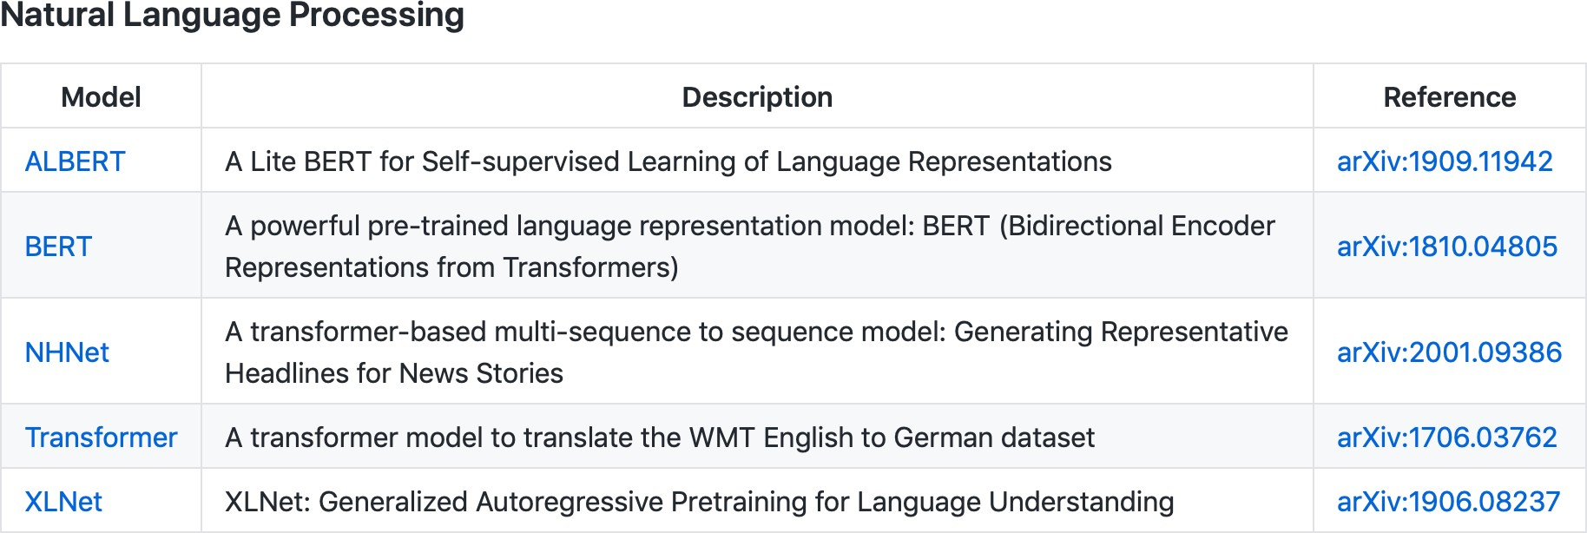
Pre-training is here!

Slide 15
Outline
"NLP's ImageNet Moment": ELMO / ULMFit
Transformers
  Attention in detail
  BERT, GPT-2, GPT-3, DistillBERT, T5
  ViT, DINO, CvT, CyTran

Slide 16
Rise of Transformers

Slide 17
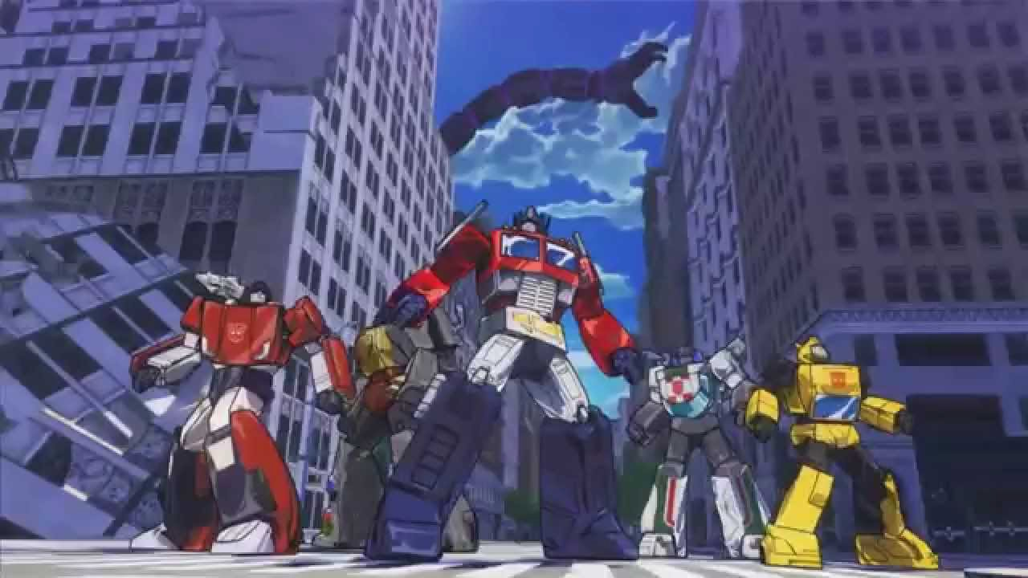
Rise of Transformers

Slide 18
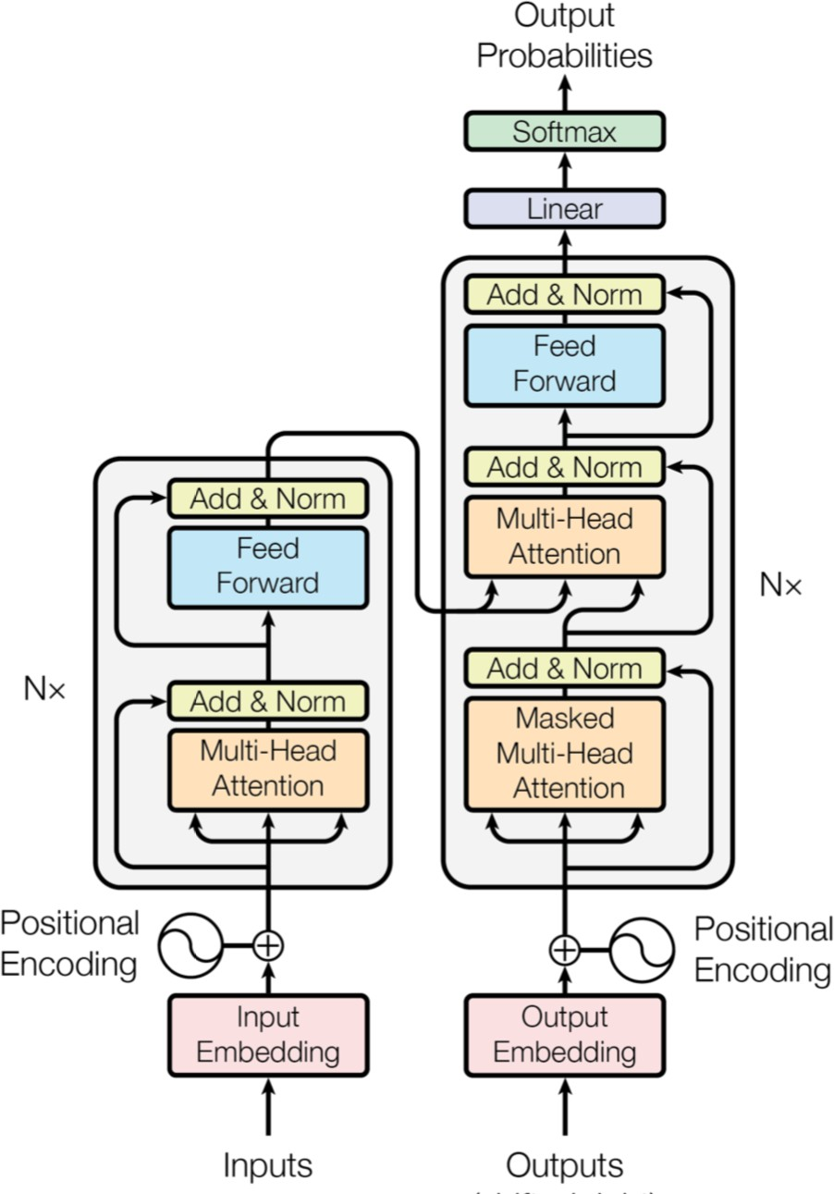
Attention is all you need (2017)
Encoder-decoder with only attention and fully-connected layers (no recurrence or convolutions)
Set new SOTA on translation datasets

Slide 19
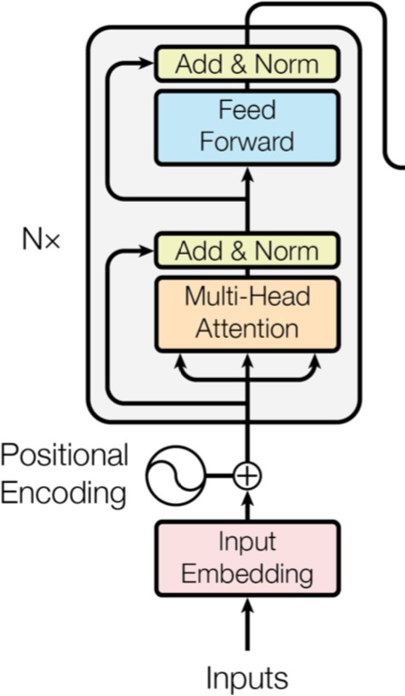
Attention is all you need (2017)
For simplicity, can focus just on the encoder
  (e.g. BERT is just the encoder)

Slide 20
Attention is all you need (2017)
The components:
  (Masked) Self-attention
  Positional encoding
  Layer normalization

Slide 21
Outline
"NLP's ImageNet Moment": ELMO / ULMFit
Transformers
  Attention in detail
  BERT, GPT-2, GPT-3, DistillBERT, T5
  ViT, DINO, CvT, CyTran

Slide 22
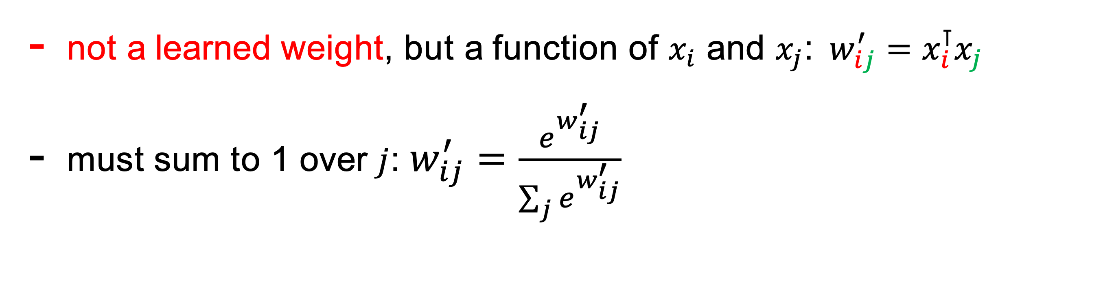
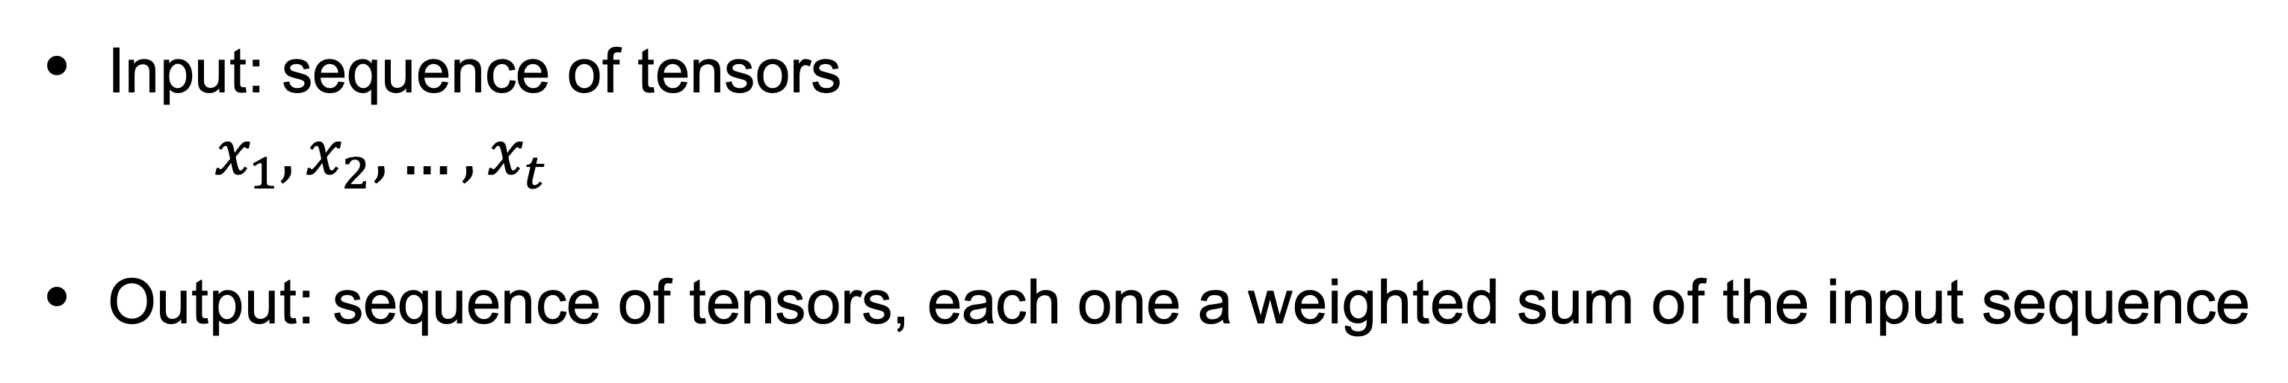
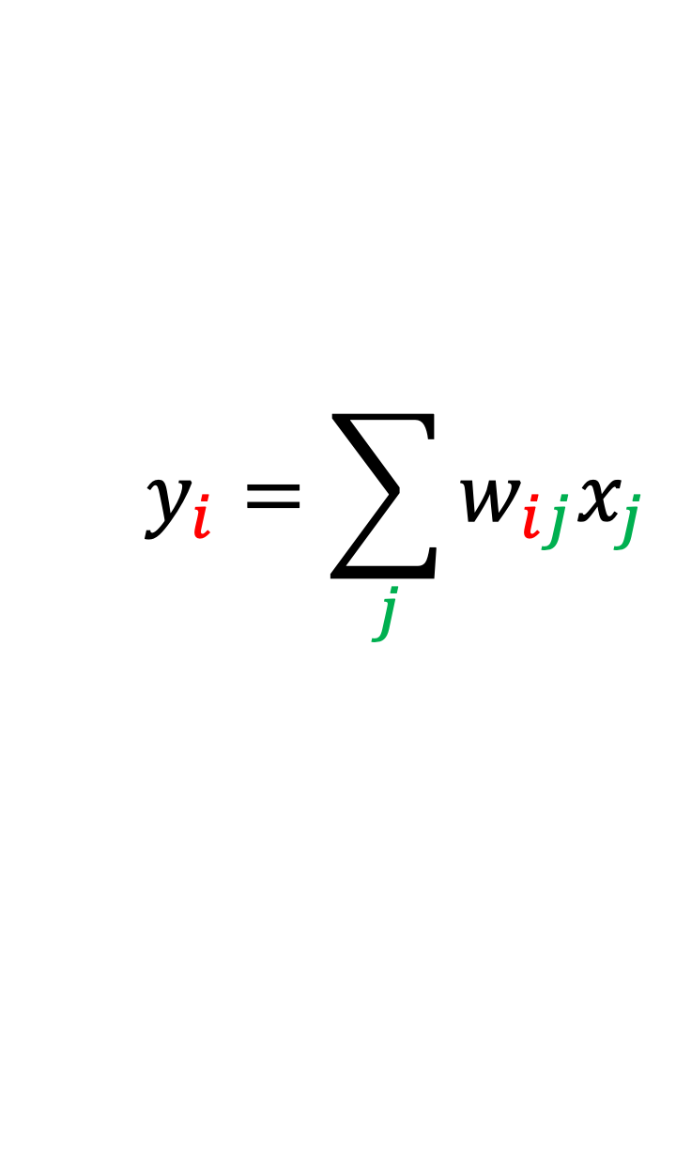
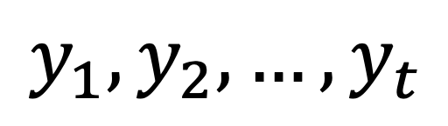
Basic self-attention
Input: sequence of tensors
$x_{1},x_{2},…,x_{t}$
Output: sequence of tensors, each one a weighted sum of the input sequence
$$y_{1},y_{2},…,y_{t}$$
$$y_{i}=\sum_{j}{w_{ij}x_{j}}$$
not a learned weight, but a function of $x_{i}$ and $x_{j}$:$w_{ij}^{′}=x_{i}^{⊺}x_{j}$
must sum to 1 over $j$: $w_{ij}^{′}=\frac{e^{w_{ij}^{′}}}{\sum_{j}{e^{w_{ij}^{′}}}}$
http://www.peterbloem.nl/blog/transformers

Slide 23
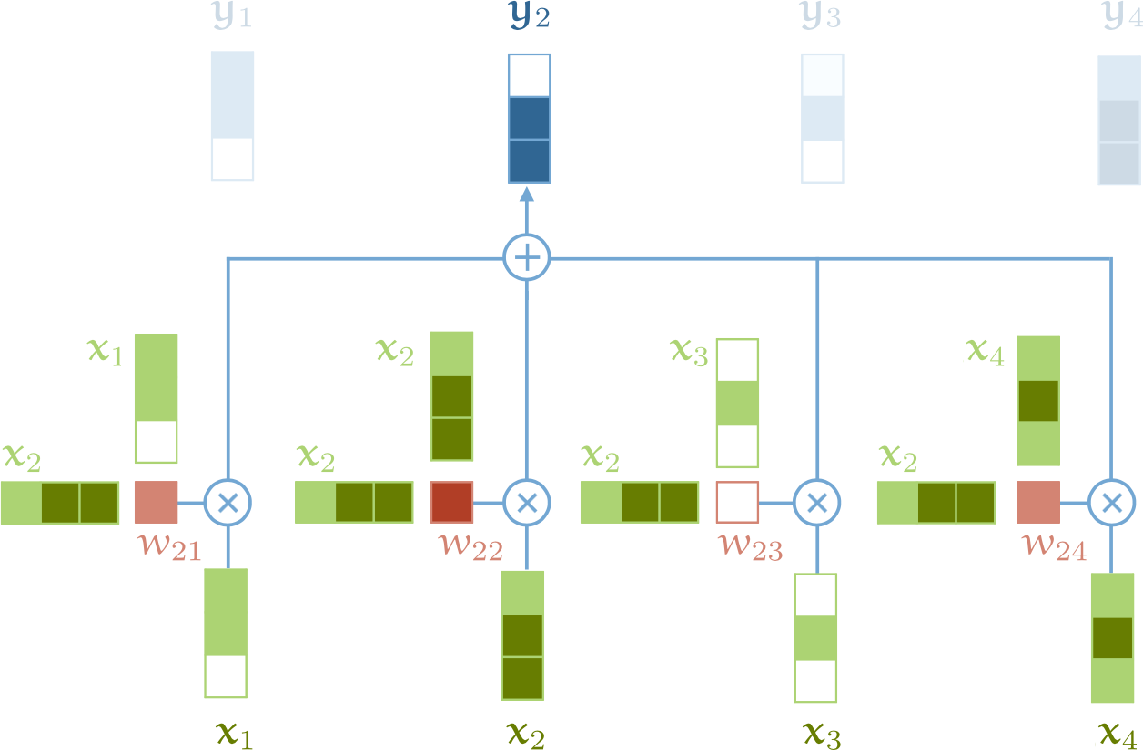
Basic self-attention
The
Cat
is
yawning
http://www.peterbloem.nl/blog/transformers

Slide 24
Basic self-attention
So far:
  No learned weights
  Order of the sequence does not affect result of computations
http://www.peterbloem.nl/blog/transformers

Slide 25
Basic self-attention
So far:
  No learned weights
Let's learn some weights!
Order of the sequence does not affect result of computations
http://www.peterbloem.nl/blog/transformers

Slide 26
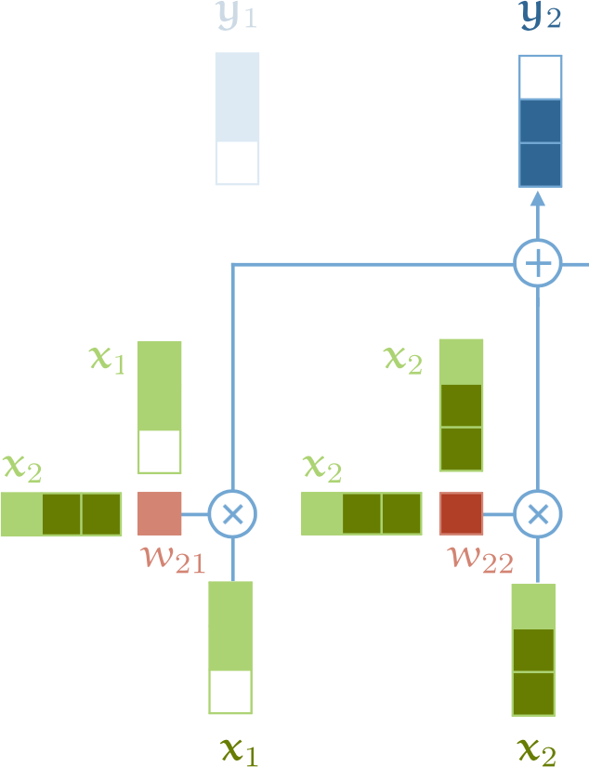
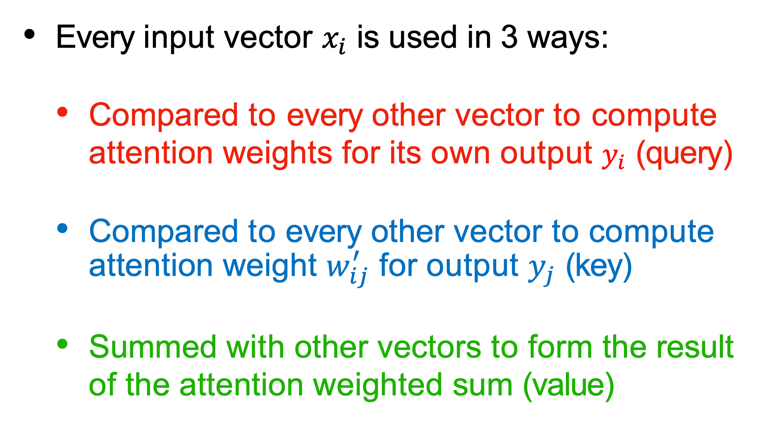
Query, Key, Value
Every input vector $x_{i}$ is used in 3 ways:
  Compared to every other vector to compute attention weights for its own output $y_{i}$ (query)
  Compared to every other vector to compute attention weight $w_{ij}^{′}$ for output $y_{j}$ (key)
  Summed with other vectors to form the result of the attention weighted sum (value)
http://www.peterbloem.nl/blog/transformers

Slide 27
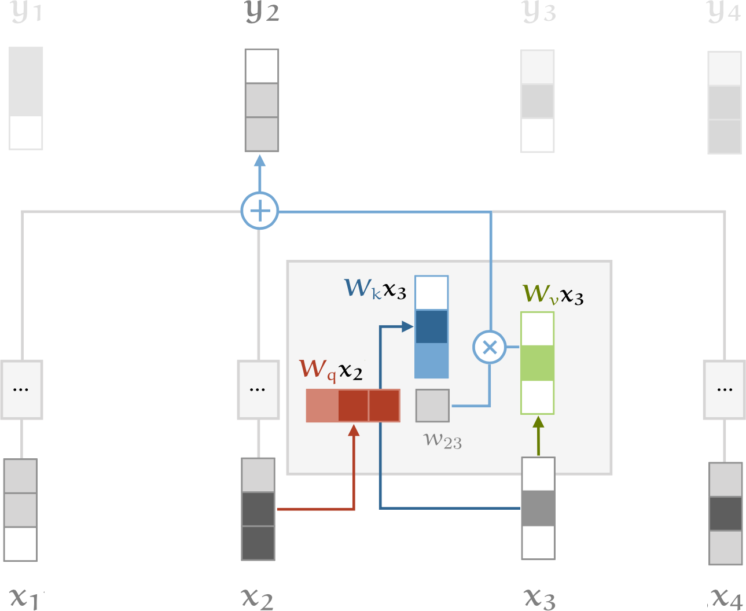


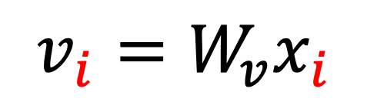
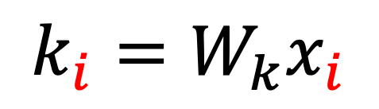
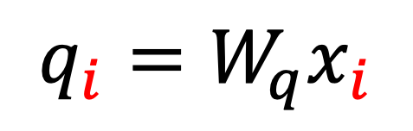

Query, Key, Value
We can process each input vector to fulfill the three roles with matrix multiplication
Learning the matrices => learning attention
$$q_{i}=W_{q}x_{i}$$
$$k_{i}=W_{k}x_{i}$$
$$v_{i}=W_{v}x_{i}$$
$$w_{ij}^{′}=q_{i}^{⊺}k_{j}$$
$$w_{ij}=softmax(w_{ij}^{′})$$
$$y_{i}=\sum_{j}{w_{ij}v_{j}}$$
http://www.peterbloem.nl/blog/transformers

Slide 28









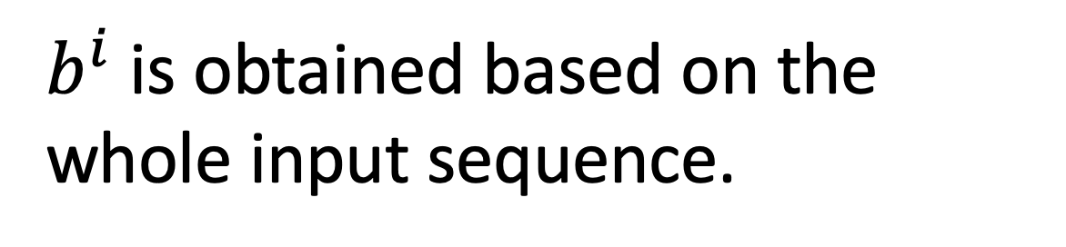





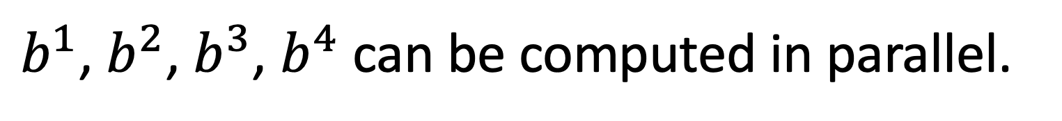



Self-Attention
$b^{i}$ is obtained based on the whole input sequence.
$b^{1}$, $b^{2}$, $b^{3}$, $b^{4}$ can be computed in parallel.
$$b^{1}$$
$$b^{2}$$
$$b^{3}$$
$$b^{4}$$
$$b^{1}$$
$$b^{2}$$
$$b^{3}$$
$$b^{4}$$
Self-Attention Layer
$$a^{1}$$
$$a^{2}$$
$$a^{3}$$
$$a^{4}$$
$$a^{1}$$
$$a^{2}$$
$$a^{3}$$
$$a^{4}$$
You can try to replace any thing that has been done by RNN with self-attention.

Slide 29
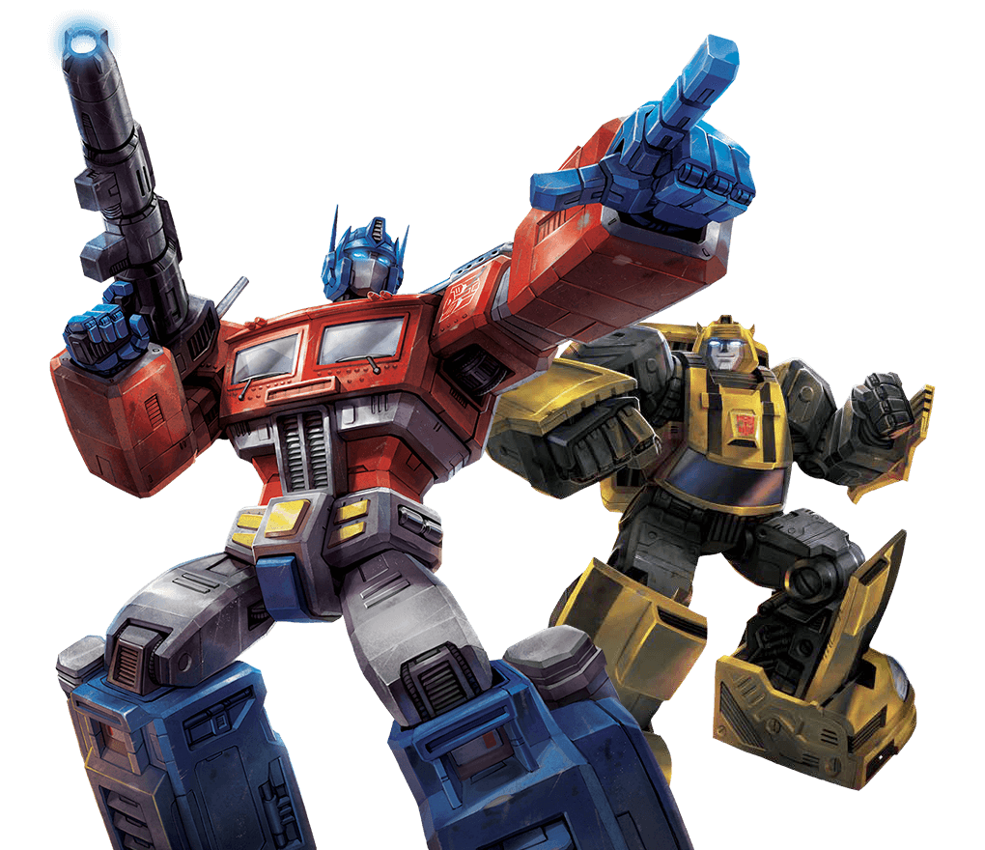


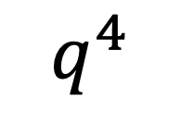
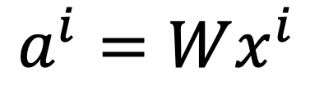






















Self-attention
$q$: query (to match others)
https://arxiv.org/abs/1706.03762
$$q^{i}=W^{q}a^{i}$$
$k$: key (to be matched)
$$k^{i}=W^{k}a^{i}$$
Attention is all you need.
$v$: information to be extracted
$$v^{i}=W^{v}a^{i}$$
$$q^{1}$$
$$k^{1}$$
$$v^{1}$$
$$q^{2}$$
$$k^{2}$$
$$v^{2}$$
$$q^{3}$$
$$k^{3}$$
$$v^{3}$$
$$q^{4}$$
$$k^{4}$$
$$v^{4}$$
$$a^{1}$$
$$a^{2}$$
$$a^{3}$$
$$a^{4}$$
$$a^{i}=Wx^{i}$$
$$x^{1}$$
$$x^{2}$$
$$x^{3}$$
$$x^{4}$$

Slide 30






Self-attention
d is the dim of $q$ and $k$
Each query q pays attention to each key k
Scaled Dot-Product Attention:
$$α_{1,i}=q^{1}∙k^{i}/\sqrt{d}$$
dot product
$$α_{1,1}$$
$$α_{1,2}$$
$$α_{1,3}$$
$$α_{1,4}$$
$$q^{1}$$
$$k^{1}$$
$$v^{1}$$
$$q^{2}$$
$$k^{2}$$
$$v^{2}$$
$$q^{3}$$
$$k^{3}$$
$$v^{3}$$
$$q^{4}$$
$$k^{4}$$
$$v^{4}$$
$$a^{1}$$
$$a^{2}$$
$$a^{3}$$
$$a^{4}$$
$$x^{1}$$
$$x^{2}$$
$$x^{3}$$
$$x^{4}$$

Slide 31





Self-attention
$${\hat{α}}_{1,i}=exp\left(α_{1,i} \right)/\sum_{j}{exp\left(α_{1,j} \right)}$$
$${\hat{α}}_{1,1}$$
$${\hat{α}}_{1,2}$$
$${\hat{α}}_{1,3}$$
$${\hat{α}}_{1,4}$$
Softmax
$$α_{1,1}$$
$$α_{1,2}$$
$$α_{1,3}$$
$$α_{1,4}$$
$$q^{1}$$
$$k^{1}$$
$$v^{1}$$
$$q^{2}$$
$$k^{2}$$
$$v^{2}$$
$$q^{3}$$
$$k^{3}$$
$$v^{3}$$
$$q^{4}$$
$$k^{4}$$
$$v^{4}$$
$$a^{1}$$
$$a^{2}$$
$$a^{3}$$
$$a^{4}$$
$$x^{1}$$
$$x^{2}$$
$$x^{3}$$
$$x^{4}$$

Slide 32






Self-attention
$$b^{1}=\sum_{i}{{\hat{α}}_{1,i}v^{i} }$$
Considering the whole sequence
$$b^{1}$$
$${\hat{α}}_{1,1}$$
$${\hat{α}}_{1,2}$$
$${\hat{α}}_{1,3}$$
$${\hat{α}}_{1,4}$$
$$q^{1}$$
$$k^{1}$$
$$v^{1}$$
$$q^{2}$$
$$k^{2}$$
$$v^{2}$$
$$q^{3}$$
$$k^{3}$$
$$v^{3}$$
$$q^{4}$$
$$k^{4}$$
$$v^{4}$$
$$a^{1}$$
$$a^{2}$$
$$a^{3}$$
$$a^{4}$$
$$x^{1}$$
$$x^{2}$$
$$x^{3}$$
$$x^{4}$$
Notes:
Relation between attention and CNN
Global receptive field (compared to convolutional architectures)

Slide 33






Self-attention
$$b^{2}=\sum_{i}{{\hat{α}}_{2,i}v^{i} }$$
Each query q pays attention to each key k
$$b^{2}$$
$${\hat{α}}_{2,1}$$
$${\hat{α}}_{2,2}$$
$${\hat{α}}_{2,3}$$
$${\hat{α}}_{2,4}$$
$$q^{1}$$
$$k^{1}$$
$$v^{1}$$
$$q^{2}$$
$$k^{2}$$
$$v^{2}$$
$$q^{3}$$
$$k^{3}$$
$$v^{3}$$
$$q^{4}$$
$$k^{4}$$
$$v^{4}$$
$$a^{1}$$
$$a^{2}$$
$$a^{3}$$
$$a^{4}$$
$$x^{1}$$
$$x^{2}$$
$$x^{3}$$
$$x^{4}$$
Notes:
Relation between attention and CNN
Global receptive field (compared to convolutional architectures)

Slide 34





Self-attention
$b^{1}$, $b^{2}$, $b^{3}$, $b^{4}$ can be computed in parallel.
$$b^{1}$$
$$b^{2}$$
$$b^{3}$$
$$b^{4}$$
Self-Attention Layer
$$a^{1}$$
$$a^{2}$$
$$a^{3}$$
$$a^{4}$$
$$x^{1}$$
$$x^{2}$$
$$x^{3}$$
$$x^{4}$$
Notes:
Relation between attention and CNN
Global receptive field (compared to convolutional architectures)

Slide 35






























Self-attention
$$q^{1}$$
$$q^{2}$$
$$q^{3}$$
$$q^{4}$$
$$a^{1}$$
$$a^{2}$$
=
$$a^{3}$$
$$W^{q}$$
$$a^{4}$$
$$Q$$
$$I$$
$$a^{1}$$
$$a^{2}$$
$$k^{1}$$
$$a^{3}$$
$$k^{2}$$
$$a^{4}$$
$$k^{3}$$
$$q^{i}=W^{q}a^{i}$$
$$k^{4}$$
=
$$W^{k}$$
$$K$$
$$I$$
$$k^{i}=W^{k}a^{i}$$
$$a^{1}$$
$$a^{2}$$
$$a^{3}$$
$$v^{1}$$
$$a^{4}$$
$$v^{2}$$
$$v^{3}$$
$$v^{4}$$
=
$$W^{v}$$
$$v^{i}=W^{v}a^{i}$$
$$V$$
$$I$$
$$q^{1}$$
$$k^{1}$$
$$v^{1}$$
$$q^{2}$$
$$k^{2}$$
$$v^{2}$$
$$q^{3}$$
$$k^{3}$$
$$v^{3}$$
$$q^{4}$$
$$k^{4}$$
$$v^{4}$$
$$a^{1}$$
$$a^{2}$$
$$a^{3}$$
$$a^{4}$$
$$x^{1}$$
$$x^{2}$$
$$x^{3}$$
$$x^{4}$$

Slide 36





















Self-attention
$$b^{1}$$
$${\hat{α}}_{1,1}$$
$${\hat{α}}_{1,2}$$
$${\hat{α}}_{1,3}$$
$${\hat{α}}_{1,4}$$
$$q^{1}$$
$$k^{1}$$
$$v^{1}$$
$$q^{2}$$
$$k^{2}$$
$$v^{2}$$
$$q^{3}$$
$$k^{3}$$
$$v^{3}$$
$$q^{4}$$
$$k^{4}$$
$$v^{4}$$
$$α_{1,1}=$$
$$k^{1}$$
$$q^{1}$$
$$α_{1,2}=$$
$$k^{2}$$
$$q^{1}$$
$$α_{1,1}$$
$$k^{1}$$
$$α_{1,2}$$
$$k^{2}$$
$$α_{1,3}=$$
$$k^{3}$$
$$q^{1}$$
$$α_{1,4}=$$
$$k^{4}$$
$$q^{1}$$
$$=$$
$$q^{1}$$
$$α_{1,3}$$
$$k^{3}$$
$$α_{1,4}$$
$$k^{4}$$
(ignore $\sqrt{d}$ for simplicity)
Notes:
Relation between attention and CNN
Global receptive field (compared to convolutional architectures)

Slide 37













































Self-attention
$$b^{2}=\sum_{i}{{\hat{α}}_{2,i}v^{i} }$$
$$b^{2}$$
$${\hat{α}}_{2,1}$$
$${\hat{α}}_{2,2}$$
$${\hat{α}}_{2,3}$$
$${\hat{α}}_{2,4}$$
$$q^{1}$$
$$k^{1}$$
$$v^{1}$$
$$q^{2}$$
$$k^{2}$$
$$v^{2}$$
$$q^{3}$$
$$k^{3}$$
$$v^{3}$$
$$q^{4}$$
$$k^{4}$$
$$v^{4}$$
$${\hat{α}}_{1,1}$$
$${\hat{α}}_{2,1}$$
$${\hat{α}}_{3,1}$$
$${\hat{α}}_{4,1}$$
$$α_{1,1}$$
$$α_{2,1}$$
$$α_{3,1}$$
$$α_{4,1}$$
$$k^{1}$$
$${\hat{α}}_{1,2}$$
$${\hat{α}}_{2,2}$$
$${\hat{α}}_{3,2}$$
$${\hat{α}}_{4,2}$$
$$α_{1,2}$$
$$α_{2,2}$$
$$α_{3,2}$$
$$α_{4,2}$$
$$k^{2}$$
$${\hat{α}}_{1,3}$$
$${\hat{α}}_{2,3}$$
$${\hat{α}}_{3,3}$$
$$=$$
$$q^{1}$$
$$q^{2}$$
$$q^{3}$$
$$q^{4}$$
$${\hat{α}}_{4,3}$$
$$α_{1,3}$$
$$α_{2,3}$$
$$α_{3,3}$$
$$α_{4,3}$$
$$k^{3}$$
$${\hat{α}}_{1,4}$$
$${\hat{α}}_{2,4}$$
$${\hat{α}}_{3,4}$$
$${\hat{α}}_{4,4}$$
$$α_{1,4}$$
$$α_{2,4}$$
$$α_{3,4}$$
$$α_{4,4}$$
$$k^{4}$$
$$Q$$
$$\hat{A}$$
$$A$$
$$K^{T}$$
Notes:
Relation between attention and CNN
Global receptive field (compared to convolutional architectures)

Slide 38

























Self-attention
$$b^{2}=\sum_{i}{{\hat{α}}_{2,i}v^{i} }$$
$$b^{2}$$
$${\hat{α}}_{2,1}$$
$${\hat{α}}_{2,2}$$
$${\hat{α}}_{2,3}$$
$${\hat{α}}_{2,4}$$
$$q^{1}$$
$$k^{1}$$
$$v^{1}$$
$$q^{2}$$
$$k^{2}$$
$$v^{2}$$
$$q^{3}$$
$$k^{3}$$
$$v^{3}$$
$$q^{4}$$
$$k^{4}$$
$$v^{4}$$
$${\hat{α}}_{1,1}$$
$${\hat{α}}_{2,1}$$
$${\hat{α}}_{3,1}$$
$${\hat{α}}_{4,1}$$
$${\hat{α}}_{1,2}$$
$${\hat{α}}_{2,2}$$
$${\hat{α}}_{3,2}$$
$${\hat{α}}_{4,2}$$
$$b^{1}$$
=
$$b^{2}$$
$$b^{3}$$
$$b^{4}$$
$$v^{1}$$
$$v^{2}$$
$$v^{3}$$
$$v^{4}$$
$${\hat{α}}_{1,3}$$
$${\hat{α}}_{2,3}$$
$${\hat{α}}_{3,3}$$
$${\hat{α}}_{4,3}$$
$$O$$
$$V$$
$${\hat{α}}_{1,4}$$
$${\hat{α}}_{2,4}$$
$${\hat{α}}_{3,4}$$
$${\hat{α}}_{4,4}$$
$$\hat{A}$$
Notes:
Relation between attention and CNN
Global receptive field (compared to convolutional architectures)

Slide 39



















Self-attention
$$O$$
$$Q$$
=
$$I$$
$$W^{q}$$
$$K$$
=
$$I$$
$$W^{k}$$
$$V$$
=
$$I$$
$$I$$
$$W^{v}$$
$$\hat{A}$$
$$A$$
=
$$Q$$
$$K^{T}$$
$$\hat{A}$$
$$O$$
=
$$V$$
A bunch of matrix multiplications, which can be executed efficiently on GPUs

Slide 40


Multi-head attention
Multiple "heads" of attention just means learning different sets of $W_{q}$, $W_{k}$, and $W_{v}$ matrices simultaneously.
Implemented as just a single matrix anyway...
http://www.peterbloem.nl/blog/transformers

Slide 41
























Multi-head Self-attention
(2 heads as example)
$$q^{i,1}=W^{q,1}q^{i}$$
$$b^{i,1}$$
$$q^{i,2}=W^{q,2}q^{i}$$
$$q^{i,1}$$
$$q^{i,2}$$
$$k^{i,1}$$
$$k^{i,2}$$
$$v^{i,1}$$
$$v^{i,2}$$
$$q^{j,1}$$
$$q^{j,2}$$
$$k^{j,1}$$
$$k^{j,2}$$
$$v^{j,1}$$
$$v^{j,2}$$
$$q^{i}$$
$$k^{i}$$
$$v^{i}$$
$$q^{j}$$
$$k^{j}$$
$$v^{j}$$
$$q^{i}=W^{q}a^{i}$$
$$a^{i}$$
$$a^{j}$$

Slide 42


Multi-head Self-attention
(2 heads as example)
$$q^{i,1}=W^{q,1}q^{i}$$
$$b^{i,1}$$
$$q^{i,2}=W^{q,2}q^{i}$$
$$b^{i,2}$$
$$q^{i,1}$$
$$q^{i,2}$$
$$k^{i,1}$$
$$k^{i,2}$$
$$v^{i,1}$$
$$v^{i,2}$$
$$q^{j,1}$$
$$q^{j,2}$$
$$k^{j,1}$$
$$k^{j,2}$$
$$v^{j,1}$$
$$v^{j,2}$$
$$q^{i}$$
$$k^{i}$$
$$v^{i}$$
$$q^{j}$$
$$k^{j}$$
$$v^{j}$$
$$q^{i}=W^{q}x^{i}$$
$$a^{i}$$
$$a^{j}$$

Slide 43





Multi-head Self-attention
(2 heads as example)
$$b^{i,1}$$
$$b^{i}$$
$$b^{i,1}$$
$$b^{i,2}$$
$$b^{i}$$
=
$$W^{O}$$
$$b^{i,2}$$
$$q^{i,1}$$
$$q^{i,2}$$
$$k^{i,1}$$
$$k^{i,2}$$
$$v^{i,1}$$
$$v^{i,2}$$
$$q^{j,1}$$
$$q^{j,2}$$
$$k^{j,1}$$
$$k^{j,2}$$
$$v^{j,1}$$
$$v^{j,2}$$
$$q^{i}$$
$$k^{i}$$
$$v^{i}$$
$$q^{j}$$
$$k^{j}$$
$$v^{j}$$
$$a^{i}$$
$$a^{j}$$

Slide 44

Transformer
Self-attention layer => Layer normalization => Dense layer
http://www.peterbloem.nl/blog/transformers

Slide 45
Transformer
Self-attention layer => Layer normalization => Dense layer
http://www.peterbloem.nl/blog/transformers

Slide 46



Layer Normalization
Neural net layers work best when input vectors have uniform mean and std in each dimension
  remember input data scaling, weight initialization
As inputs flow through the network, means and std's get blown out
Layer Normalization is a hack to reset things to where we want them in between layers
https://arxiv.org/pdf/1803.08494.pdf

Slide 47
Transformer
Self-attention layer => Layer normalization => Dense layer
http://www.peterbloem.nl/blog/transformers

Slide 48
Transformer
So far:
  Learned query, key, value weights
  Multiple heads
  Order of the sequence does not affect result of computations
http://www.peterbloem.nl/blog/transformers

Slide 49
Transformer
So far:
  Learned query, key, value weights
  Multiple heads
Order of the sequence does not affect result of computations
Let's encode each vector with position
http://www.peterbloem.nl/blog/transformers

Slide 50


















Positional Encoding
$$q^{i}$$
$$k^{i}$$
$$v^{i}$$
$$e^{i}$$
+
$$a^{i}$$
No position information in self-attention.
Original paper: each position has a unique positional vector $e^{i}$ (not learned from data)
In other words: each $x^{i}$ appends a one-hot vector $p^{i}$
$$x^{i}$$
$$x^{i}$$
$$a^{i}$$
$$W$$
=
$$W^{I}$$
$$x^{i}$$
$$p^{i}$$
$$W^{I}$$
$$W^{P}$$
$$p^{i}=$$
0
………
$$e^{i}$$
1
i-th dim
$$W^{P}$$
+
$$p^{i}$$
0
…

Slide 51












$$x^{i}$$
$$W$$
$$p^{i}$$
$$W^{I}$$
$$W^{P}$$
$$a^{i}$$
=
$$W^{I}$$
$$x^{i}$$
$$e^{i}$$
+
$$W^{P}$$
$$p^{i}$$
-1
1
source of image: http://jalammar.github.io/illustrated-transformer/

Slide 52


Transformer
http://www.peterbloem.nl/blog/transformers

Slide 53


Transformer
Position embedding: just what it sounds!
http://www.peterbloem.nl/blog/transformers

Slide 54

Transformer: last trick
Since the Transformer sees all inputs at once, to predict next vector in sequence (e.g. generate text), we need to mask the future.
http://www.peterbloem.nl/blog/transformers

Slide 55

Transformer: last trick
Since the Transformer sees all inputs at once, to predict next vector in sequence (e.g. generate text), we need to mask the future.
http://www.peterbloem.nl/blog/transformers

Slide 56















Seq2seq with Attention
Review: https://www.youtube.com/watch?v=ZjfjPzXw6og&feature=youtu.be
$$c^{1}$$
$$c^{2}$$
$$o^{1}$$
$$o^{2}$$
$$o^{3}$$
$$h^{1}$$
$$h^{2}$$
$$h^{3}$$
$$h^{4}$$
Self-Attention Layer
Self-Attention Layer
$$x^{1}$$
$$x^{2}$$
$$x^{3}$$
$$x^{4}$$
$$c^{1}$$
$$c^{2}$$
$$c^{3}$$
Encoder
Decoder

Slide 57
Outline
"NLP's ImageNet Moment": ELMO / ULMFit
Transformers
  Attention in detail
  BERT, GPT-2, GPT-3, DistillBERT, T5
  ViT, DINO, CvT, CyTran

Slide 58
Attention is all you need (2017)
Encoder-decoder for translation

Slide 59

Attention is all you need (2017)
Encoder-decoder for translation
Later models made it mostly just the encoder or just the decoder
...but then the latest models are back to encoder-decoder
http://www.peterbloem.nl/blog/transformers

Slide 60


GPT / GPT-2
Generative Pre-trained Transformer
https://docs.google.com/presentation/d/1fIhGikFPnb7G5kr58OvYC3GN4io7MznnM0aAgadvJfc

Slide 61

GPT / GPT-2
Generative Pre-trained Transformer
GPT learns to predict the next word in the sequence, just like ELMo or ULMFIT
https://arxiv.org/pdf/1810.04805.pdf

Slide 62

GPT / GPT-2
Generative Pre-trained Transformer
GPT learns to predict the next word in the sequence, just like ELMO or ULMFIT
Since it conditions only on preceding words, it uses masked self-attention
http://jalammar.github.io/illustrated-gpt2/

Slide 63


GPT / GPT-2
Trained on 8M web pages
117M params
345M params
762M params
1.5B params
http://jalammar.github.io/illustrated-gpt2/
63

Slide 64

Talk to Transformer
https://talktotransformer.com 1.5B parameter model
64

Slide 65

BERT
Bidirectional Encoder Representations from Transformers
Encoder blocks only (no masking)
BERT involves pre-training on A LOT of text with 15% of all words masked out
  also sometimes predicting whether one sentence follows another
65

Slide 66

BERT
340M parameters:
  24 transformer blocks, embedding dim of 1024, 16 attention heads
66

Slide 67

Transformers
https://medium.com/huggingface/encoder-decoders-in-transformers-a-hybrid-pre-trained-architecture-for-seq2seq-af4d7bf14bb8
67

Slide 68



Number of parameters
https://www.microsoft.com/en-us/research/blog/turing-nlg-a-17-billion-parameter-language-model-by-microsoft/
68

Slide 69

T5: Text-to-Text Transfer Transformer
•
•
Feb 2020
Evaluated most recent transfer learning techniques
Input and output are both text strings
Trained on C4 (Colossal Clean Crawled Corpus) - 100x larger than Wikipedia
11B parameters
SOTA on GLUE, SuperGLUE, SQuAD
•
•
•
•
https://ai.googleblog.com/2020/02/exploring-transfer-learning-with-t5.html
69

Slide 70

T5: Text-to-Text Transfer Transformer
https://medium.com/@Moscow25/the-best-deep-natural-language-papers-you-should-read-bert-gpt-2-and-looking- forward-1647f4438797
70

Slide 71


Slide 72

GPT -3
96

Slide 73



Slide 74


Slide 75

Really, really good text generation
Text typed by me
Text generated by the transformer

Slide 76

One problem: perpetuating unfortunate things
GSV Breakfa
https://twitter.com/an_open_mind/status/1284487376312709120

Slide 77

Reasonable mental model

Slide 78

Useful for more than text…

Slide 79

Useful for more than text…

Slide 80


Image Generation
https://openai.com/blog/dall-e/

Slide 81

No sign of slowing down
105

Slide 82


Slide 83

Number of parameters
The way things are trending, only big companies can afford to compete!
But there is another direction to go in: doing more with less
https://gluebenchmark.com/leaderboard

Slide 84



DistillBERT
Knowledge Distillation: a smaller model is trained to reproduce the output of a larger model
84

Slide 85

Papers and Leaderboards
paperswithcode.com
85

Slide 86


Implementations
https://github.com/huggingface/transformers
86

Slide 87
Outline
"NLP's ImageNet Moment": ELMO / ULMFit
Transformers
  Attention in detail
  BERT, GPT-2, GPT-3, DistillBERT, T5
  ViT, DINO, CvT, CyTran

Slide 88
An image is worth 16x16 words: Transformers for image recognition at scale (ICLR 2021)
The Vision Transformer (ViT) is an Artificial Neural Network (ANN) architecture for Computer Vision for category-level recognition.
It can be seen as an extension of Convolutional Neural Networks (CNNs) with an arbitrarily large receptive field.

Slide 89


Receptive Field
Receptive field of neuron $j$ of layer $l$ w.r.t layer $l−1$
Region of layer $l−1$ that neuron $j$ has access to in order to produce its activation
The receptive field of a CNN is strictly dependent upon the kernel size of the given convolutional layer.
Image source: Lin, Haoning & Shi, Zhenwei & Zou, Zhengxia. (2017). Maritime Semantic Labeling of Optical Remote Sensing Images with Multi-Scale Fully Convolutional Network. Remote Sensing. 9. 480. 10.3390/rs9050480.

Slide 90

Attention
Attention is a mechanism for creating arbitrarily long-range weighted dependencies between word tokens in language models
If we can find a way to translate this tool to images, we can effectively find a way to replace/expand convolutions

Slide 91

Self-attention
The self-attention mechanism = a tool to relate a pixel in an image to all the pixels inside the same image
For each pixel $i$, we create:
A row vector $q_{i,∙}$called query
A row vector $k_{i,∙}$ called key
A row vector $v_{i,∙}$ called value
we suppose they share the dimensions $d$

Slide 92


Self-attention
We can now view the process of self-attention as a question-making:
«Pixel $i$, what are you looking at?»
«Pixel $i$, where is your attention directed?»
For images, we can view self-attention as a mechanism for building (semantic) long-range learnable relationships between pixels in the same image

Slide 93



Self-attention
How does this process relate to the key-value store example?
In the key-value store, we're applying a so-called hard attention
We formulate a query
$$A= argmax\left(q_{i,∙}⋅K^{⊤}\right)V$$
We pick the best-matching key
$$A= softmax\left(q_{i,∙}⋅K^{⊤}\right)V$$
We retrieve the corresponding value
In the attention mechanism, we apply soft attention
Soft attention is differentiable, hence we can use it in ANNs
$A$measures the extent to which a given pixel attends to all the other pixels in the image.

Slide 94


Embedding the input
ViT draws heavily from language transformers
One of the staples of transformers is the embedding of the input in a lower dimension to reduce complexity
Moreover, the transformer attaches an additional learnable embedding called [class], a learnable initial context
Equivalent to RNN «context token»
Input image
$$∈ℝ^{h×w×C}$$
*
0
1
2
...
N
Learnable [class] embedding
$$E∈ℝ^{C×D}$$

Slide 95


Embedding the input as patches
After operating this embedding, the model is still too complex
Self-attention is $𝒪(n^{2})$, which is still huge if we have, e.g., images of size $224× 224$
ViT solves this issue by applying the embedding to image patches instead of pixels
For an RBG image, we have $N$ patches $x_{p}$ of shape $P× P×C$
$E∈ℝ^{{ (P}^{2}⋅C)×D}$
Image source: [ViT]

Slide 96


Permutation Invariance
We still have one issue to solve: attention works on (non-ordered) sets, which means that the attention mechanism has no way to determine which is the position of any one of the N embeddings
The effect of this is that we may induce permutation invariance in our ViT, which is a property we don't really want.

Slide 97

Positional embedding
We solve this issue by attaching positional embeddings to each embedding
ViT lets the positional embedding be a learnable matrix $E_{pos}∈ℝ^{(N+1)×D}$
We just sum it to the input embedding from before.
$z_{0}=\left[x_{class};x_{p}^{\left(1\right)}E;…;x_{p}^{\left(N\right)}E\right]+E_{pos}$
$z_{0}∈ℝ^{\left(N+1\right)×D}$
We add parameter $E_{pos}$
N+1
0 | ​ | 1 | ​ | 2 |  | 3 |  | 4 |  | 5 |  | 6 |  | 7 |  | 8
​ | ​ | ​ | ​
D
+
D
​ | ​ | ​ | ​
​ | ​ | ​ | ​
=
D
​ | ​ | ​ | ​
​ | ​ | ​ | ​
Embeddings

Slide 98






Building the ViT
The CNN is (mainly) a stack of convolutional layers
The ViT is a stack of MSA layers
$$z_{0}$$
MSA
MLP
$$z_{1}$$
MSA
MLP
MSA
MLP
$$z_{L}$$
?
…
Embed
We’re missing one last step

Slide 99





Classifier (MLP-head)
The final classifier is a 1D fully-connected layer + layernorm
It operates only on the first component of the embedding
  It is the equivalent of the RNN context (the [CLS] token), which gets «updated» layer-by-layer
  Linear reprojection onto a $c$-dimensional space
    $c$ = num classes
  Expresses the confidence of the network in the prediction for each class
cat
…
MSA
MLP
$$z_{L}$$
dog
layer norm.
building
$$\left(N+1\right)×D$$
duck
$$D$$
$$c$$

Slide 100


Architectural specs
ViT-L/16
Large spec
16x16 patches
Note: usually $d=\frac{D}{H}$
Dropout is applied after these linear ops:
Patch embedding
Projection
MLP
The smaller the patches, the larger the attention structures

Slide 101
Training methodology
A pre-training phase is recommended for ViT
  Train the model on a large-scale dataset like ImageNet
and then fine-tune on the downstream task
The pre-training is operated with a «large» MLP head (2 linear layers)
The fine-tuning is done with the «small» 1-layer MLP head initialized at 0
It is suggested to run this fine-tuning on a higher resolution
  E.g. ImageNet 226x226 → 384x384

Slide 102

Emerging Properties in Self-Supervised Vision Transformers (ICCV 2021)

Slide 103

DINO (ICCV 2021)

Slide 104

DINO (ICCV 2021)

Slide 105

CyTran: Cycle-Consistent Transformers for Non-Contrast to Contrast CT Translation (2021)
Based on CvT
Replaces MLP with pointwise convolution:
  processes high-resolution images efficiently

Slide 106

CyTran (2021)

Slide 107


CyTran (2021)

Slide 108

SepTr (INTERSPEECH, 2022)
Transformers in audio spectrogram processing:
Combined with Convolutional Neural Networks
Stand alone transformers
  Splits each spectrogram into
patches, then builds tokens
Notes:
Vision transformers have rapidly become the hottest topic in computer vision to date, showing promising results across a broad range of tasks.
Due to the unquestionable success in solving many computer vision tasks, these models have also drawn the attention of the signal processing community.
In the preliminary studies adopting transformers for audio tasks, the attention architecture was typically used in conjunction with convolutional neural networks.
More recently, approaches purely based on transformer modules have been employed for audio processing.

Slide 109
Motivation
The spectrogram is a 2D representation of distinct dimensions (time and frequency) which are independent
The transformer’s trainable parameters scale quadratically with the number of tokens, leading to a high memory footprint
Our solution:
Employ attention independently on each axis, reducing the complexity with respect to the number tokens
Notes:
Signals are often represented as spectrograms (through Discrete Fourier Transform) which can be directly provided as input to vision transformers.
However, naively applying transformers to spectrograms is suboptimal. Moreover, the attention spans across both directions, leading to a quadratic complexity with respect to the number of tokens.
We argue that a better approach is to separate the attention dedicated to each axis, an update which leads to a linear scaling between the trainable parameters and the input size.

Slide 110

SepTr (INTERSPEECH, 2022)
Notes:
Let’s have a deep dive into our Separable transformer architecture.
We considering a spectrogram with k times p frequency bins and n times p time slots as input

Slide 111
SepTr (INTERSPEECH, 2022)
Notes:
In the first stage, we divide the input spectrogram into k times n square patches of size p times p.
In the experiments, we take patches of size 1 times 1, since we consider that it is more natural to compute the self-attention at the finest possible level.

Slide 112
SepTr (INTERSPEECH, 2022)
Notes:
The tokens are further fed into a linear projection block, which projects the tokens into d-dimensional vectors depicted with green in the figure.

Slide 113
SepTr (INTERSPEECH, 2022)
Notes:
Next, we separate the projected tokens in the time domain into data sub-samples. This means that a data sample is composed by the frequency tokens at the same time interval.
The class token is replicated for each time interval and a positional embedding is added to all tokens.

Slide 114

SepTr (INTERSPEECH, 2022)
Notes:
The tokens are processed by the vertical transformer block, capturing frequency features from a certain time slot.

Slide 115

SepTr (INTERSPEECH, 2022)
Notes:
The output of the vertical transformer is also composed of tokens. These are further rearranged such that, now, a data sample is a frequency bin. More precisely, we will have a batch of k frequency bins and for each bin we have the corresponding time tokens.
The mean class token is averaged for all the processed class tokens and further replicated for the new batch of data samples, such that each frequency bin will have a corresponding class token.
A positional embedding is added in a similar fashion as before.

Slide 116

SepTr (INTERSPEECH, 2022)
Notes:
The tokens are processed by the horizontal transformer block, capturing time features from a certain frequency bin.

Slide 117

SepTr (INTERSPEECH, 2022)
Notes:
This process is repeated L times, where L is the depth of the transformer.

Slide 118

SepTr (INTERSPEECH, 2022)
Notes:
Finally, the class token is averaged and fed int a multi layer perceptron head, which computes the final output.

Slide 119

Results (1)
Notes:
We first analyze the impact of the vertical and horizontal transformers, when these modules are used alone or jointly.
We present ablation results on the CREMA-D data set, where V stands for vertical and H for horizontal blocks.
We observe that computing the attention on a single axis with SepTr-V or SepTr-H leads to suboptimal results, even below the ViT baseline.
This shows that performing attention on one axis only is not sufficient.

Slide 120
Results (1)
Notes:
Further, we show results while alternating the order of the vertical and horizontal transformers.
Regardless of how the separable attention is applied via SepTr-HV or SepTr-VH, we observe important performance boosts (higher than 5 percent) over the models attending to only one of the axes.
Switching the order of the vertical and horizontal transformers has a marginal influence on the accuracy level, both SepTr-HV or SepTr-VH being able to outperform the state-of-the-art methods by significant margins.
As we obtained slightly better results with SepTr-VH, we continued the rest of the experiments with this architecture.

Slide 121

Results (1)
Notes:
On the SCV2 and ESC-50 data sets, we consider state-of-the-art methods that are not pre-trained on external data, ensuring a fair comparison with SepTr, which is trained from scratch.
On SCV2, SepTr attains an accuracy of 98.51 percent, which is 0.40% higher than the previous state-of-the-art accuracy.
On ESC-50, SepTr yields an accuracy of 91.13%, surpassing ViT by 2.43%.
In summary, SepTr surpasses all the state-of-the-art methods on each and every data set by significant margins.

Slide 122

Results (2)
GMACs
  ViT 80.09
  SepTr 80.57
Inference time
  ViT 5.69 ms
  SepTr 5.72 ms
*Device: Nvidia GeForce GTX 3090 GPU with 24 GB of VRAM
Notes:
We compare the performance of SepTr and ViT in terms of the memory footprint (number of learnable parameters), inference time and number of multiply-accumulate operations (MACs), on an Nvidia GeForce GTX 3090 GPU with 24 GB of VRAM.
In terms of GMACs and inference time, the differences are negligible, but when we refer to the memory footprint, we observe a large difference between the two models.
In the right Figure, we illustrate the number of learnable parameters as a function of the input spectrogram size.
We observe that SepTr has an almost constant number of parameters with respect to the input dimension, while the number of weights in ViT exhibits a quadratic growth, leading to comparatively larger models.
Unlike ViT, our model is able to handle high resolution spectrograms, an essential advantage leading to high accuracy levels in the audio domain.

