Slide 1
Distributional Semantics.
Word Embeddings.
Skip-gram and CBOW Models.
Radu Ionescu, Prof. PhD.
raducu.ionescu@gmail.com
Faculty of Mathematics and Computer Science
University of Bucharest

Slide 2
Distributional Semantics

Slide 3
Why vector models of meaning?
Allows us to compute the similarity between words
fast is similar to rapid
tall is similar to height
Question answering:
Q: “How tall is Mt. Everest?”
Candidate A: “The official height of Mount Everest is 29029 feet”

Slide 4
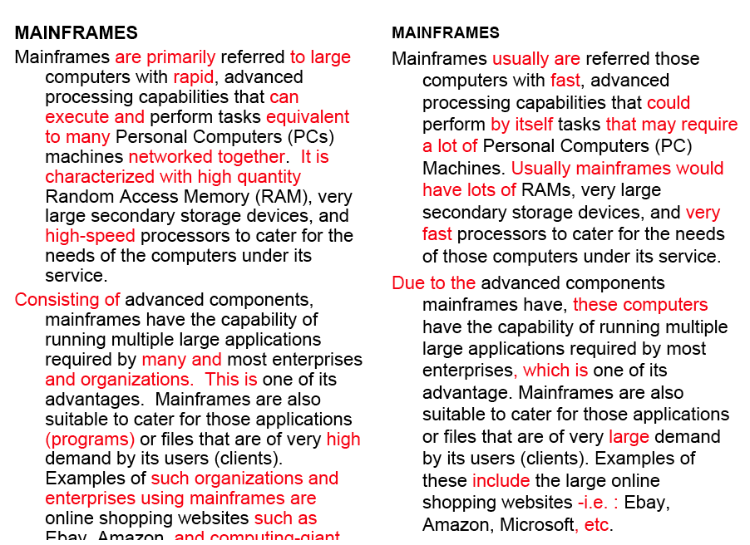
Word similarity for plagiarism detection

Slide 5
Word similarity for historical linguistics
Sagi, Kaufmann Clark 2013
Kulkarni, Al-Rfou, Perozzi, Skiena 2015
Semantic change over time

Slide 6
Problems with thesaurus-based meaning
We don’t have a thesaurus for every language
We can’t have a thesaurus for every year
  For historical linguistics, we need to compare word meanings in year t to year t+1
Thesauri have problems with recall
  Many words and phrases are missing
  Thesauri work less well for verbs, adjectives

Slide 7
Vector-space models of meaning
(distributional semantics)
Intuitions: Zellig Harris (1954):
  “oculist and eye-doctor … occur in almost the same environments”
  “If A and B have almost identical environments we say that they are synonyms.”
Firth (1957):
  “You shall know a word by the company it keeps!”

Slide 8
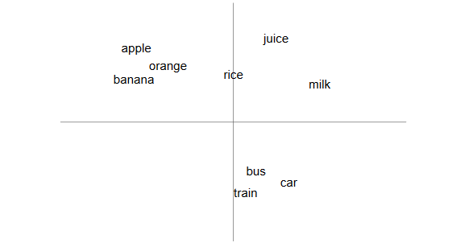
“A word is known by the company it keeps”

Slide 9
Intuition of distributional word similarity
Example: Suppose I asked you what is tesgüino?
    A bottle of tesgüino is on the table.
    Everybody likes tesgüino.
    Tesgüino makes you drunk.
    We make tesgüino out of corn.
From context words humans can guess tesgüino means
  an alcoholic beverage like beer
Intuition for algorithm:
  Two words are similar if they have similar word contexts

Slide 10
Different kinds of vector models
Sparse vector representations:
  Mutual-information weighted word co-occurrence matrices
Dense (compact) vector representations:
  Singular Value Decomposition (and Latent Semantic Analysis)
  Neural-network-inspired models (skip-grams, CBOW)
  Brown clusters (not covered)

Slide 11
Shared intuition
Model the meaning of a word by “embedding” in a vector space
The meaning of a word is a vector of numbers
  Vector models are also called embeddings!
Contrast: word meaning is represented in many computational linguistic applications by a vocabulary index (“word number 545”)

Slide 12
Words and co-occurrence vectors

Slide 13
Co-occurrence Matrices
We represent how often a word occurs in a document
  Term-document matrix
Or how often a word occurs with another
  Term-term matrix
    (or word-word co-occurrence matrix
    or word-context matrix)

Slide 14

Term-document matrix
Each cell: count of word $w$ in a document $d$:
Each document is a count vector in $ℕ^{|V|}$, i.e. a column below:

Slide 15
Similarity in term-document matrices
Two documents are similar if their vectors are similar

Slide 16

The words in a term-document matrix
Each word is a count vector in $ℕ^{|D|}$, i.e. a row below:

Slide 17
The words in a term-document matrix
Two words are similar if their vectors are similar

Slide 18
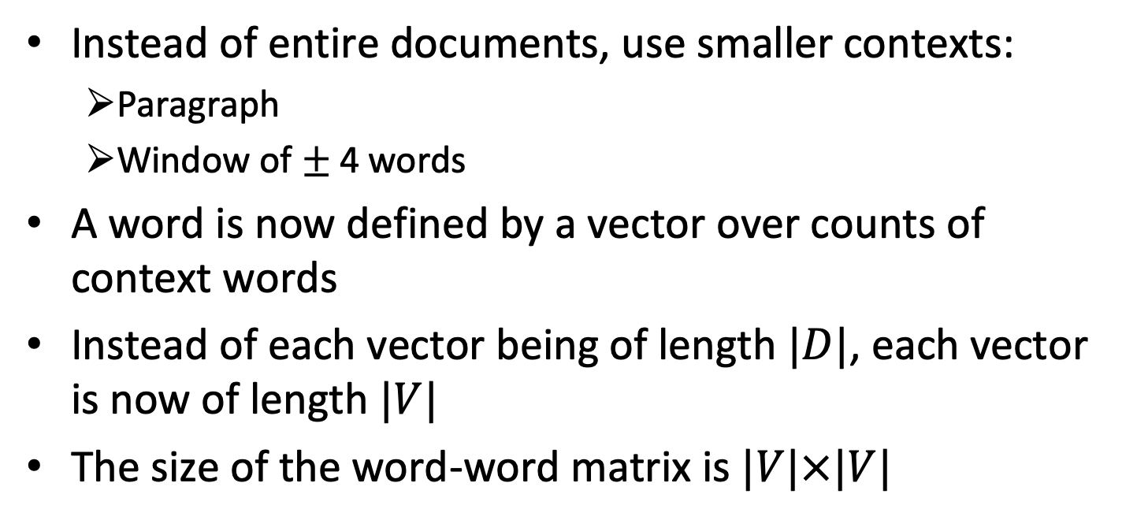
The word-word or word-context matrix
Instead of entire documents, use smaller contexts:
  Paragraph
  Window of $±$ 4 words
A word is now defined by a vector over counts of context words
Instead of each vector being of length $|D|$, each vector is now of length $|V|$
The size of the word-word matrix is $|V|×|V|$

Slide 19
Word-Word matrix with sample contexts $±$ 7 words

Slide 20
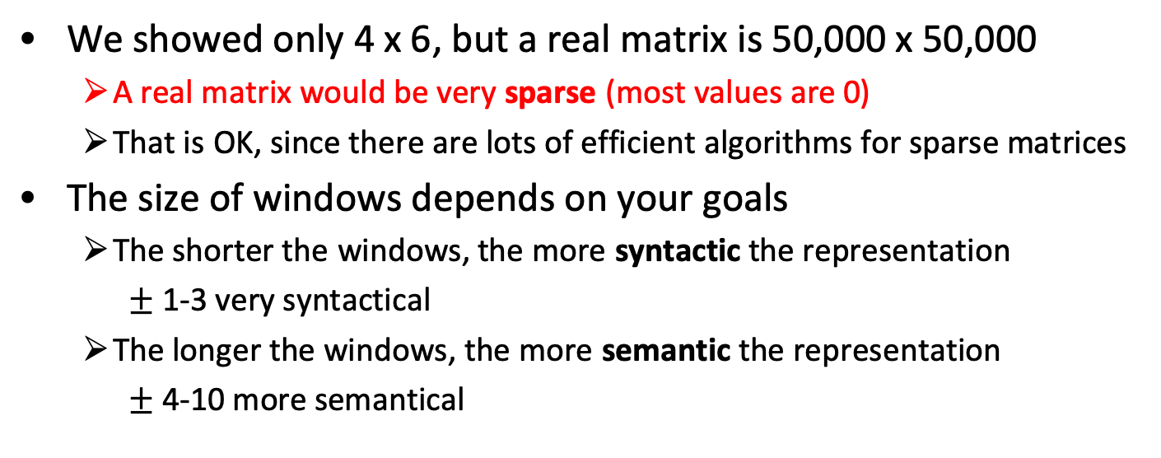
Word-word matrix
We showed only 4 x 6, but a real matrix is 50,000 x 50,000
  A real matrix would be very sparse (most values are 0)
  That is OK, since there are lots of efficient algorithms for sparse matrices
The size of windows depends on your goals
  The shorter the windows, the more syntactic the representation
    $±$ 1-3 very syntactical
  The longer the windows, the more semantic the representation
    $±$ 4-10 more semantical

Slide 21
Two kinds of co-occurrence between words
First-order co-occurrence (syntagmatic association):
  They are typically nearby each other
  wrote is a first-order associate of book or poem
Second-order co-occurrence (paradigmatic association):
  They have similar neighbors
  wrote is a second-order associate of words like said or remarked
[Schütze and Pedersen, 1993]

Slide 22
Measuring similarity: the cosine

Slide 23
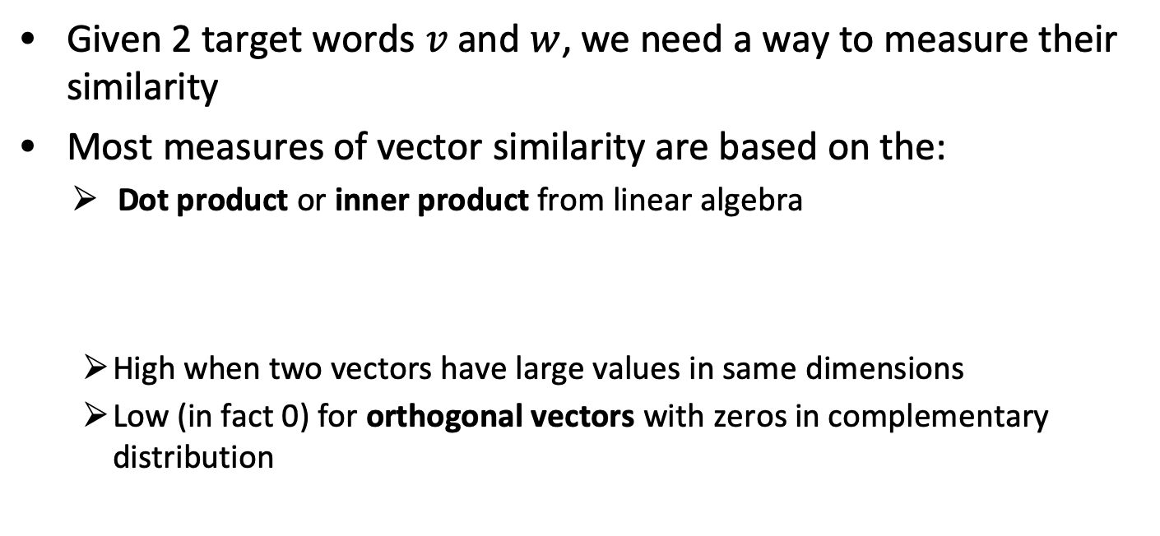
Measuring similarity
Given 2 target words $v$ and $w$, we need a way to measure their similarity
Most measures of vector similarity are based on the:
Dot product or inner product from linear algebra
  High when two vectors have large values in same dimensions
  Low (in fact 0) for orthogonal vectors with zeros in complementary distribution

Slide 24
Problem with dot product
Dot product is higher if the vector is longer. Vector length:
Vectors are longer if they have higher values in each dimension
That means more frequent words will have higher dot products
That’s bad: we don’t want a similarity metric to be sensitive to word frequency

Slide 25
Solution: cosine similarity
Just divide the dot product by the length of the two vectors!
This turns out to be the cosine of the angle between them!

Slide 26
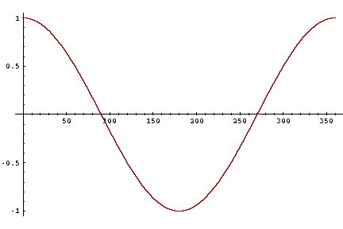
Cosine for computing similarity
Sec. 6.3
Dot product
Unit vectors
-1: vectors point in opposite directions
+1: vectors point in same directions
0: vectors are orthogonal

Slide 27


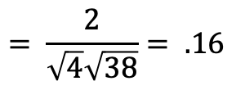

Example:
 | large | data | computer
apricot | 2 | 0 | 0
digital | 0 | 1 | 2
information | 1 | 6 | 1
Which pair of words is more similar?
cosine(apricot,information) =
cosine(digital,information) =
cosine(apricot,digital) =
$$2+0+0$$
$$= \frac{2}{\sqrt{4}\sqrt{38}}= .16$$
$$\sqrt{4+0+0 }$$
$$\sqrt{4+0+0 }$$

Slide 28
Visualizing vectors and angles
 | large | data
apricot | 2 | 0
digital | 0 | 1
information | 1 | 6

Slide 29
Evaluating similarity
Intrinsic Evaluation:
  Correlation between algorithm and human word similarity ratings
Extrinsic (task-based, end-to-end) Evaluation:
  Spelling error detection, WSD, essay grading
  Taking TOEFL multiple-choice vocabulary tests
Levied is closest in meaning to which of these:
  imposed, believed, requested, correlated

Slide 30
Dense Vectors

Slide 31
Sparse versus dense vectors
Vectors from term-term matrices are
  long (length |V|= 20,000 to 50,000)
  sparse (most elements are zero)
Alternative: learn vectors which are
  short (length 200-1000)
  dense (most elements are non-zero)

Slide 32
Why dense vectors?
  Short vectors may be easier to use as features in machine learning (less weights to tune)
  Dense vectors may generalize better than storing explicit counts
  They may do better at capturing synonymy:
    car and automobile are synonyms, but are represented as distinct dimensions
    This fails to capture similarity between a word with car as a neighbor and a word with automobile as a neighbor

Slide 33
Methods for getting short dense vectors
Singular Value Decomposition (SVD)
  A special case of this is called LSA – Latent Semantic Analysis
“Neural Language Model”-inspired predictive models
  Skip-grams and CBOW
Brown clustering

Slide 34
Dense Vectors via SVD

Slide 35
Intuition
Approximate an N-dimensional dataset using fewer dimensions by first rotating the axes into a new space
In the new space, the highest order dimension captures the most variance in the original dataset
And the next dimension captures the next most variance, etc.
Many such (related) methods:
  PCA – principle components analysis
  Factor Analysis
  SVD

Slide 36
Dimensionality reduction

Slide 37
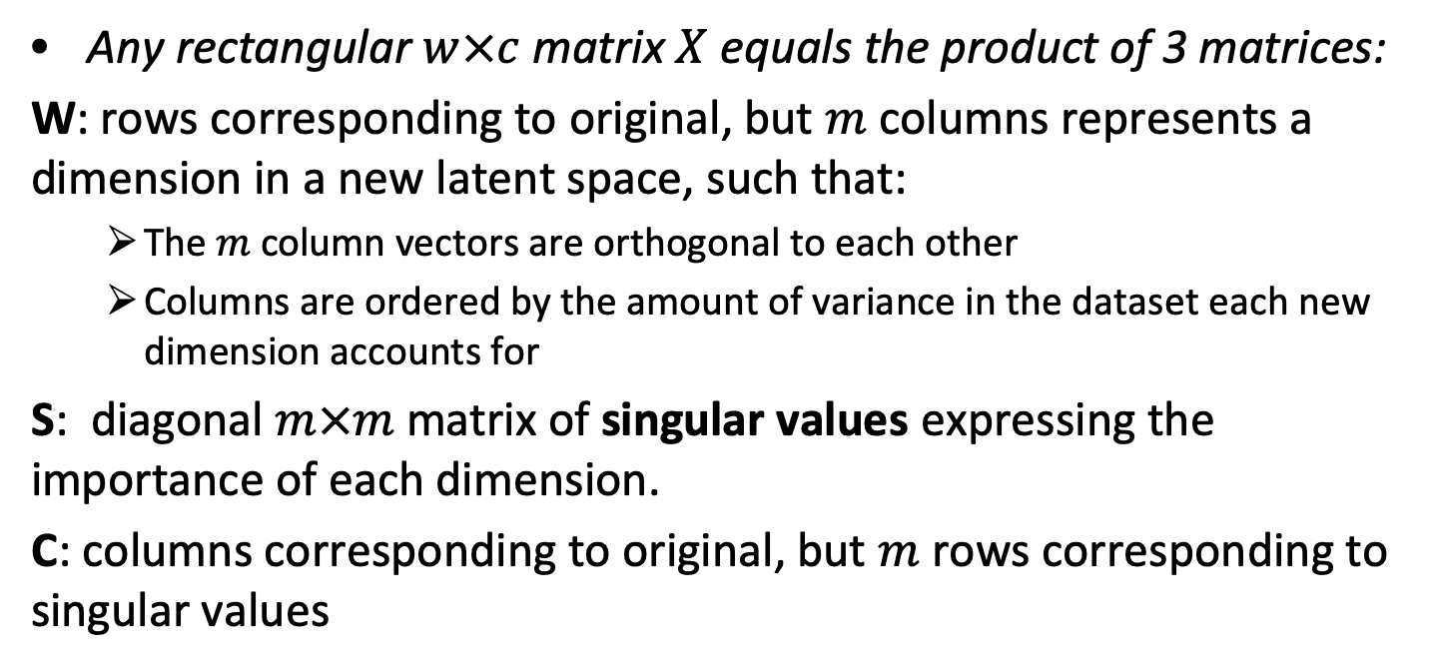
Singular Value Decomposition
Any rectangular $w×c$ matrix $X$ equals the product of 3 matrices:
W: rows corresponding to original, but $m$ columns represents a dimension in a new latent space, such that:
  The $m$ column vectors are orthogonal to each other
  Columns are ordered by the amount of variance in the dataset each new dimension accounts for
S: diagonal $m×m$ matrix of singular values expressing the importance of each dimension.
C: columns corresponding to original, but $m$ rows corresponding to singular values

Slide 38
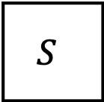



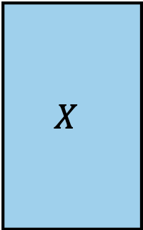



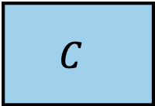
Singular Value Decomposition
Contexts
$$X$$
$$W$$
$$S$$
$$C$$
$$∙$$
$$∙$$
Words
=
$$m×m$$
$$m×c$$
$$w×c$$
$$w×m$$
[Landuaer and Dumais 1997]

Slide 39
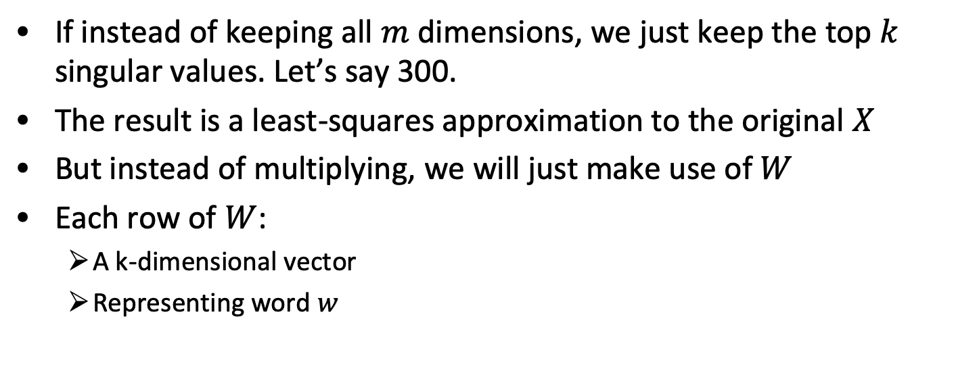
SVD applied to term-document matrix:
Latent Semantic Analysis
If instead of keeping all $m$ dimensions, we just keep the top $k$ singular values. Let’s say 300.
The result is a least-squares approximation to the original $X$
But instead of multiplying, we will just make use of $W$
Each row of $W$:
  A k-dimensional vector
  Representing word $w$
[Deerwester et al. 1988]

Slide 40



Latent Semantic Analysis
Contexts
$$X$$
$$W$$
$$S$$
$$C$$
$$∙$$
$$∙$$
Words
=
$$k×k$$
$$k×c$$
$$w×c$$
$$w×k$$
[Deerwester et al. 1988]

Slide 41
LSA more details
300 dimensions are commonly used
The cells are commonly weighted by a product of two weights
  Local weight: Log term frequency
  Global weight: either inverse document frequency or an entropy measure

Slide 42
Let’s return to word-word matrices
Can we apply to SVD to them?
Yes

Slide 43
SVD applied to term-term matrix
(I’m simplifying here by assuming the matrix has rank |V|)

Slide 44
Truncated SVD on term-term matrix

Slide 45
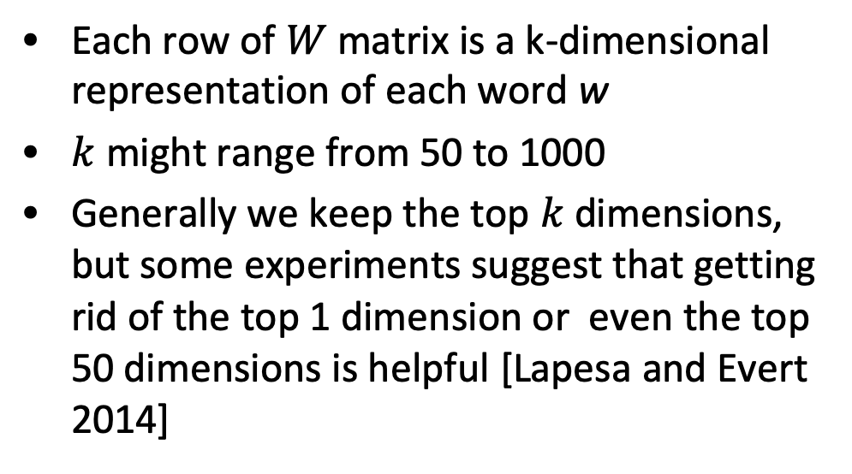
Truncated SVD produces embeddings
Each row of $W$ matrix is a k-dimensional representation of each word w
$k$ might range from 50 to 1000
Generally we keep the top $k$ dimensions, but some experiments suggest that getting rid of the top 1 dimension or even the top 50 dimensions is helpful [Lapesa and Evert 2014]

Slide 46
Embeddings versus sparse vectors
Dense SVD embeddings sometimes work better than sparse word-word matrices at tasks like word similarity
  Denoising: low-order dimensions may represent unimportant information
  Truncation may help the models generalize better to unseen data
  Having a smaller number of dimensions may make it easier for classifiers to properly weight the dimensions for the task.
  Dense models may do better at capturing higher order co-occurrence

Slide 47
Skip-gram and CBOW models

Slide 48
Prediction-based models:
An alternative way to get dense vectors
Skip-gram (Mikolov et al. 2013a), CBOW (Mikolov et al. 2013b)
Learn embeddings as part of the process of word prediction
Train a neural network to predict neighboring words:
    Inspired by neural net language models
    In so doing, learn dense embeddings for the words in the training corpus
Advantages:
  Fast, easy to train (much faster than SVD)
  Available online in the word2vec package
  Including sets of pre-trained embeddings!

Slide 49
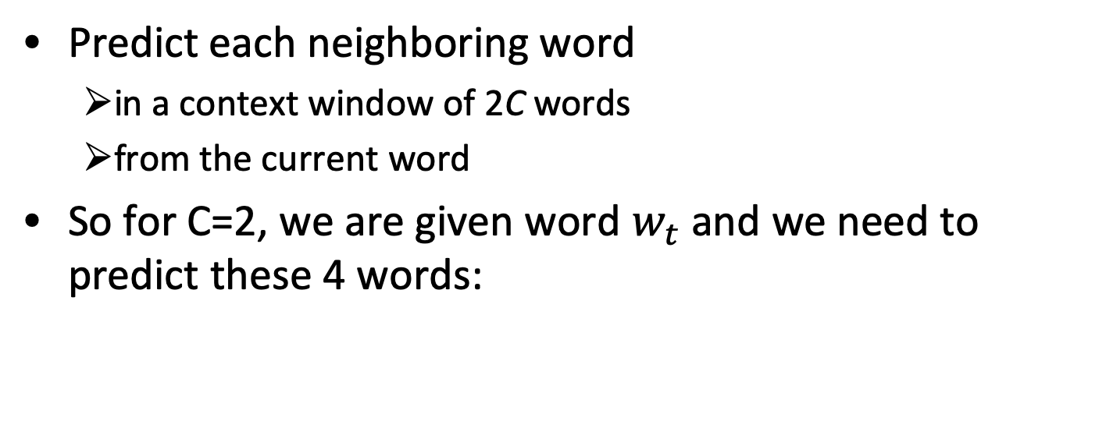
Skip-gram
Predict each neighboring word
  in a context window of 2C words
  from the current word
So for C=2, we are given word $w_{t}$ and we need to predict these 4 words:

Slide 50
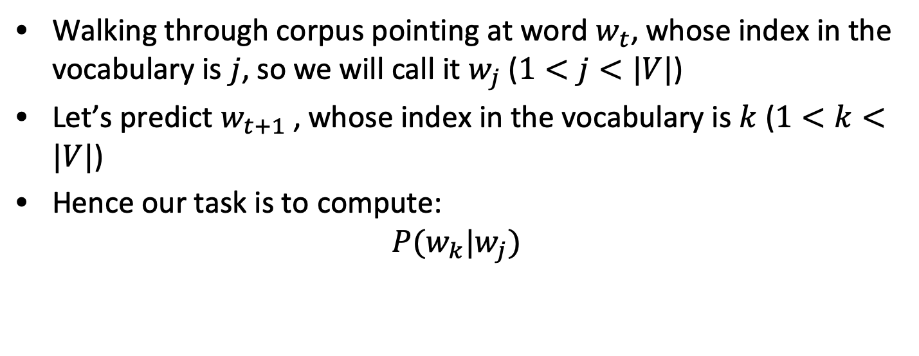
Setup
Walking through corpus pointing at word $w_{t}$, whose index in the vocabulary is $j$, so we will call it $w_{j}$ ($1<j<|V|$)
Let’s predict $w_{t+1}$ , whose index in the vocabulary is $k$ ($1<k<|V|$)
Hence our task is to compute:
$$P(w_{k}|w_{j})$$

Slide 51
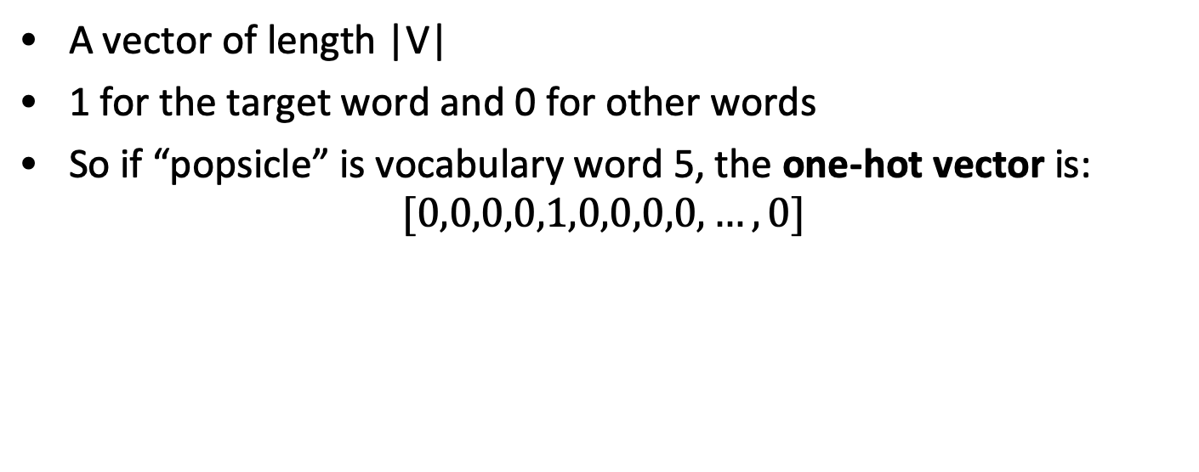
One-hot vectors
A vector of length |V|
1 for the target word and 0 for other words
So if “popsicle” is vocabulary word 5, the one-hot vector is:
$$[0,0,0,0,1,0,0,0,0,…,0]$$

Slide 52
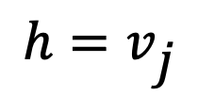


Skip-gram
$$h=vj$$
$$o=W’∙h$$
$$o=W’∙h$$

Slide 53
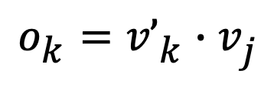
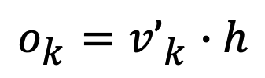
Skip-gram
$$h=vj$$
$$o=W’∙h$$
$$ok=v’k∙h$$
$$ok=v’k∙vj$$

Slide 54

Turning outputs into probabilities
$ok=v’k∙vj$
We use softmax to turn into probabilities

Slide 55
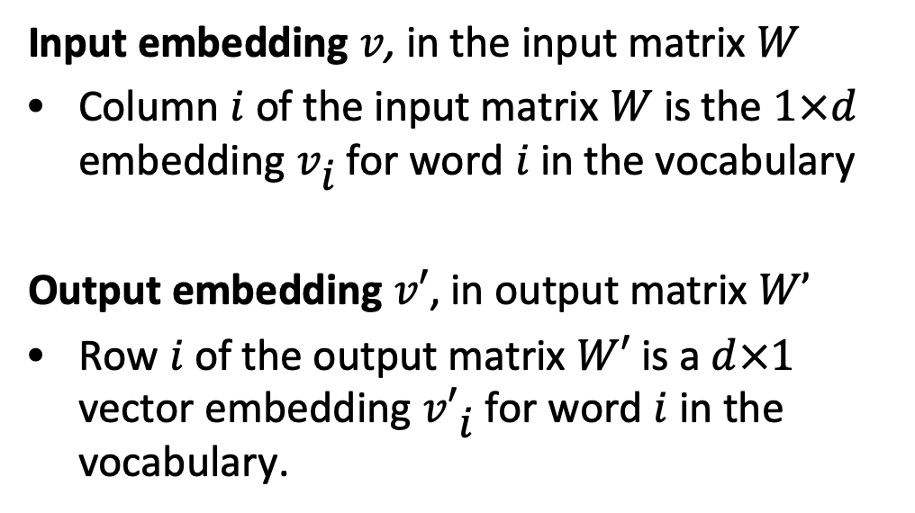
Skip-grams learn two embeddings for each word
Input embedding $v$, in the input matrix $W$
Column $i$ of the input matrix $W$ is the $1×d$ embedding $vi$ for word $i$ in the vocabulary
Output embedding $v′$, in output matrix $W’$
Row $i$ of the output matrix $W′$ is a $d×1$ vector embedding $v′i$ for word $i$ in the vocabulary.

Slide 56
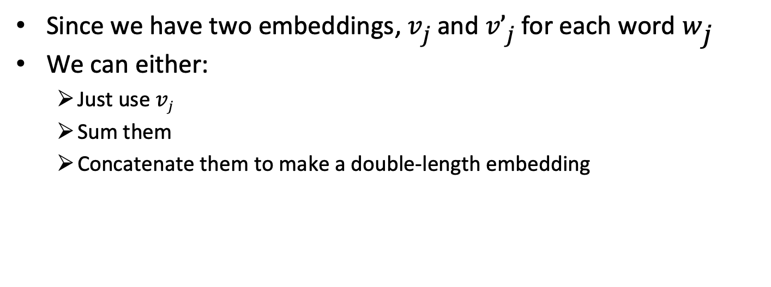
Embeddings from W and W’
Since we have two embeddings, $vj$ and $v’j$ for each word $wj$
We can either:
  Just use $vj$
  Sum them
  Concatenate them to make a double-length embedding

Slide 57
But wait, how do we learn the embeddings?

Slide 58
CBOW (Continuous Bag of Words)

Slide 59
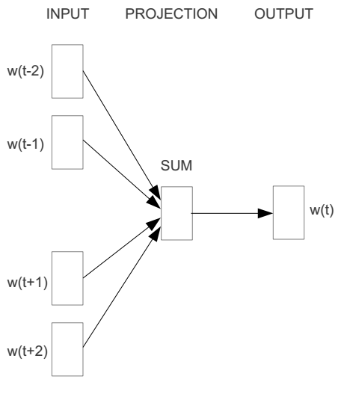
CBOW (Continuous Bag of Words)
E.g. “The cat sat on floor”
  Window size = 2
the
cat
sat
on
floor

Slide 60
CBOW (Continuous Bag of Words)
Input layer
Index of cat in vocabulary
0
1
0
cat
0
Hidden layer
Output layer
0
0
0
0
0
0
…
0
0
0
one-hot
vector
0
sat
one-hot
vector
0
0
0
0
1
0
…
1
0
on
0
0
0
0
…
0

Slide 61



CBOW (Continuous Bag of Words)
We must learn W and W’
Input layer
0
1
0
cat
0
$$W_{V×N}$$
Hidden layer
Output layer
0
0
0
0
0
0
V-dim
…
0
0
$${W′}_{N×V}$$
0
0
sat
0
0
0
0
1
0
$$W_{V×N}$$
N-dim
…
V-dim
1
0
on
0
0
0
0
V-dim
…
N will be the size of word vector
0

Slide 62
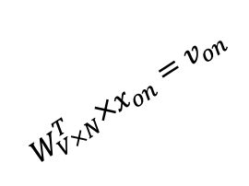

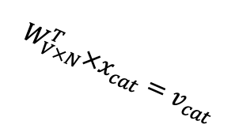



CBOW (Continuous Bag of Words)
$$W_{V×N}^{T} ×x_{cat}=v_{cat}$$
0.1 | 2.4 | 1.6 | 1.8 | 0.5 | 0.9 | … | … | … | 3.2
0.5 | 2.6 | 1.4 | 2.9 | 1.5 | 3.6 | … | … | … | 6.1
… | … | … | … | … | … | … | … | … | …
… | … | … | … | … | … | … | … | … | …
0.6 | 1.8 | 2.7 | 1.9 | 2.4 | 2.0 | … | … | … | 1.2
0
2.4
2.6
…
…
1.8
Input layer
1
$$×$$
0
$$=$$
0
0
0
1
0
0
0
0
0
Output layer
x_{cat}
0
…
0
$$W_{V×N}^{T}×x_{cat}=v_{cat}$$
0
0
0
0
0
V-dim
…
0
0
$$\hat{v}=\frac{v_{cat}+v_{on}}{2}$$
0
+
0
sat
0
0
0
0
$$W_{V×N}^{T}×x_{on}=v_{on}$$
1
0
…
V-dim
1
Hidden layer
0
x_{on}
0
0
N-dim
0
0
V-dim
…
0

Slide 63
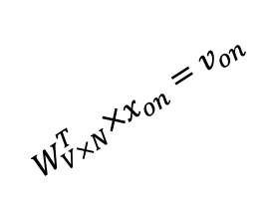

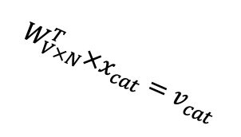



CBOW (Continuous Bag of Words)
$$W_{V×N}^{T} ×x_{on}=v_{on}$$
0.1 | 2.4 | 1.6 | 1.8 | 0.5 | 0.9 | … | … | … | 3.2
0.5 | 2.6 | 1.4 | 2.9 | 1.5 | 3.6 | … | … | … | 6.1
… | … | … | … | … | … | … | … | … | …
… | … | … | … | … | … | … | … | … | …
0.6 | 1.8 | 2.7 | 1.9 | 2.4 | 2.0 | … | … | … | 1.2
0
1.8
2.9
…
…
1.9
0
Input layer
$$×$$
0
1
$$=$$
0
0
1
0
0
0
0
0
Output layer
x_{cat}
…
0
0
$$W_{V×N}^{T}×x_{cat}=v_{cat}$$
0
0
0
0
0
V-dim
…
0
0
$$\hat{v}=\frac{v_{cat}+v_{on}}{2}$$
0
+
0
sat
0
0
0
0
$$W_{V×N}^{T}×x_{on}=v_{on}$$
1
0
…
V-dim
1
Hidden layer
0
x_{on}
0
0
N-dim
0
0
V-dim
…
0

Slide 64






CBOW (Continuous Bag of Words)
Input layer
0
1
0
cat
0
$$W_{V×N}$$
Hidden layer
Output layer
0
0
0
0
0
0
V-dim
…
0
0
$$W_{V×N}^{′}×\hat{v}=z$$
0
$$\hat{y}=softmax(z)$$
0
0
0
0
0
$$\hat{v}$$
1
0
$$W_{V×N}$$
…
1
N-dim
0
on
0
${\hat{y}}_{sat}$
0
0
V-dim
0
V-dim
…
N will be the size of word vector
0

Slide 65




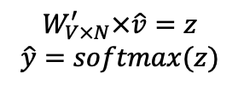
CBOW (Continuous Bag of Words)
Input layer
0
We would prefer $\hat{y}$ close to ${\hat{y}}_{sat}$
1
0
cat
0
$$W_{V×N}$$
Hidden layer
Output layer
0
0
0
0
0.01
0.02
0.00
0.02
0.01
0.02
0.01
0.7
…
0.00
0
0
V-dim
…
0
0
0
$$W_{V×N}^{′}×\hat{v}=z$$
$$\hat{y}=softmax(z)$$
0
0
0
0
0
$$\hat{v}$$
1
0
$$W_{V×N}$$
…
1
N-dim
0
on
0
${\hat{y}}_{sat}$
0
0
V-dim
0
V-dim
…
N will be the size of word vector
$\hat{y}$
0

Slide 66




CBOW (Continuous Bag of Words)
$$W_{V×N}^{T}$$
Input layer
0.1 | 2.4 | 1.6 | 1.8 | 0.5 | 0.9 | … | … | … | 3.2
0.5 | 2.6 | 1.4 | 2.9 | 1.5 | 3.6 | … | … | … | 6.1
… | … | … | … | … | … | … | … | … | …
… | … | … | … | … | … | … | … | … | …
0.6 | 1.8 | 2.7 | 1.9 | 2.4 | 2.0 | … | … | … | 1.2
Contains word vectors
0
1
0
0
Output layer
x_{cat}
0
0
$$W_{V×N}$$
0
0
0
0
V-dim
…
0
0
$$W_{V×N}^{′}$$
0
0
sat
0
0
0
0
1
0
$$W_{V×N}$$
…
1
0
V-dim
x_{on}
0
Hidden layer
0
N-dim
0
0
V-dim
…
0
We can consider either $W$ or $W’$ as the word’s representation
Or take the average
Notes:
W contains input word vectors.
W’ contains output word vectors.
We can consider either W or W’ as the word’s representation. Or even take the average.

Slide 67
Properties of embeddings
Nearest words to some embeddings [Mikolov et al. 2013a]
“Efficient Estimation of Word Representations in Vector Space” Tomas Mikolov, Kai Chen, Greg Corrado, Jeffrey Dean, Arxiv 2013

Slide 68
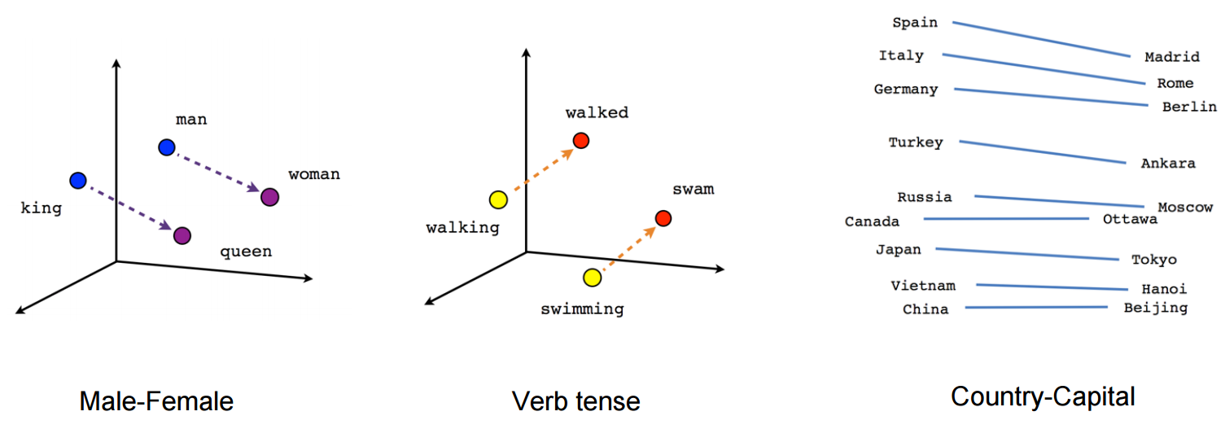
Embeddings capture relational meaning!

Slide 69
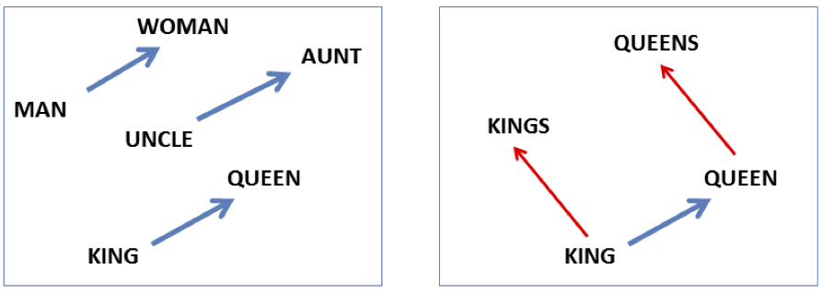

Embeddings allow math operations on words
vector(‘king’) - vector(‘man’) + vector(‘woman’) $≈$vector(‘queen’)
vector(‘Paris’) - vector(‘France’) + vector(‘Italy’) $≈$ vector(‘Rome’)

Slide 70
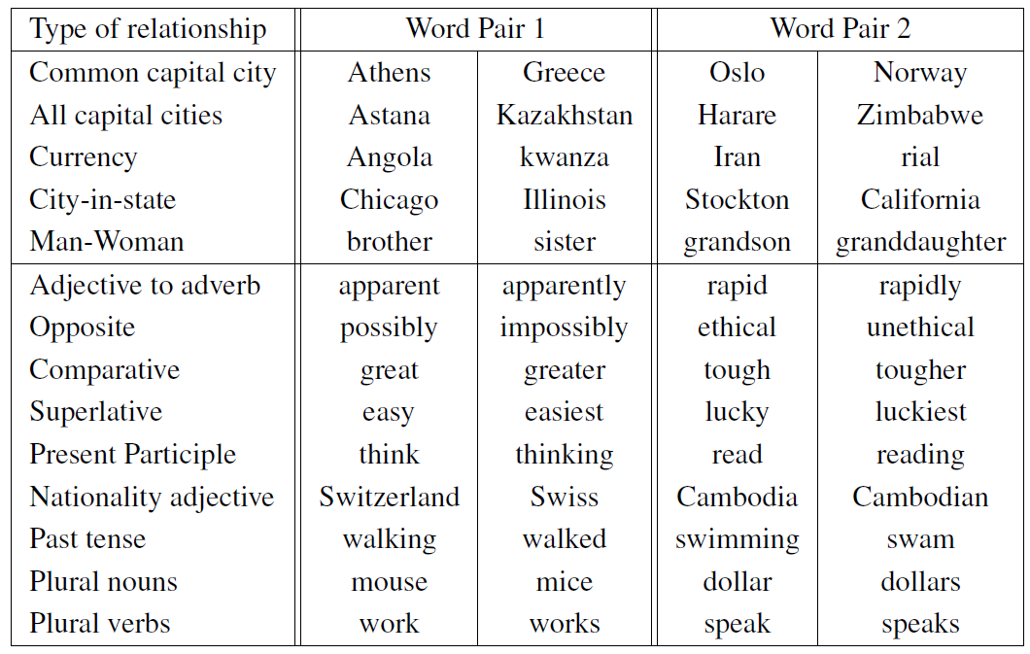
Relations Learned by Word2vec
Word2vec model computed from 6 billion word corpus of news articles

Slide 71
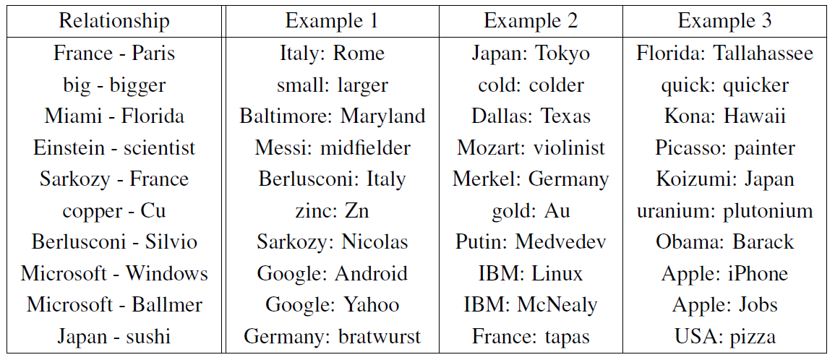
Relations Learned by Word2vec
Word2vec model computed from 6 billion word corpus of news articles
A relation is defined by the vector displacement in the first column. For each start word in the other column, the closest displaced word is shown

Slide 72
Relations Learned by Word2vec
Word2vec model computed from 6 billion word corpus of news articles
A relation is defined by the vector displacement in the first column. For each start word in the other column, the closest displaced word is shown

Slide 73
Relations Learned by Word2vec
Word2vec model computed from 6 billion word corpus of news articles
A relation is defined by the vector displacement in the first column. For each start word in the other column, the closest displaced word is shown

Slide 74
Relations Learned by Word2vec
Word2vec model computed from 6 billion word corpus of news articles
A relation is defined by the vector displacement in the first column. For each start word in the other column, the closest displaced word is shown

Slide 75
Relations Learned by Word2vec
Word2vec model computed from 6 billion word corpus of news articles
A relation is defined by the vector displacement in the first column. For each start word in the other column, the closest displaced word is shown

Slide 76
Relations Learned by Word2vec
Word2vec model computed from 6 billion word corpus of news articles
A relation is defined by the vector displacement in the first column. For each start word in the other column, the closest displaced word is shown

Slide 77
Relations Learned by Word2vec
Word2vec model computed from 6 billion word corpus of news articles
A relation is defined by the vector displacement in the first column. For each start word in the other column, the closest displaced word is shown

